Slide 1
Asesiad
Uned 444 Cefnogi'r broses asesu a chynllunio gofal a chymorth
Deilliant Dysgu 4
Datblygu cynlluniau gofal a chymorth yn seiliedig ar asesiad a chanlyniadau y cytunwyd arnynt
Assessment
Unit 444 Support the assessment and care and support planning process
Learning Outcome 4
Develop care and support plans based on assessment and agreed outcomes

Slide 2


Slide 3
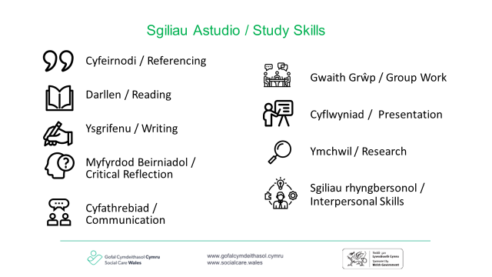

Slide 4
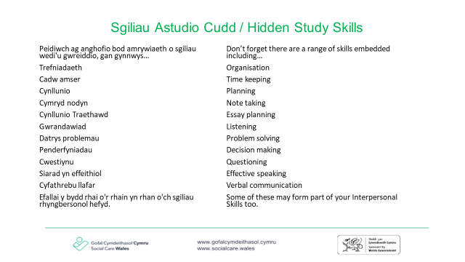

Slide 5
Nod
Aim
Archwilio pwysigrwydd datblygu cynlluniau gofal a chymorth gyda’r unigolyn a/neu ei ofalwr
To explore the importance of developing care and support plans with the individual and/or their carer

Slide 6
Amcanion
Objectives
Gallu disgrifio pam ei bod yn bwysig i lais unigolion a/neu eu gofalwyr fod yn ganolog i’r broses cynllunio gofal a chymorth
Cynyddu eich ymwybyddiaeth o bwysigrwydd cael cynlluniau clir, sy'n cael eu deall gan bawb sy'n gysylltiedig
Cynyddu eich dealltwriaeth o’r broses cynllunio gofal a chymorth
To be able to describe why it is important for individuals and /or their carers voice to be central to the care and support planning process
To increase awareness of the importance of plans being clear and understood by all who are involved
To increase understanding of the care and support planning process

Slide 7
Astudiaethau dan gyfarwyddyd
Directed study
Darllenwch drwy God Ymarfer Rhan 4 Deddf Gwasanaethau Cymdeithasol a Llesiant (Cymru) 2014 - Diwallu Anghenion
Pam mae cydgynhyrchu yn bwysig wrth ddatblygu cynlluniau gofal a chymorth?
Sut ydych chi'n cysylltu â theuluoedd, ffrindiau, rhwydweithiau a'r gymuned ar hyn o bryd wrth ddarparu cymorth i'r unigolyn?
Sut ydych chi’n adolygu cynlluniau gofal a chymorth ar hyn o bryd? Pwy arall sy'n rhan o'r broses hon?
Dewch â chopi gwag o gynllun gofal a chymorth a ddefnyddir gan eich asiantaeth
Read through Social Services and Wellbeing (Wales) Act 2014 Code of Practice Part 4 – Meeting Needs
Why is co-production important when developing care and support plans?
How do you currently connect with families, friends, networks and the community in providing support to the individual?
How do you currently review care and support plans? Who else is involved in this process?
Bring a blank copy of a care and support plan used by your agency

Slide 8
Gwaith pâr
Pairs work
Mewn parau rhannwch eich ymatebion i'r cwestiynau a ofynnwyd fel rhan o'r astudiaeth dan gyfarwyddyd
Cytunwch ar ymateb ac ysgrifennwch hwn ar bapur siart troi i'w rannu gyda'r grŵp
In pairs share your responses to the questions posed as part of the directed study
Agree a response and write this on flip chart paper to share with the group
Notes:
Hwylusydd i ddarparu papur siart troi a beiros.
Hwylusydd i ofyn cwestiynau i ddatblygu dealltwriaeth o'r broses ymhellach.
cysylltwch hyn ag unedau a darlithoedd blaenorol, gan ddangos yn glir sut mae'r holl ddysgu wedi'i gysylltu.
Facilitator to provide flip chart paper and pens.
Facilitator to ask questions to further develop understanding of the process.
Connect this to previous units and lectures, clearly demonstrating how all of the learning is connected.

Slide 9
Cynlluniau gofal a chymorth
Care and support plans
Oedolion
Plant
Adults
Children
Notes:
Yr hwylusydd i ofyn beth yw’r tebygrwydd rhwng cynlluniau gofal a chymorth ar gyfer oedolion a phlant – myfyrwyr i weiddi allan - hwylusydd i gofnodi ar siart troi
seiliedig ar hawliau
llais yr oedolyn a'r plentyn yn ganolog
yn cynnwys eu dymuniadau a'u teimladau
cyfeiriwch at y canlyniadau llesiant
ystyried rhwydwaith teulu a ffrindiau.
cytuno ar y cynllun gofal a chymorth
cynllun wrth gefn
sut y bydd y cynllun yn cael ei fonitro
adolygu - ar gyfer plant uchafswm o 6 mis oedolion 12 mis
gwahaniaethau.
mae angen i gynllun plentyn ystyried dymuniadau'r person sydd â CRh
mae gan y plentyn lai o reolaeth
gallai materion galluedd o ran oedolion gynnwys dymuniadau'r person sy'n eiriol dros yr oedolyn
ac ati
Facilitator to ask what are the similarities between care and support plans for adults and children – students to shout out - facilitator to record on flip chart
rights based
the voice of the adult and child is central
includes their wishes and feelings
reference to the wellbeing outcomes
considered family and friends network
the care and support plan is agreed
contingency plan
how the plan is going to be monitored
Reviewed - for children max 6 months adults 12 months
differences
a child's plan needs to consider the wishes of the person with PR
the child has less control
capacity issues re adults might involve the wishes of the person advocating for the adult
etc

Slide 10
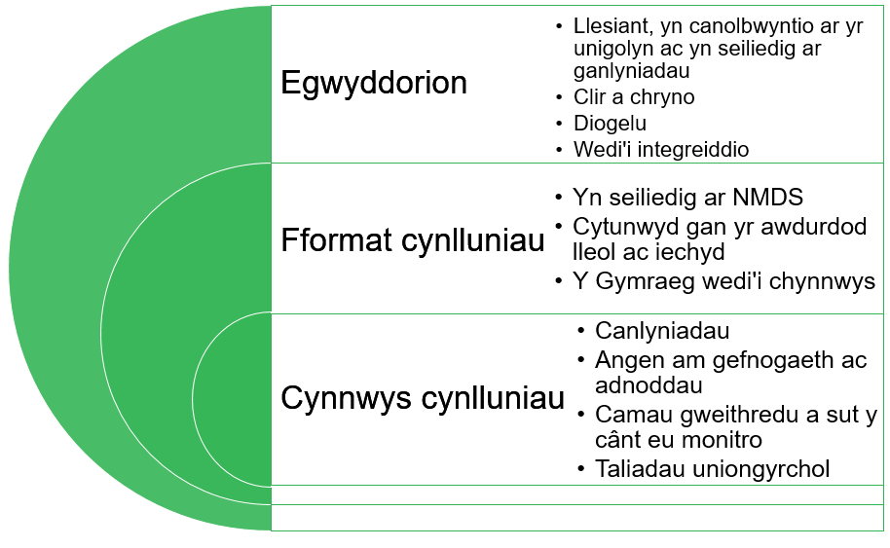
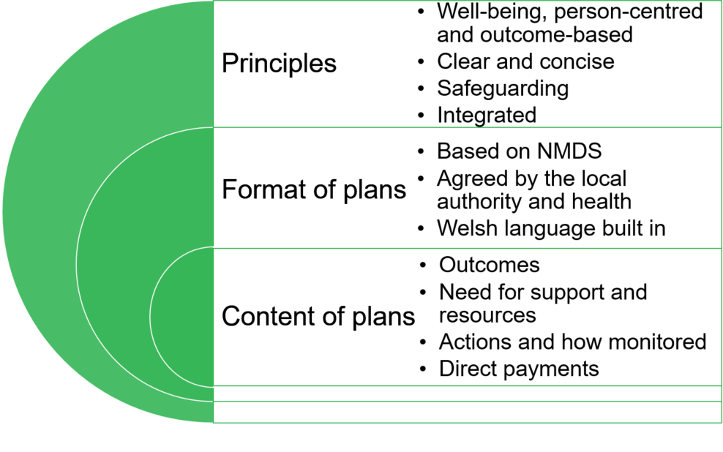
Format and content of plans
Fformat a chynnwys cynlluniau

Slide 11
Gwaith grŵp
Group work
Os nad yw'r plentyn (person â CRh) neu oedolyn yn rhan o'r broses o drafod neu ddatblygu'r cynllun, mae'n sicr o fethu Ydych chi'n cytuno neu'n anghytuno â'r datganiad uchod?
If the child (person with PR) or adult is not involved in the negotiation or development of the plan, it is doomed to fail
Do you agree or disagree with this statement?
Notes:
10 munud yn eich grŵp
darparu tystiolaeth i gefnogi eich safbwynt
10 minutes in your group
provide evidence to support your position

Slide 12
Gwaith grŵp yn parhau
Group work continued
Sut ydyn ni’n cynnwys plant ac oedolion yn y broses cynllunio gofal a chymorth?
A yw cynlluniau bob amser yn cael eu rhannu ag oedolion a phlant (person â CRh)?
Beth yw'r risgiau os nad ydym yn rhannu?
How do we include children and adults in the care and support planning process?
Are plans always shared with adults and children (person with PR) ?
What are the risks if we do not share?
Notes:
10 munud i ysgrifennu’r dulliau a ddefnyddiwch i gynnwys plant ac oedolion yn y broses cynllunio gofal a chymorth.
atgoffwch y myfyrwyr bod angen i’r cynllun gofal a chymorth gynnwys yr angen cymwys a’r anghenion hynny sy’n cael eu diwallu fel bod yr Awdurdod Lleol yn ymwybodol ac yn gallu trefnu i’r angen wedi’i ddiwallu gael ei ailasesu os na ellir ei ddiwallu mwyach.
pontio i'r sleid nesaf Sut ydyn ni'n mynd i'r afael â/rheoli risg?
10 minutes to write down the methods you use to include children and adults in the care and support planning process.
remind students that the care and support plan need to include both the eligible need and those needs that are being met so that the Local Authority is aware and can arrange for the met need to be reassessed if it can no longer be met.
transition to next slide How do we address /manage risk?

Slide 13
Risg
Risk
Mae cymryd risg yn hanfodol i wneud penderfyniadau dynol, ac felly i ymarfer gwaith cymdeithasol wrth gynghori a chefnogi unigolion i wneud penderfyniadau. Felly rydym yn defnyddio'r term risg fel sefyllfa gwneud penderfyniadau lle mae'r canlyniadau'n ansicr a lle ceisir buddion ond bod canlyniadau annymunol yn bosibl.
(Taylor B. t12)
Taking risk is intrinsic to human decision making, and hence to social work practice in advising and supporting individuals to make decisions. Thus we use the term risk as a decision making situation where the outcomes are uncertain and where benefits are sought but undesirable outcomes are possible.’
(Taylor B. p12)
Notes:
Can we ever eradicate risk?

Slide 14
Safbwyntiau
Perspectives
Nid yw risg yn gysyniad newydd ond mae iaith wedi newid mewn ymateb i ddigwyddiadau difrifol o niwed
Rheoli risg – wedi’i fframio fel rhywbeth negyddol, bygythiad neu berygl ac mae’r pwyslais ar gyfrifoldeb proffesiynol i nodi lefel y risg ac anelu at ei dileu
Cymryd risg – yn cael ei ystyried yn gadarnhaol ac mae’r pwyslais ar hunanbenderfyniad a grymuso a all arwain at ganlyniadau gwahanol (Hothersall & Lowit 2010)
Risk is not a new concept but language has changed in response to serious incidents of harm
Risk control – is framed as a negative, a threat or danger and the emphasis is on professional responsibility to identify the level of risk and aim to eliminate it
Risk taking – viewed positively and emphasis is on self-determination and empowerment which can lead to different outcomes (Hothersall & Lowit 2010)
Notes:
Ask students to reflect – how do their agencies practice? What impacts the culture of risk aversion.

Slide 15
Gwybodaeth ddealledig
Tacit knowledge
Greddf
Mae Calder yn awgrymu mai 'greddf yw gwybodaeth sy'n deillio o deimlad greddfol neu ryw broses isymwybod. Ni ddylid ei chymysgu â barn broffesiynol, sy'n broses ymwybodol lle mae ffeithiau a phrofiad yn cael eu hystyried yn sail ar gyfer gwneud penderfyniadau rhesymegol (2016, tud 148)
Intuition
Calder suggests that ‘intuition is knowledge that stems from a gut feeling or some subconscious process. It is not to be confused with professional judgement, which is a conscious process where facts and experience are both considered to form a basis for making reasoned decisions' (2016, pg 148)
Notes:
gofynnwch i fyfyrwyr fyfyrio ar yr hyn y mae Calder yn ei awgrymu yma
gofynnwch iddyn nhw feddwl am adeg pan wnaethon nhw gyfarfod ag unigolyn a chael y 'teimlad greddfol hwnnw'. A wnaethant stopio a meddwl am hyn, a mynd ati i'w brofi neu ei wrthbrofi neu a ddaeth hyn yn 'ffaith'. Archwiliwch beryglon gweithio fel hyn.
Ask students to reflect on what Calder is suggesting here
Ask them to think of a time when they met with an individual and had that ‘gut feeling’. Did they stop and think about this , setting out to prove or disprove it or did this just become a ‘fact’? Explore the dangers of working in this way.

Slide 16
Yn ddull cadarnhaol o gymryd risgiau, dylai’r broses o wneud penderfyniadau fod yn:
A positive risk-taking approach, decision-making should be:
• Balanced, recognising the potential for benefit as well as the risk of harm, and considering the possible emotional, psychological and social impact of each option, as well as the physical
• Defensible, that is well-founded, justifiable and recorded proportionately; not defensive, that is driven by the need to protect ourselves and our agencies
• Collaborative with people who use services, their families and other professionals, using all available resources to achieve the outcomes that matter most to people.
(Social Care Wales, Blood and Wardle)
• Cytbwys, gan gydnabod y potensial ar gyfer budd yn ogystal â’r risg o niwed, ac ystyried effaith emosiynol, seicolegol a chymdeithasol posibl pob opsiwn, yn ogystal â’r effaith gorfforol
• Amddiffynadwy, sef â sail dda, y gellir ei gyfiawnhau a'i gofnodi'n gymesur; heb fod yn amddiffynnol, sy'n cael ei yrru gan yr angen i amddiffyn ein hunain a'n hasiantaethau.
• Cydweithredol gyda phobl sy’n defnyddio gwasanaethau, eu teuluoedd a gweithwyr proffesiynol eraill, gan ddefnyddio’r holl adnoddau sydd ar gael i gyflawni’r canlyniadau sydd bwysicaf i bobl.
(Gofal Cymdeithasol Cymru, Blood a Wardle)
Notes:
What are some of the barriers to positive risk taking?
Examples of legislations which promotes positive risk taking?
The Social Services and Well-being Act (Wales) Act 2014 Code of Practice talks about “positive risk” being an “essential part of everyday life” (Part 3, page 27).
Positive risk taking is also supported in the Mental Capacity Act 2005, the Human Rights Act 1998 and the Equality Act 2010.
The main barriers here include: a “blame culture” in many social services departments, driven by performance management and the requirements of the regulation and inspection regime. A lack of understanding that the law requires a positive risk-taking approach and how this differs from “negligent” practice. A lack of time to invest in working with families to hear their worries, understand what matters to the individual, and broker alternative solutions (which can often be more sustainable and cost effective over time). Taken from Blood and Wardle report https://socialcare.wales/cms-assets/documents/Positive-risk-and-shared-decision-making.pdf

Slide 17
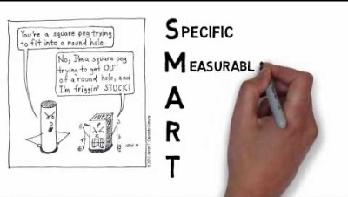
CAMPUS
SMART
NB. This image is only available in English
Notes:
Wrth i'r myfyrwyr wrando ar y fideo - sut mae hyn yn berthnasol i'w gwaith gyda phlant / oedolion
er enghraifft
penodol
a ydym bob amser yn glir ynghylch yr hyn yr ydym am ei weld?
a ydym bob amser yn glir ynghylch sut yr ydym yn mynd i fesur y nod?
a yw hyn yn ein helpu gyda'n hadolygiad a'n cynllun wrth gefn?
As students are listening to the video - how does this apply to their work with children /adults?https://www.youtube.com/watch?v=1-SvuFIQjK8
for example
specific
are we always clear about what we want to see?
are we always clear about how we are going to measure the goal?
does this help us with our review and contingency?
A care and support plan could relate to a single service meeting one or more care and support needs or be more complex and involve mapping out several different services meeting one or more needs. Need to use SMART objectives:
Specific
Measurable
Achievable
Realistic
Time-limited
Need to think about direct payments having the conversation about how care and support needs can be met as part of planning process. Care and support plans have to be completed even if the individual will self-manage this plan through the use of direct payments.

Slide 18
Astudiaethau achos
gwaith grŵp
Case studies
group work
Yn eich grwpiau darllenwch yr astudiaethau achos
Ysgrifennwch beth rydych chi'n meddwl yw'r peth gwaethaf all ddigwydd i'r unigolyn yn y sefyllfa hon
Ysgrifennwch eich nod - beth sydd angen i chi ei weld yn digwydd er mwyn bod yn llai pryderus
Cofiwch y bydd gan unigolion eu nodau eu hunain
In your groups read the case studies
Write down what you think is the worst thing that can happen to the individual in this situation
Write down your goal - what you need to see happening to be less worried
Remember individuals will have their own goals
Notes:
dosbarthwch astudiaethau achos Oedolyn – Mrs Jones
Plentyn- Deana
cymhwyswch CAMPUS i'r cynllunio fel eich bod yn glir ynghylch yr hyn sydd angen i chi ei weld yn digwydd ym mywyd oedolyn/plentyn i reoli'r pryder.
cyfeiriwch at y canlyniadau llesiant
Hand out case studies Adult – Mrs Jones
Child- Deana
Apply SMART to the planning so that you are clear about what it is you need to see happening in adult/child's life to manage the worry.
Reference to the wellbeing outcomes

Slide 19
Mesur llwyddiant
Measuring success
Dull sy'n canolbwyntio ar atebion
cwestiyn lle 0 yw'r gwaethaf a 10 yw'r gorau.
yn eich grwpiau datblygwch 2 gwestiwn graddio i helpu Mrs. Jones a Deana i fod yn gliriach ynghylch eu nod. Ystyriwch y canlyniadau Llesiant wrth ddatblygu eich cwestiynau
Solution focused approach
Question where 0 is worst and 10 is best.
In your groups develop 2 scaling questions to help Mrs. Jones and Deana be clearer about what their goal might be. Consider the wellbeing outcomes when developing your questions
Notes:
taflen – gwybodaeth ynglŷn â graddio cwestiynau
taflen - enghreifftiau o raddio cwestiynau
Bydd yr hwylusydd hefyd yn datblygu cwestiwn i'w raddio i'w rannu â'r grŵp
handout – information re scaling questions
handout- examples of scaling questions.
Facilitator to also develop a scaling question to share with the group
How important is this change to you on a scale of one to 10?
What made you pick this number and not a lower number?
What might it take for you to move up?

Slide 20
Cytuno ar gamau gweithredu, rolau a chyfrifoldebau ac amserlen
Agreeing actions roles and responsibilities & timeframe
Myfyrdod unigol
A yw’r cynllun gofal a chymorth presennol a ddefnyddir gan eich asiantaeth yn amlygu’r uchod?
Individual reflection
Does the current care and support plan used by your agency highlight the above?
Notes:
Pob myfyriwr i gyfeirio at naill ai Mrs Jones neu Deana a datblygu taflwybr yn manylu ar y gweithredoedd, rolau, cyfrifoldeb ac amserlen.
Gofynnwch i’r grŵp – faint o amser fydd y gwaith hwn yn ei gymryd yn eich barn chi? am ba mor hir fydd angen y cynllun gofal a chymorth? unwaith y cytunir ar y nod gallwch weithio tuag yn ôl gan dalu sylw i'r camau sydd eu hangen i gyrraedd y nod
Each student to refer to either Mrs Jones or Deana and develop a trajectory detailing the actions, roles, responsibility and timeframe.
Ask the group – how long do you think this work will take? How long is the care and support plan needed? Once the goal has been agreed you can work backwards paying attention to the steps required to achieve the goal

Slide 21
Cludadwyedd cynlluniau
Portability of plans
Pan fydd unigolyn â chynllun gofal a chymorth yn symud o un awdurdod i’r llall yng Nghymru mae’r cynllun yn symud gyda nhw nes bod asesiad newydd wedi’i gwblhau.
Nid yw hyn yn berthnasol i gynlluniau a ddarperir o dan bwerau dewisol
Mae yna ddisgwyliad y bydd arfer da yn berthnasol pan fydd person yn symud ar draws ffiniau cenedlaethol er mwyn tarfu cyn lleied â phosibl ar y gofal a’r cymorth a ddarperir i’r person hwnnw.
When an individual with a care and support plan moves from one authority to another in Wales the plan moves with them until a new assessment is completed
This does not apply to plans provided under discretionary powers
There is an expectation that good practice will apply when a person moves across national boundaries to minimise disruption of the care and support provided to that person

Slide 22
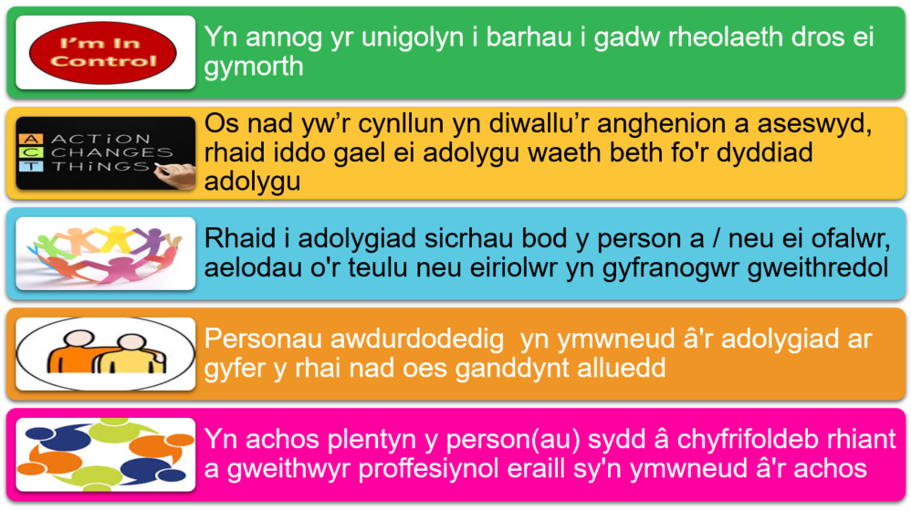
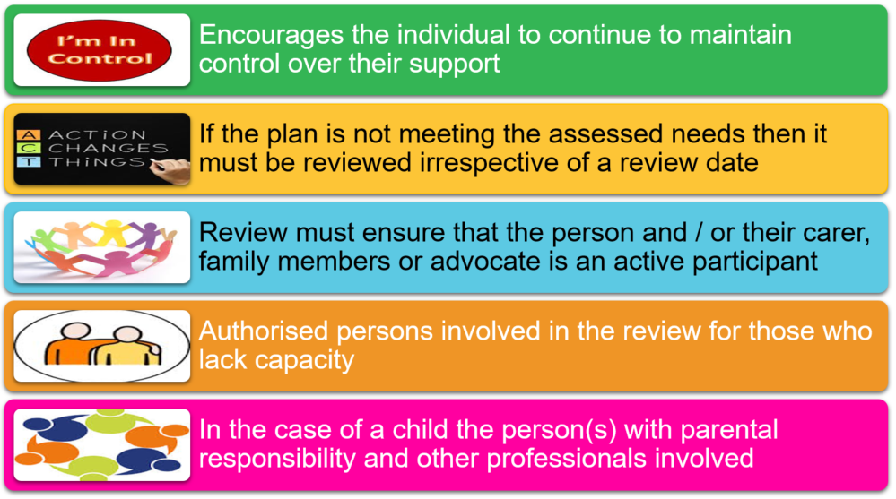
Review of plans
Adolygu cynlluniau
Notes:
[NODYN HWYLUSYDD: mae gan y sleid hon animeiddiad]
Byddwn yn canolbwyntio ar hyn yr wythnos nesaf.
[FACILITATORS NOTE: this slide has animation]
We will be focusing on this next week.

Slide 23
Astudiaethau dan gyfarwyddyd
Directed study
Beth yw’r gofynion deddfwriaethol ar gyfer adolygu cynlluniau gofal a chymorth?
Sut ydych chi’n cynllunio ac yn trefnu adolygiad o gynllun gofal a chymorth i unigolyn ar hyn o bryd?
Sut ydych chi'n cynnwys unigolion wrth werthuso eu cynllun ar hyn o bryd?
Cod Ymarfer Rhan 4 Diwallu Anghenion
Dewch ag enghreifftiau gwag o ffurflenni adborth i'r ddarlith nesaf i'w rhannu
What are the legislative requirements for the review of care and support plans?
How do you currently plan for and arrange a review of an individuals care and support plan?
How do you currently include individuals in evaluating their plan?
Code of Practice Part 4 Meeting Needs
Please bring blank examples of feedback forms to the next lecture to share

