Slide 1
Asesiad
Uned 444 Cefnogi'r broses asesu a chynllunio gofal a chymorth
Deilliant Dysgu 5
Cynnal adolygiadau o gynlluniau gofal a chymorth yn unol â’ch rôl a’ch cyfrifoldebau eich hun, deddfwriaeth a’r Codau Ymarfer
Assessment
Unit 444 Support the assessment and care and support planning process
Learning Outcome 5
Undertake reviews of care and support plans according to own role and responsibilities, legislation and the Codes of Practice

Slide 2


Slide 3
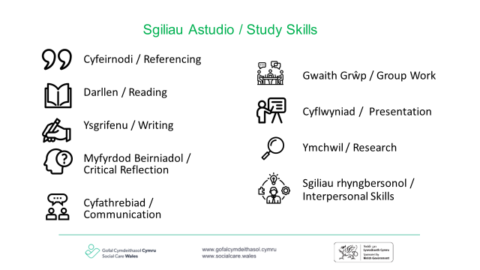

Slide 4
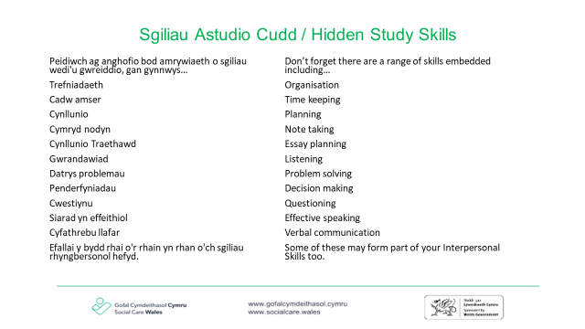

Slide 5
Nod
Aim
Rhannu'r fframwaith deddfwriaethol sy'n sail i'r broses adolygu
Ystyried ein rôl a’n cyfrifoldebau wrth gynnal adolygiadau o gynlluniau gofal a chymorth
To share the legislative framework that underpins the review process
To consider roles and responsibilities when undertaking reviews of care and support plans

Slide 6
Amcan
Objective
Disgrifio gwahanol ddulliau o alluogi unigolion i werthuso i ba raddau y maent wedi cyflawni eu canlyniadau llesiant
Gweithio gyda'n gilydd i archwilio sut rydym yn rheoli'r amseroedd nad yw unigolion a'u rhwydwaith yn cadw at y cynllun y cytunwyd arno
To describe different methods of enabling individuals to evaluate how far they achieved their wellbeing outcomes
To work together to explore how we manage the times individuals and their network do not stick to the agreed plan

Slide 7
Astudiaethau dan gyfarwyddyd
Directed study
Beth yw’r gofynion deddfwriaethol ar gyfer adolygu cynlluniau gofal a chymorth?
Sut ydych chi’n cynllunio ac yn trefnu adolygiad o gynllun gofal a chymorth i unigolyn ar hyn o bryd?
Sut ydych chi'n cynnwys unigolion wrth werthuso eu cynllun ar hyn o bryd?
Cod Ymarfer Rhan 4 Diwallu Anghenion
Dewch ag enghreifftiau gwag o ffurflenni adborth i'r ddarlith nesaf i'w rhannu
What are the legislative requirements for the reviews of care and support plans?
How do you currently plan for and arrange a review of an individual's care and support plan
How do you currently include individuals in evaluating their plan?
Code of Practice Part 4 Meeting Needs
Please bring blank examples of feedback forms to the next lecture to share

Slide 8
Sut mae cynnwys unigolion wrth adolygu eu cynlluniau?
How do we include individuals when reviewing their plans?
Turn to the person next to you and share how your agency and you currently include individuals when reviewing their plans
What methods do you use to support an individual to evaluate how far they have achieved (or not) their outcome?
Trowch at y person nesaf atoch a rhannwch sut mae eich asiantaeth a chithau ar hyn o bryd yn cynnwys unigolion wrth adolygu eu cynlluniau
Pa ddulliau a ddefnyddiwch i gefnogi unigolyn i werthuso i ba raddau y mae wedi cyflawni (neu beidio) ei ganlyniad?
Notes:
gofynnwch i fyfyrwyr weithio mewn parau - gallant symud o gwmpas yr ystafell a gweithio gyda rhywun gwahanol,
10 munud
yr hwylusydd i ofyn am adborth a chofnodi hyn ar siart troi.
egwyddor cyd-gynhyrchu
Ask students to work in pairs - they can move around the room and work with someone different
10 minutes
facilitator ask for feedback and record this on flip chart.
co-production principle's

Slide 9
Gwerthusiad – y pellter a deithiwyd
Evaluation –distance travelled
Ymarfer unigol – ysgrifennwch pam mae gwerthuso yn bwysig?
Negodi ac ymgynghori
Casglu gwybodaeth
Trafod a dadansoddi
Adolygu’r meini prawf cymhwysedd
Cynllunio
Individual exercise – write down why evaluation is important?
Negotiation and consultation
Information gathering
Discussion and analysis
Review the eligibility criteria
Planning
Notes:
Mae gwerthuso hefyd yn berthnasol i ni fel gweithwyr – pa mor agos neu bell ydyn ni wedi gallu deall/rheoli’r risgiau a gyflwynir mewn unrhyw sefyllfa benodol. Dyma gyfle i adolygu’r asesiad – ydy’r wybodaeth gyfredol yn newid canlyniad yr asesiad? ac ati
cydweithio – mae cydgynhyrchu yn ein galluogi i rannu os ydym wedi mynd o’i le hefyd. Yr agwedd bwysicaf ar adolygiad yw archwilio’r hyn sydd wedi gweithio’n dda, unrhyw rwystrau i gyflawni canlyniadau llesiant personol, pryderon a sut i fynd i’r afael â’r rhain wrth symud ymlaen gyda chyfrifoldeb a rennir.
Evaluation also applies to us as workers- how near or far have we been able to understand/manage the risks presented in any given situation and supported the individual to reach their outcomes. This is an opportunity to review the assessment - does the current information change the outcome of the assessment? etc
Working together – co production enables us to share if we have got something wrong too. The most important aspect of a review is to explore what has worked well, any barriers to achieving personal wellbeing outcomes, worries and how to address these moving forward with a shared responsibility.

Slide 10
Dull cwestiynu
A questioning approach
A gynhaliwyd y sesiynau y cytunwyd arnynt ar amser?
A ydych yn glir ynghylch yr hyn yr ydym yn ei fesur?
a sut mae hyn yn cael ei fesur?
Sut mae'r unigolyn yn gwerthuso effeithiolrwydd y cynllun gofal
Did the agreed sessions take place on time?
Are you clear about what we are measuring?
And how this is being measured?
How is the individual evaluating the effectiveness of the care plan?
Notes:
Rhannwch rai cwestiynau i helpu myfyrwyr i ystyried pwysigrwydd cynnwys yr unigolyn. Gan gyfeirio at y person y maent yn meddwl amdano, os byddwn yn gofyn i’r person hwnnw ar raddfa o 0 -10 ble mae 10 yw rwy’n deall fy nghynllun gofal yn llwyr, beth yw fy rolau a’m cyfrifoldebau i ac eraill a sut yr wyf yn mynd i werthuso effeithiolrwydd fy nghynllun, a 0 yw does gen i ddim syniad? ble fyddech chi'n ei raddio heddiw?
beth sy'n eich gosod chi ar y rhif hwnnw?
beth sydd angen digwydd i fynd â chi i 10
ble ydych chi'n meddwl y byddai'r person yn ei raddio heddiw?
beth sy'n ei osod ar y rhif hwnnw?
beth sydd angen digwydd i'w cael i 10?
Share some questions to help students consider the importance of the individual being involved. Referring to the person they are thinking of, if we ask that person on a scale of 0 -10 where 10 is I totally understand my care plan, what the roles and responsibilities of myself and others are and how I am going to evaluate the effectiveness of my plan and 0 is I have not got a clue, where would you rate it today?
What places you at that number ?
What number would you like to work towards? What needs to happen to achieve this?
where do you think the person would rate it today?
what places them at that number?
what needs to happen to get them to a 10?

Slide 11
Review of plans
Adolygu cynlluniau
Review must ensure that the person and / or their carer, family members or advocate is an active participant
Rhaid i adolygiad sicrhau bod y person a / neu ei ofalwr, aelodau o'r teulu neu eiriolwr yn gyfranogwr gweithredol
Authorised persons involved in the review for those who lack capacity
Personau awdurdodedig yn ymwneud â'r adolygiad ar gyfer y rhai nad oes ganddynt alluedd
If the plan is not meeting the assessed needs then it must be reviewed irrespective of a review date
Os nad yw’r cynllun yn diwallu’r anghenion a aseswyd, rhaid iddo gael ei adolygu waeth beth fo'r dyddiad adolygu
In the case of a child the person(s) with parental responsibility and other professionals involved
Yn achos plentyn y person(au) sydd â chyfrifoldeb rhiant a gweithwyr proffesiynol eraill sy'n ymwneud â'r achos
Encourages the individual to continue to maintain control over their support
Yn annog yr unigolyn i barhau i gadw rheolaeth dros ei gymorth
Notes:
[NODYN HWYLUSYDD: mae gan y sleid hon animeiddiad]
gofynnwch i'r myfyrwyr feddwl am blentyn neu oedolyn y maent yn ymwneud ag ef ar hyn o bryd a gwneud nodiadau yn dilyn pob un o’r pwyntiau y byddwn yn gweithio drwyddynt
gweithio trwy bob adran o'r sleid
Fi sy'n rheoli - sut ydych chi'n sicrhau bod yr unigolyn yn rheoli ei gymorth. Ystyriwch rwystrau e.e. gallu, oedran, anabledd ac ati.
atgyfnerthu pwysigrwydd gweld unrhyw adegau pan nad yw’r cynllun yn bodloni’r angen a aseswyd fel cyfle i ddatblygu dealltwriaeth ddyfnach o sefyllfa’r person, beth oedd yn amharu ar ddiwallu’r angen, a sut y gallwch chi ddatblygu cynllun gyda’ch gilydd lle mae darpariaeth ar gyfer rheoli heriau'r dyfodol.
Pa ddulliau ydych chi'n eu defnyddio i sicrhau cyfranogiad gweithredol?
Person awdurdodedig - cysylltwch hwn â'r Uned ynglŷn â deddfwriaeth
Personau â CRh - Deddf Plant 1989. Gofynnwch i'r myfyrwyr ystyried sut maen nhw'n cynnwys rhieni absennol - rhieni anodd eu cyrraedd sydd â CRh?
[FACILITATORS NOTE: this slide has animation]
ask students to think of a child or adult they are currently involved with and to make notes following each of the points we will be working through
work through each section of the slide
I’m in control- how do you ensure the individual is in control over their support? Consider barriers e.g capacity, age, disability etc.
Reinforce the importance of seeing any times that the plan is not meeting the assessed need as an opportunity to develop a deeper understanding of the person’s situation, what was getting in the way of the need being met, and how can you develop a plan together that has a provision for managing future challenges.
What methods do you use to ensure active participation?
Authorised person - connect this to the Unit re legislation
Persons with PR-Children Act 1989. Ask students to consider how they involve absent parents - difficult to reach parents with PR?

Slide 12
Adborth gan unigolion
Feedback from individuals
Mewn parau, rhannwch sut rydych chi'n casglu adborth ar hyn o bryd gan yr unigolion rydych chi'n gweithio gyda nhw?
A oes unrhyw heriau i gasglu adborth?
In pairs share how you currently gather feedback from the individuals you work with?
Are there any challenges to gathering feedback?
Notes:
3 munud
gofynnwch am adborth – yr hwylusydd i gofnodi'r adborth ar y siart troi.
atgoffwch y myfyrwyr o'r ddeddfwriaeth sy'n sail i bolisïau rhannu gwybodaeth a chyfrinachedd.
3 minutes
ask for feedback – facilitator to record the feedback on flip chart.
remind students of the legislation underpinning the sharing of information and confidentiality policies.

Slide 13
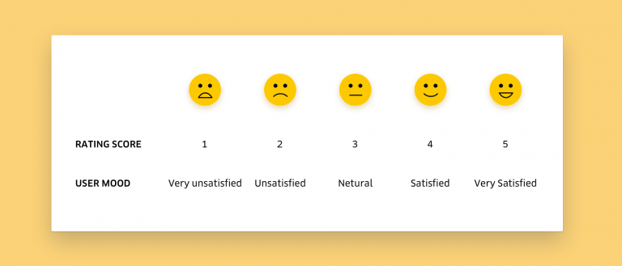
Enghreifftiau o ffurflenni adborth
Examples of feedback forms
NB. This image is only available in English
Notes:
Gofynnwch i fyfyrwyr fynd i mewn i grwpiau a rhannu enghreifftiau o sut mae eu hasiantaeth yn casglu adborth
Ask students to get into groups and share examples of how their agency gathers feedback

