Slide 1
Asesiad
Uned 444 Cefnogi'r broses asesu a chynllunio gofal a chymorth
Deilliant Dysgu 2
Cyfathrebu â Phlant 0-12 oed
Assessment
Unit 444 Support the assessment and care and support planning process
Learning Outcome 2
Communicating with Children aged 0-12

Slide 2


Slide 3
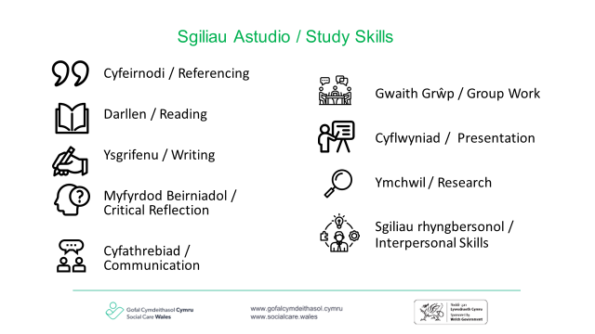

Slide 4
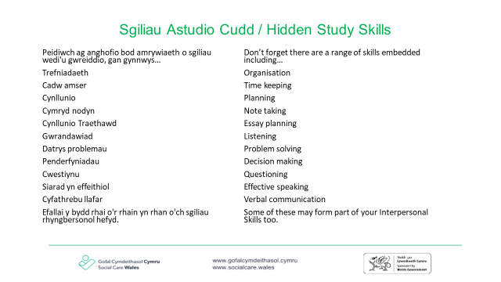

Slide 5
Nod cyffredinol
Overall aim
Deall pwysigrwydd cynnal asesiadau ystyrlon gydag unigolion, eu teuluoedd/gofalwyr am yr hyn sy’n bwysig iddynt am y cymorth sydd ei angen arnynt
To understand the importance of undertaking meaningful assessments with individuals, their families/carers about what matters to them and the support they need
Notes:
Atgoffwch y myfyrwyr o nod cyffredinol deilliant dysgu 2 gan amlygu bod y sgwrs beth sy'n bwysig yr un mor berthnasol i blant.
Remind students of the overall aim of learning outcome 2 highlighting that the what matters conversation equally applies to children .

Slide 6
Nodau
Aims
Ystyried sut rydym yn siarad â phlant yn y grŵp oedran hwn
Cynyddu ein dealltwriaeth o ddatblygiad plant
Mabwysiadu dull gweithredu seiliedig ar hawliau wrth asesu sefyllfa plentyn.
To consider how we talk to children in this age group
To increase our understanding of child development
To adopt a rights based approach when assessing a child’s situation.

Slide 7
Amcanion
Objectives
Cymhwyso'r hyn rydyn ni'n ei ddysgu heddiw i astudiaeth achos a phlentyn rydych chi'n gweithio gydag ef ar hyn o bryd.
Disgrifio rhai o ddamcaniaethau datblygiad plant
Ymarfer defnyddio gwahanol offer a all ein helpu i weld byd y plentyn trwy ei lygaid.
To apply what we learn to a case study and a child you are currently working with.
To describe some of the theories of child development
To practice using different tools that can help us to see the child's world through their eyes.
Notes:
Os nad yw myfyrwyr yn gweithio gyda phlentyn, gallant feddwl am blentyn y maent yn ei adnabod. Os oes yna fyfyrwyr nad oes ganddynt unrhyw blant yn eu bywydau (mae hyn wedi digwydd i mi ar ddigwyddiad hyfforddi) gofynnwch iddynt ddewis oedran a chanolbwyntio ar blentyn o'r oedran hwnnw am weddill yr ymarfer
If students are not working with a child, they can think of a child known to them. If there are students that do not have any children in their lives (This has happened to me on a training event) ask them to chose an age and focus on a child of that age for the rest of the exercise

Slide 8
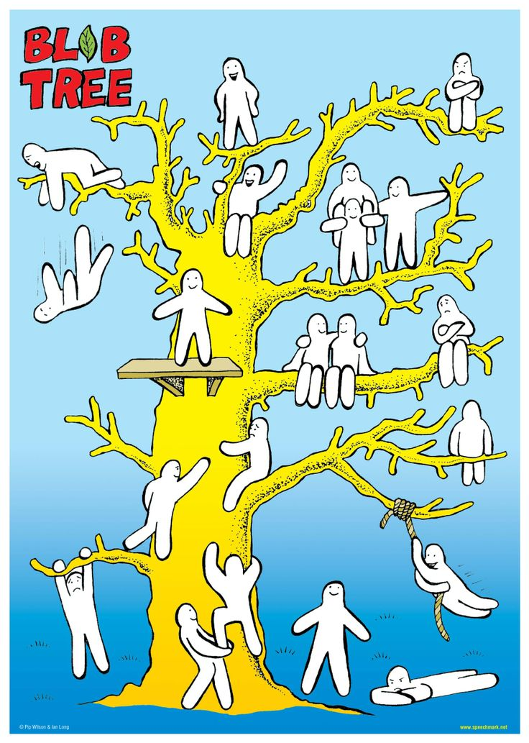

Slide 9
Egwyddorion asesu
Principles of assessment
Canolbwyntio ar y plentyn
Wedi'i wreiddio yn natblygiad plant
Ecolegol yn eu dull
Sicrhau cyfle cyfartal
Cynnwys gweithio gyda phlant a theuluoedd
Adeiladu ar gryfderau yn ogystal â nodi pryderon ac anawsterau
Child centred
Rooted in child development
Ecological in their approach
Ensure equality of opportunity
Involve working with children and families
Build on strengths as well as identifying worries and difficulties
Notes:
cysylltu'r sleid hon â'r astudiaeth dan gyfarwyddyd
Yn rhyngasiantaethol yn eu dull at asesu a darparu gwasanaethau
Yn broses barhaus, nid digwyddiad unigol
Yn cael eu cyflawni ochr yn ochr â chamau gweithredu eraill a darparu gwasanaethau
Wedi’u seilio ar wybodaeth sy’n seiliedig ar dystiolaeth – mae angen nifer lluosog o ffynonellau. Mae hyn yn eich galluogi i gasglu a dadansoddi'r wybodaeth er mwyn gwirio cywirdeb y wybodaeth rydych yn ei chasglu
atgoffwch y myfyrwyr am 5 elfen y broses asesu - Deddf Gwasanaethau Cymdeithasol a Llesiant (Cymru) 2014
cysylltwch hyn â'r safbwyntiau damcaniaethol y dysgodd myfyrwyr amdanynt ar eu hastudiaeth dan gyfarwyddyd.
mae hyn wedyn yn arwain at bwysigrwydd cydsyniad
English
Are interagency in their approach to assessment and the provision of services
Are a continuing process, not a single event
Are carried out in parallel with other action and providing services
Are grounded in evidence based knowledge – a multiple number of sources are needed. This enables you to gather and analyse the information in order to check the accuracy of the information you are gathering
remind students of the 5 elements of the assessment process- Social Services and Wellbeing (Wales) Act 2014
connect this to the theoretical perspectives students learnt about on their directed study.
this then leads to the importance of consent (explored further in slide 11)

Slide 10
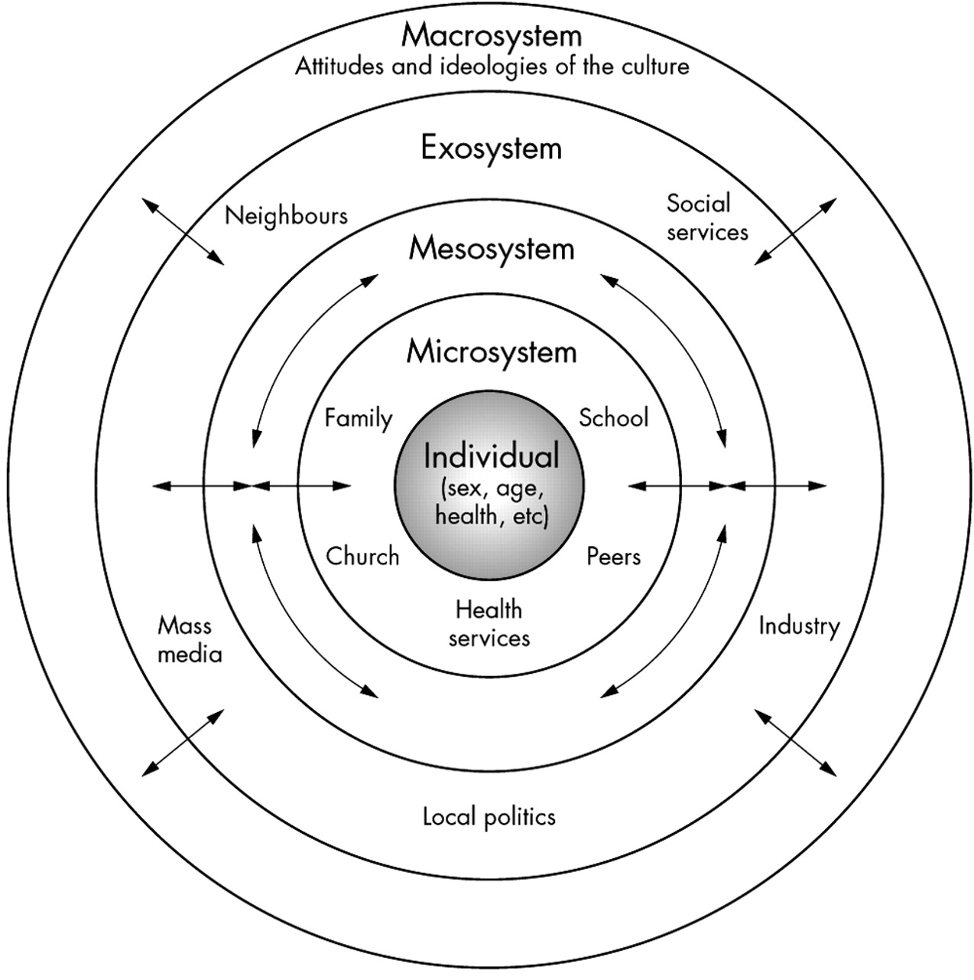
Safbwynt Ecolegol
Ecological Perspective
NB. This is an image and only available in English.
Notes:
Mae model ecolegol Urie Bronfenbrenner yn awgrymu bod angen i unigolion gael eu gweld yng nghyd-destun eu hamgylchedd.
Archwiliwch sut mae myfyrwyr yn cymhwyso'r dull hwn ar hyn o bryd - ydyn nhw'n cymhwyso'r dull hwn at eu gwaith gyda phlant a'u teuluoedd?
English -
Urie Bronfenbrenner ecological model suggests that individuals need to be seen in the context of their environment.
Explore how students currently apply this approach- do they apply this approach to their work with children and their families?
What other approaches do they use?
when considering the quote ‘ it takes a village to raise a child’ , how can we learn who is important to children , who helps them the most, who do they talk to the most?

Slide 11
Dull sy'n canolbwyntio ar hawliau
Rights based approach
Confensiwn y Cenhedloedd Unedig ar Hawliau’r Plentyn 1989 (daeth i rym yn y DU ym 1991) Mae Cymru wedi cynnwys CCUHP yn ei holl bolisïau ar gyfer plant ers 2004.
Mesur Hawliau Plant a Phobl Ifanc (Cymru) 2011
Deddf Gwasanaethau Cymdeithasol a Llesiant (Cymru) 2014 - canolbwyntio ar ganlyniadau llesiant i blant. Mae eiriolaeth, cael llais, cael fy nghlywed a chydnabod fy nghryfderau fel plentyn, wrth wraidd y darn hwn o ddeddfwriaeth.
United Nations Convention on the Rights of the Child 1989 (came into force in the UK in 1991). Wales has included the UNCRC in all its policies for children since 2004.
Rights of Children and Young Persons (Wales) Measure 2011
Social Services and Wellbeing (Wales) Act 2014 – a focus on the wellbeing outcomes for children. Advocacy, having a voice, being heard and acknowledging my strengths as a child, is at the heart of this piece of legislation.
Notes:
ailedrych ar bwysigrwydd dull seiliedig ar hawliau
revisit the importance of a rights based approach

Slide 12
Cyfathrebu
Communication
“Pwrpas uniongyrchol cyfathrebu... yw cysylltu â gwir hunan y plentyn, sef yr hyn y mae'n ei deimlo am ei fywyd ar adeg y cyfarfod. Rydyn ni eisiau helpu plant i gadw mewn cysylltiad â nhw eu hunain a chynnal ymdeimlad o'u hunaniaeth a'u gwerth unigryw eu hunain mewn perthynas â phobl eraill."
(Winnicott, 1964 fel y dyfynnwyd yn Wilson, G. et al 2008: 311)
“The immediate purpose of communication… is to get in touch with the real self of the child, which is what s/he is feeling about their life at the moment of the meeting. We want to help children remain in contact with themselves and maintain a sense of their own unique identity and worth in relation to other people.”
(Winnicott, 1964 as cited in Wilson, G. et al 2008: 311)
Notes:
Gofynnwch i'r grŵp pwy sy'n rhaid eu cynnwys yn yr asesiad o blentyn? Y person/personau sydd â Chyfrifoldeb Rhiant.(CRh)
Os ydych am siarad â’r plentyn ar ei ben ei hun – beth yw’r arfer gorau yn y sefyllfa hon – er enghraifft byddech yn gofyn am ganiatâd gan y person â CRh
Sicrhewch fod gan y person â CRh ddealltwriaeth lawn o'r hyn y byddwch yn ei wneud gyda'r plentyn - er enghraifft, rhannwch ddiben y sesiwn, unrhyw offer y gallech fod yn eu defnyddio a lle bo'n ddiogel i wneud hynny gallwch gynnwys y person ei hun. Mae hefyd yn arfer da gofyn i’r plentyn a hoffai gael rhywun gyda nhw – eiriolaeth
Ask the group who must be included in the assessment of a child? The person/persons with Parental Responsibility(PR)
If you want to speak to the child on their own - what is best practice in this situation - for example you would request permission from the person with PR
Ensure the person with PR has a full understanding of what you will be doing with the child - for example share the purpose of session, any tools you might be using and where safe to do so involve the person themselves. It is also good practice to ask the child whether they would like someone with them – advocacy
transition to next slide
It is important when working with children that we enter their world.

Slide 13
Cyfathrebu sy'n canolbwyntio ar yr unigolyn
Person centered communication
Yn ystyriol o unigrywiaeth y plentyn
Yn gwrando ar yr hyn y mae'r unigolyn yn ei ddweud
Yn defnyddio distawrwydd yn effeithiol i ganiatáu gofod unigol i feddwl a myfyrio
Yn cael ei arwain gan y plentyn
Is considerate of the uniqueness of the child
Listens to what the individual is saying
Uses silence effectively to allow the individual space to think and reflect
Is led by the child

Slide 14
Ymarfer unigol
Individual exercise
Caewch eich llygaid a chofiwch adeg fel plentyn pan wnaethoch chi brofi rhywbeth trist neu rywbeth na allech ei ddeall. Ceisiwch gofio faint oedd eich oed, pa mor fawr oeddech chi, pwy arall oedd o gwmpas, beth oeddech chi'n ei deimlo.
Gyda phwy fyddech chi wedi hoffi siarad am eich teimladau? Gyda phwy wnaethoch chi siarad?
Disgrifiwch un peth a wnaeth eich helpu.
Disgrifiwch un peth yr hoffech chi wedi ei weld yn digwydd
Beth ydych chi'n ei gofio am yr oedolion o'ch cwmpas ar y pryd?
Sut gallai eich profiadau lywio eich ymarfer?
(Wilson, et al (2011: tud 461)
Close your eyes and remember a time as a child when you experienced something sad or something you could not understand. Try to recall how old you were, how big you were, who else was around, what you felt.
Who would you have liked to talk to about your feelings? Who did you talk to?
Describe one thing that helped you.
Describe one thing you would have liked to happen
What do you remember about the adults around you at the time?
How might your experiences inform your practice?
(Wilson, et al (2011:pg 461)
Notes:
Hwylusydd - sleid wedi'i hanimeiddio.
Gofynnwch i’r myfyrwyr gadw eu hunain yn ddiogel – gan gydnabod ein bod ni i gyd wedi cael profiad gwahanol/unigryw wrth dyfu i fyny. Ni fydd y gwaith hwn yn cael ei rannu, fodd bynnag rydym yn cysylltu â'r teimladau a brofwyd a'r hyn a fyddai wedi helpu.
yr hwylusydd i ysgrifennu ymatebion ar siart troi.
pontio i'r sleid nesaf-
wrth wneud unrhyw waith gyda phlentyn mae'n bwysig ystyried caniatâd - mewn parau
Facilitator- slide is animated.
Ask students to keep themselves safe - acknowledging that we have all had a different /unique experience growing up. This work will not be shared , however we well be connecting to the feelings experienced and what would have helped.
facilitator to write down responses on a flip chart.
transition to next slide-
when undertaking any work with a child it is important to consider consent

Slide 15
Cydsyniad
Consent
Gweithio mewn parau
Pwy all gydsynio i asesiad o blentyn?
A all rhiant wrthod asesiad o'i blentyn?
A all plentyn ofyn am asesiad o’i angen am ofal a chymorth?
Working in pairs
Who can consent to an assessment of a child?
Can a parent refuse an assessment of their child?
Can a child request an assessment of their need for care and support?
Notes:
Wrth ddarllen drwy’r pwyntiau cysylltwch hyn â’r modiwl deddfwriaethol – er enghraifft, wrth asesu anghenion gofal a chymorth plentyn, rhaid i’r gweithwyr geisio caniatâd y sawl sydd â chyfrifoldeb rhiant. Dros 16 oed - gall plentyn (os yw'r Gymwys o ran Gallick) ofyn am asesiad o'i anghenion hyd yn oed os yw'r person â CRh yn gwrthod. Gall plentyn o’r oedran hwn hefyd wrthod asesiad oni bai nad oes ganddo’r galluedd neu fod pryderon diogelu.
Deddf Plant 1989 - Cyfrifoldeb Rhiant (a ddiwygiwyd gan Ddeddf Mabwysiadu a Phlant 2004)
Deddf Gwasanaethau Cymdeithasol a Llesiant (Cymru) 2014
Deddf Gwasanaethau Cymdeithasol a Llesiant (Cymru) 2014
Adran 21 - dyletswydd i asesu angen plentyn am ofal a chymorth
Adran 22: gwrthod asesiad o anghenion ar gyfer plentyn 16-17 oed
Adran 23 - gwrthod asesiad o anghenion ar gyfer plentyn o dan 16 oed
pontio i'r sleid nesaf - gofynnwch i'r myfyrwyr feddwl am bwysigrwydd mynd i mewn
When reading through the points connect this to the legislative module - for example when assessing the care and support needs of a child the workers must seek consent of the person(s) with parental responsibility. Over the age of 16 - a child (if Gillick Competent) can request an assessment of their needs even if the person with PR refuses. A child of this age can also refuse an assessment unless they do not have capacity or there are safeguarding concerns.
Children Act 1989- Parental Responsibility (amended by the Adoption and Children Act 2004)
Social Services and Wellbeing (Wales) Act 2014
Section 21- duty to assess the need of a child for care and support
Section 22 refusal of a needs assessment for a child aged 16-17
Section 23- refusal of a needs assessment for a child under 16

Slide 16
Cyfrinachedd
Confidentiality
Sut ydym ni/allwn ni gadw cyfrinachedd ar gyfer plentyn?
How do we /can we maintain confidentiality for a child?
Notes:
yn eich grwpiau trafodwch - enwebwch rywun i gofnodi eich syniadau a'ch adborth i'r prif grŵp
Ymarfer 5 munud.
in your groups discuss- nominate someone to record your thoughts and feedback to the main group
5 minute exercise.

Slide 17
Pwysigrwydd arsylwi plant ifanc
The importance of observing young children
“Mae arsylwi yn cynnig cyfle i roi sylw manwl i holl brofiad, datblygiad a ffyrdd plant o fod yn y byd” (Lefevre, 2010; 150)
Ni fydd arsylwi plant ifanc bob amser yn canolbwyntio ar iaith – mae iaith y corff a pharaiaith yn ddangosyddion da. Mae angen i ni “wrando ar y gerddoriaeth o dan y geiriau”. (Lefevre, 2010; 150)
“Observation offers an opportunity to attend in detail to the whole of children’s experience, development and ways of being in the world” (Lefevre, 2010; 150)
Observation of young children will not always focus upon language – body language and paralanguage are good indicators. We need to “listen to the music beneath the words”. (Lefevre, 2010;150)
Notes:
Gall arsylwi plant lywio ein dealltwriaeth o ble maent yn cyrraedd cerrig milltir datblygiadol, lle mae oedi corfforol neu wybyddol.
Gofynnwch i’r grŵp – at beth allai Lefevre fod yn cyfeirio wrth ddweud bod angen i ni wrando ar y gerddoriaeth o dan ei eiriau?
Observation of children can inform our understanding of where they are meeting developmental milestones, where there is physical or cognitive delay.
Ask the group – what might Lefevre be referring when stating we need to listen to the music beneath the words?
It is crucial to observe the interaction between the child and care giver - this gives the worker an indication of attachment. (Refer to Chapter 3 Walker and Crawford book on attachment) • Social care workers need to consider the way in which observation impacts upon behaviour and can often impact upon behaviour of the adult/parent and child • Careful consideration needs to be given to consent, boundaries and the power dynamics within the period of observation.

Slide 18
Arsylwi plant ifanc
Observing young children
http://www.youtube.com/watch?v=rOGBaOcXYeU&feature=related
http://www.youtube.com/watch?v=rOGBaOcXYeU&feature=related
Notes:
pe baech yn weithiwr yn ymweld â'r teulu hwn, pa ddamcaniaeth fyddech chi'n ei ffurfio o arsylwi'r plentyn blwydd oed hwn.
if you were the worker visiting this family, what hypothesis would you form from observing this one year old child.

Slide 19
Dull sy'n canolbwyntio ar hawliau
Rights based approach
Pa hawliau sydd gan blant?
A ddylem fod yn rhoi tystiolaeth o'r hawliau hyn yn ein hasesiadau gyda phlant?
Sut ydych yn dangos tystiolaeth o hawliau plant ar hyn o bryd ar y gwaith yr ydych yn ei wneud?
What rights do children have?
Should we be evidencing these rights in our assessments with children?
How do you currently evidence children’s rights on the work that you do?
Notes:
myfyrwyr i weithio mewn parau
Confensiwn y Cenhedloedd Unedig ar Hawliau'r Plentyn - er enghraifft
erthygl 3 (lles pennaf y plentyn) Rhaid i les pennaf y plentyn fod yn brif flaenoriaeth ym mhob penderfyniad a gweithred sy'n effeithio ar blant.
erthygl 9 (gwahanu oddi wrth rieni) Ni ddylai plant gael eu gwahanu oddi wrth eu rhieni yn erbyn eu hewyllys oni bai fod hynny er eu lles pennaf (er enghraifft, os yw rhiant yn brifo neu’n esgeuluso plentyn). Mae gan blant y mae eu rhieni wedi gwahanu yr hawl i gadw mewn cysylltiad â’r ddau riant, oni bai y gallai hyn achosi niwed iddynt.
erthygl 12 (parch i farn y plentyn)
Mae gan bob plentyn yr hawl i fynegi ei farn, ei deimladau a’i ddymuniadau ym mhob mater sy’n effeithio arno, ac i’w farn gael ei hystyried a’i chymryd o ddifrif. Mae'r hawl hon yn berthnasol bob amser, er enghraifft yn ystod achosion mewnfudo, penderfyniadau tai neu fywyd cartref dydd i ddydd y plentyn.
erthygl 13 (rhyddid mynegiant) Rhaid i bob plentyn fod yn rhydd i fynegi ei feddyliau a’i farn ac i gael mynediad at bob math o wybodaeth, cyn belled ag y bo hynny o fewn y gyfraith.
students to work in pairs
United Nations Convention on the Rights of the Child – for example
article 3 (best interests of the child) The best interests of the child must be a top priority in all decisions and actions that affect children.
article 9 (separation from parents) Children must not be separated from their parents against their will unless it is in their best interests (for example, if a parent is hurting or neglecting a child). Children whose parents have separated have the right to stay in contact with both parents, unless this could cause them harm.
article 12 (respect for the views of the child)
Every child has the right to express their views, feelings and wishes in all matters affecting them, and to have their views considered and taken seriously. This right applies at all times, for example during immigration proceedings, housing decisions or the child’s day-to-day home life.
article 13 (freedom of expression) Every child must be free to express their thoughts and opinions and to access all kinds of information, as long as it is within the law.

Slide 20
Cyfathrebu
Communication
Beth sy'n bwysig i blant?
Sut rydym yn cyfathrebu
gyda phlentyn 10 mis oed?
gyda phlentyn 5 oed?
gyda phlentyn 10 oed?
What matters to children ?
How do we communicate
with a 10 month old?
with a 5 year old?
with a 10 year old?
Notes:
yn eich grŵp cyfeiriwch at unedau blaenorol a’r fideo ar gyfer astudio dan gyfarwyddyd – beth fyddech chi’n ymwybodol ohono wrth ystyried oedran datblygiadol y plentyn?
Pa ddulliau cyfathrebu fyddwch chi'n dibynnu arnyn nhw? - pa offer allech chi eu defnyddio
Pwy arall sydd angen cymryd rhan?
Beth allai fod yn rhwystr i gyfathrebu â’r plentyn? pa gamau y gallech eu cymryd i oresgyn y rhwystrau hyn?
atgoffwch y myfyrwyr bod plant wrth eu bodd yn chwarae
In your group refer to previous units and the video for directed study - what would you be aware of when considering the developmental age of the child?
What methods of communication will you be relying on? What tools might you use
Who else needs to be involved?
What might be the barriers to communicating with the child? what actions might you take to overcome these barriers?
remind students that children love to play

Slide 21
Mae Johnny yn dair oed ac yn byw gyda'i fam (Sue 21 oed) a'i chwaer iau Claire (2 flwydd oed) ar stad o dai yn Ne Cymru.
Mae'r ymarferydd gofal cymdeithasol newydd gael yr atgyfeiriad ar ôl i'r heddlu ddod yn gysylltiedig yn dilyn digwyddiad o gam-drin domestig o fewn y teulu. Mae tad Johnny, Gerald bellach yn y ddalfa.
Mae Johnny yn mynychu meithrinfa leol, mae'n glynu wrth ei fam pan fydd yn ei ollwng yn y boreau, mae'n cymryd amser iddo setlo. Mae'r nyrs feithrin yn disgrifio Johnny fel un 'pryderus' ac mae hefyd wedi dechrau taro'r plant eraill. Dywed yr Ymwelydd Iechyd mai anaml y mae Johnny a Claire yn edrych arni pan fydd yn ymweld, maent yn gyndyn iawn i adael eu Mam Sue i chwarae gyda'r teganau y mae'n dod â nhw gyda hi ac ar un achlysur roedd sŵn uchel a chuddiodd Johnny o dan y bwrdd a gwnaeth Claire ddim ymateb o gwbl.
Pa farnau carreg filltir allech chi eu gwneud am Johnny a Claire?
Johnny is three years of age and lives with his mother (Sue aged 21) and younger sister Claire (2 years of age) on a housing estate in South Wales.
The social care practitioner has just been allocated the referral after the police became involved following an incident of domestic abuse within the family. Johnny’s father Gerald is now in custody.
Johnny attends a local nursery, he is really clingy with his mother when she drops him off in the mornings, it takes him a while to settle. The nursery nurse describes Johnny as ‘anxious’ and he has also started to hit the other children. The Health Visitor states that Johnny and Claire rarely look at her when she visits, they are very reluctant to leave their Mum Sue to play with the toys she brings and on one occasion there was a loud noise and Johnny hid under the table and Claire did not react at all.
What milestone judgements might you make about Johnny and Claire?
Notes:
Make a list of questions that you might be useful in informing your assessment of the children’s development and wellbeing. How might you find out from Johnny and Claire how they feel? What tools can we use to capture the child’s voice? in your groups share some tools you might use to capture the child’s voice so that the parents/family understand what you are worried about.
Beware of Leading questions

Slide 22
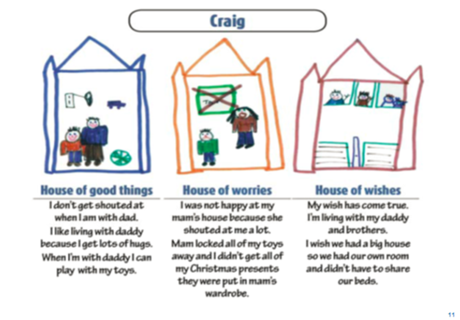
This slide is only available in English
Notes:
The Signs of Safety approach to child protection casework was developed through the 1990s in Western Australia. It was created by Andrew Turnell and Steve Edwards
Use lego – rename houses make it personal

Slide 23
Offer rydyn ni'n eu defnyddio i ddeall sefyllfa plentyn a'i rwydwaith sydd wedi'i gysylltu'n naturiol
Tools we use to understand a child’s situation and their naturally connected network
Geno gramau
mapiau eco
naratif
offer i gasglu gwybodaeth gan blant
offer a ddefnyddiwn i rannu gwybodaeth
Geno grams
Eco maps
Narrative
Tools to gather information from children
Tools we use to share information
Notes:
Mae animeiddiadau ar y sleid
gofynnwch i'r myfyrwyr weiddi pa offer maen nhw'n eu defnyddio i helpu i ddeall sefyllfa person a rhwydwaith sydd wedi'i gysylltu'n naturiol - hwylusydd i gasglu adborth ar siart troi. Gofynnir i fyfyrwyr hefyd esbonio offer nad ydynt yn gyfarwydd i'r grŵp - mae hyn yn helpu pob myfyriwr i gynyddu eu hymwybyddiaeth o'r offer sydd ar gael
yr hwylusydd i ddarllen ac egluro cysylltiad yr offer a grybwyllwyd â’r broses asesu a sgwrs am yr hyn sy’n bwysig.
There are animations on the slide
ask students to shout out what tools they use to help understand a person’s situation and naturally connected network – facilitator to capture feedback on flipchart. Students will also be asked to explain tools that are not familiar with the group - this helps all students to increase their awareness of tools available
facilitator to read through and explain the connection of the tools mentioned to the assessment process and what matters conversation.

Slide 24
Astudiaethau dan gyfarwyddyd
Directed study
Gwyliwch Fideo Dan Siegal
Gwyliwch y fideo - Adam
Sut mae theori yn eich helpu i ddeall y cyfnod bywyd y mae Adam yn ei brofi?
Pa gwestiynau, offer, dulliau cyfathrebu y byddwch chi'n dibynnu arnyn nhw i ddechrau datblygu perthynas ag Adam?
Pa ffactorau fydd angen i chi eu hystyried?
Watch the Dan Siegal Video
Watch the Video – Adam
How does theory help you to understand the life stage Adam is experiencing?
What questions, tools, methods of communication will you be relying on to start to develop a relationship with Adam?
What factors will you need to consider?
Notes:
https://www.youtube.com/watch?v=0O1u5OEc5eY Dan Siegal video Dan Siegel: The Purpose of the Teenage Brain
Dan Siegel is a clinical professor of psychiatry at The University of
California, Los Angeles School of Medicine and the founding co-director
of the Mindful AwarenessResearch Center at UCLA.

Slide 25
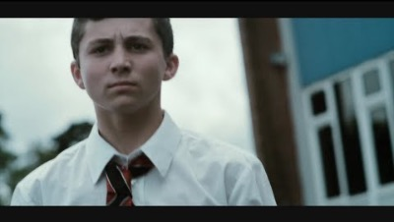
Adam

