Slide 1
Uned 443:
Deall Ffactorau sy'n Cyfrannu at Angen am Ofal a Chymorth ar Unigolion a/neu Ofalwyr
Unit 443:
Understanding Factors that Contribute to Individuals and/ or Carers Needing Care and Support
Notes:
Croeso a chyflwyniadau.
Welcome and introduction.

Slide 2


Slide 3
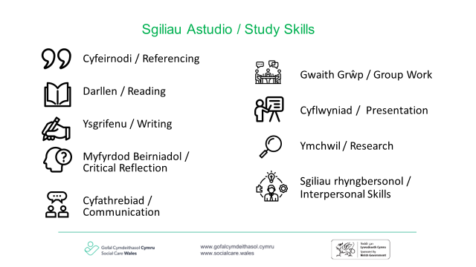

Slide 4

Deilliant Dysgu:
4. Deall y Cysyniad o 'Anabledd', 'Anabl' a 'Nam Corfforol'.
Learning Outcome:
4. Understand the Concept of ‘Disability’, ‘Disabled’ and ‘Physical Impairment’.

Slide 5
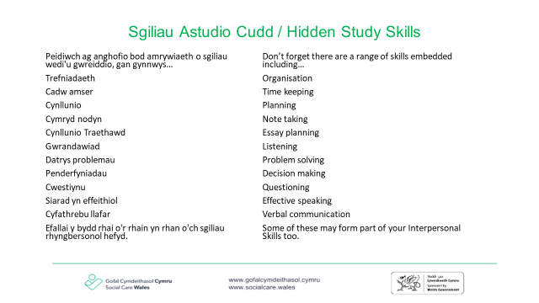

Slide 6
Meini prawf asesu i'w cwmpasu:
Rydych yn deall:
4.1 Beth a olygir gan y termau ‘anabledd’, ‘anabl’ a ‘nam corfforol’
4.2 Pwysigrwydd sefydlu gydag unigolion eu hoff ddefnydd o derminoleg a chydnabod y gall hyn newid dros amser
4.3 Beth a olygir gan y termau 'cynhenid', 'caffaeledig', 'niwrolegol' a 'blaengar' pan gânt eu defnyddio mewn perthynas â nam corfforol
4.4 Pwysigrwydd cydnabod canologrwydd yr unigolyn yn hytrach na'r nam
4.5 Effeithiau (cadarnhaol a negyddol) cael eich labelu fel rhywun sydd â nam corfforol
4.6 Effeithiau posibl rhwystrau cymdeithasol ac amgylcheddol ar unigolyn ag anabledd corfforol
Assessment criteria to be covered:
You understand:
4.1 What is meant by the terms ‘disability’, ‘disabled’ and ‘physical impairment’
4.2 The importance establishing with individuals their preferred use of terminology and recognising that this may change over time
4.3 What is meant by the terms ‘congenital’, ‘acquired’, ‘neurological’ and ‘progressive’ when used in relation to physical impairment
4.4 The importance of recognising the centrality of the individual rather than the impairment
4.5 The impacts (positive and negative) of being labelled as having a physical impairment
4.6 Potential impacts of social and environmental barriers on an individual with a physical disability
Notes:
Mae’r rhain yn adlewyrchu’r meini prawf asesu ar gyfer deilliant dysgu 7.
These reflect the assessment criteria for learning outcome 7.

Slide 7
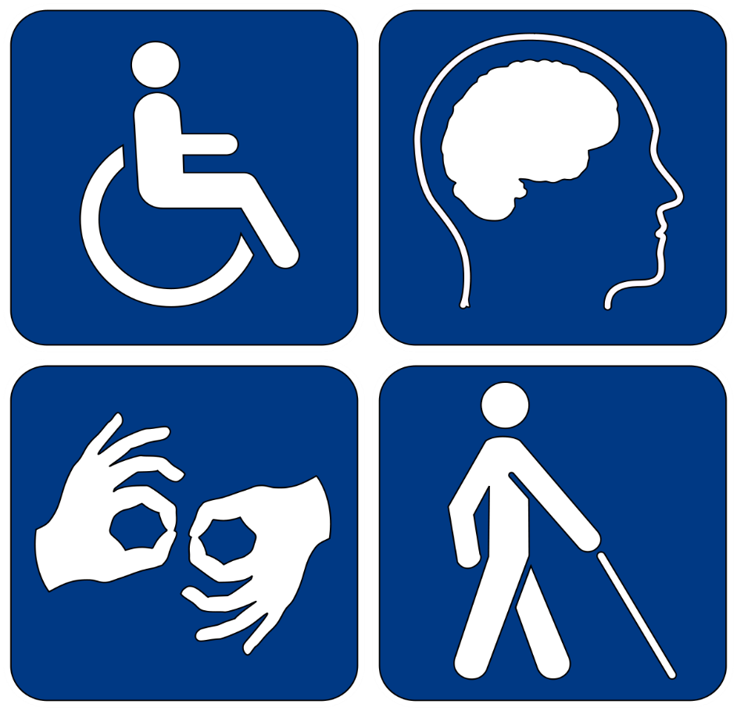
Blwch sylwadau
4.1 Beth yw ystyr y term 'anabledd'?
Comments box
4.1 What is meant by the term ‘disability’?
Notes:
Sleid yn ymwneud ag AC 4.1: (5 munud)
Slide relates to AC 4.1: (5 mins)

Slide 8
Diffiniad o anabledd o dan Ddeddf Cydraddoldeb 2010:
'Rydych yn anabl o dan Ddeddf Cydraddoldeb 2010 os oes gennych nam corfforol neu feddyliol sy’n cael effaith negyddol ‘sylweddol’ a ‘hirdymor’ ar eich gallu i wneud gweithgareddau dyddiol arferol’.
Mae 'sylweddol' yn fwy na mân neu ddibwys, ee mae'n cymryd llawer mwy o amser nag y byddai fel arfer i gyflawni tasg ddyddiol fel gwisgo.
Mae 'hirdymor' yn golygu 12 mis neu fwy, ee cyflwr anadlu sy'n datblygu o ganlyniad i haint ar yr ysgyfaint.
Definition of disability under the Equality Act 2010:
‘You’re disabled under the Equality Act 2010 if you have a physical or mental impairment that has a ‘substantial’ and ‘long-term’ negative effect on your ability to do normal daily activities’.
‘Substantial’ is more than minor or trivial, e.g. it takes much longer than it usually would to complete a daily task- like getting dressed.
‘Long-term’ means 12 months or more, e.g. a breathing condition that develops as a result of a lung infection.
Notes:
Sleid yn ymwneud ag AC 4.1 Felly, mae’r Ddeddf Cydraddoldeb yn gwbl glir. Rhaid profi bod diagnosis i ystyried rhywun yn 'anabl' fod yn sylweddol ac yn hirdymor.
Slide relates to AC 4.1. So, the Equality Act is quite clear. A diagnosis to be considered ‘disabled’ must be proven to be substantial and long-term.

Slide 9
Beth yw darpariaethau pennu anabledd?
What are the provisions of determining disability’?
1. Mae effaith nam yn un hirdymor os—
(a) mae wedi para am o leiaf 12 mis,
( b ) mae'n debygol o bara am o leiaf 12 mis, neu
( c ) mae'n debygol o bara am weddill oes y person dan sylw.
2. Os bydd nam yn peidio â chael effaith andwyol sylweddol ar allu person i gyflawni gweithgareddau arferol o ddydd i ddydd, mae i’w drin fel pe bai’n parhau i gael yr effaith honno os yw’r effaith honno’n debygol o ddigwydd eto.
3. Mae nam sy'n cynnwys anffurfiad difrifol i'w drin fel pe bai'n cael effaith andwyol sylweddol ar allu'r person dan sylw i gyflawni gweithgareddau arferol o ddydd i ddydd.
4. Gall y rheoliadau, yn benodol, wneud darpariaeth mewn perthynas ag anffurfiad a gafwyd yn fwriadol.
1. The effect of an impairment is long-term if—
(a) it has lasted for at least 12 months,
(b) it is likely to last for at least 12 months, or
(c) it is likely to last for the rest of the life of the person affected.
2. If an impairment ceases to have a substantial adverse effect on a person's ability to carry out normal day-to-day activities, it is to be treated as continuing to have that effect if that effect is likely to recur.
3. An impairment which consists of a severe disfigurement is to be treated as having a substantial adverse effect on the ability of the person concerned to carry out normal day-to-day activities.
4. The regulations may, in particular, make provision in relation to deliberately acquired disfigurement.
Notes:
Sleid yn ymwneud ag AC 4.1 Atodlen 1 - Mae gan Ran 1 o'r Ddeddf Cydraddoldeb Reoliadau a all wneud darpariaeth i gyflwr o ddisgrifiad rhagnodedig fod yn nam, neu beidio.
Slide relates to AC 4.1. Schedule 1- Part 1 of the Equality Act has Regulations that may make provision for a condition of a prescribed description to be, or not to be, an impairment.

Slide 10
Beth yw darpariaethau pennu anabledd?
What are the provisions of determining disability’?
5. Effaith triniaeth feddygol:
Mae nam i'w drin fel un sydd ag effaith andwyol sylweddol os:
(a) mae mesurau yn cael eu cymryd i'w drin neu i'w gywiro, ac
( b ) oni bai am hynny, y byddai’n debygol o gael yr effaith honno
6. Cyflyrau meddygol penodol
Mae canser, haint HIV a sglerosis ymledol i gyd yn anableddau.
Haint HIV yw haint gan firws sy'n gallu achosi Syndrom Diffyg Imiwnedd Caffaeledig
7. Gall y rheoliadau ragnodi amgylchiadau pan fo person sydd ag anabledd i’w drin fel pe na bai ganddo’r anabledd mwyach.
https://www.legislation.gov.uk/ukpga/2010/15/schedule/1
5. Effect of medical treatment:
An impairment is to be treated as having a substantial adverse effect:
(a) measures are being taken to treat or correct it, and
(b) but for that, it would be likely to have that effect
6. Certain medical conditions
Cancer, HIV infection and multiple sclerosis are each a disability.
HIV infection is infection by a virus capable of causing the Acquired Immune Deficiency Syndrome
7. The regulations may prescribe circumstances in which a person who has a disability is to be treated as no longer having the disability.
https://www.legislation.gov.uk/ukpga/2010/15/schedule/1
Notes:
Sleid yn ymwneud ag AC 4.1 Atodlen 1 - Mae gan Ran 1 o'r Ddeddf Cydraddoldeb Reoliadau a all wneud darpariaeth i gyflwr o ddisgrifiad rhagnodedig fod yn nam, neu beidio.
Mae Darpariaeth 5 yn cydnabod, hyd yn oed os nad yw rhywun yn profi poen neu effeithiau sylweddol y nam oherwydd ‘mesurau’ - trwy hyn gallwn gynnwys triniaeth feddygol, efallai y byddant yn dal i gael eu hystyried yn anabl oherwydd pe bai’r mesurau (triniaeth) yn cael eu dileu, yna mae’n debygol byddent yn profi effeithiau andwyol sylweddol.
Slide relates to AC 4.1. Schedule 1- Part 1 of the Equality Act has Regulations that may make provision for a condition of a prescribed description to be, or not to be, an impairment.
Provision 5 is recognising that even if someone is not experiencing pain or substantial effects of the impairment because of ‘measures’- by this we can include medical treatment, they may still be considered disabled because if the measures (treatment) were removed, then it is likely they would experience substantial adverse effects.

Slide 11
Protected Rights Under the Equality Act 2010
Hawliau a Ddiogelir o dan Ddeddf Cydraddoldeb 2010
Mae Deddf Cydraddoldeb 2010 yn dweud na ddylid gwahaniaethu yn eich erbyn oherwydd:
bod gennych anabledd
mae rhywun yn meddwl bod gennych anabledd (gelwir hyn yn wahaniaethu trwy ganfyddiad)
rydych yn gysylltiedig â rhywun ag anabledd (gelwir hyn yn wahaniaethu trwy gysylltiad)
The Equality Act 2010 says that you must not be discriminated against because:
you have a disability
someone thinks you have a disability (this is known as discrimination by perception)
you are connected to someone with a disability (this is known as discrimination by association)
Notes:
Mae'r sleid yn ymwneud â'r holl feini prawf asesu.
Slide relates to all assessment criteria.

Slide 12
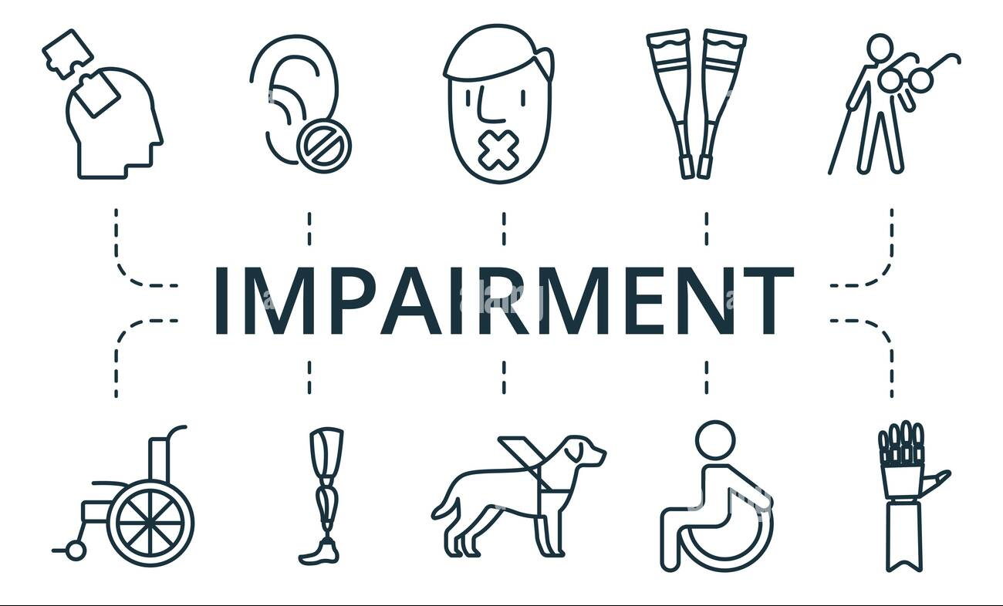
What is meant by ‘Physical Impairment’?
Beth yw ystyr 'Nam Corfforol'?
Mae nam corfforol yn cael ei ystyried yn anaf, salwch, neu gyflwr cynhenid (cyflwr y cawsoch eich geni ag ef) sy'n achosi neu'n debygol o achosi effaith hirdymor ar ymddangosiad corfforol a/neu gyfyngu ar weithrediad yr unigolyn sy'n wahanol i'r cyffredin.
A physical impairment is viewed as an injury, illness, or congenital (a condition you are born with) that causes or is likely to cause a long term effect on physical appearance and/or limitation of function within the individual that differs from the commonplace.
Notes:
Sleid yn ymwneud ag AC 4.1 Mae nam corfforol yn effeithio ar y gallu corfforol i symud, cydlynu gweithredoedd, neu berfformio gweithgareddau corfforol, ac mae'n gyfyngedig iawn, yn ddiffygiol neu wedi'i oedi ac mae'n cael ei arddangos gan anawsterau mewn un neu fwy o'r meysydd canlynol: tasgau corfforol ac echddygol; symudiad annibynnol; cyflawni swyddogaethau bywyd sylfaenol. Bydd y term yn cynnwys namau orthopedig difrifol neu namau a achosir gan anomaledd cynhenid, parlys yr ymennydd, trychiadau, a thoriadau os yw nam o'r fath yn effeithio'n andwyol ar berfformiad.
Slide relates to AC 4.1. Physical impairment affects the physical capacity to move, coordinate actions, or perform physical activities, and is significantly limited, impaired, or delayed and is exhibited by difficulties in one or more of the following areas: physical and motor tasks; independent movement; performing basic life functions. The term shall include severe orthopedic impairments or impairments caused by congenital anomaly, cerebral palsy, amputations, and fractures if such impairment adversely affects performance.

Slide 13
Additionally…
At hynny...
Gall namau corfforol fod o ganlyniad i:
Parlys yr Ymennydd
Anaf i fadruddyn y cefn
Nychdod Cyhyrol
Spina bifida
Anaf (coes neu fraich wedi torri)
Anaf i'r pen
Nam neu golled o ran y synhwyrau
Colli aelod/au
Strôc
Sglerosis Ymledol
Clefyd Alzheimer
Tiwmorau ar yr ymennydd
Clefyd Parkinson
Clefyd Rhwystrol Cronig yr Ysgyfaint (COPD).
Physical impairments can be a result of:
Cerebral Palsy
Spinal-cord injury
Muscular Dystrophy
Spina bifida
Injury (broken leg or arm)
Head injury
Sensory impairment or loss
Loss of limb/s
Stroke
Multiple Sclerosis
Alzheimer’s
Brain tumours
Parkinson’s
Chronic Obstructive Pulmonary Disease (COPD).
Notes:
Sleid yn ymwneud ag AC 4.1
Slide relates to AC 4.1.

Slide 14

Stop and reflect
Stopiwch a myfyriwch
4.1 Beth a olygir gan y termau ‘anabledd’, ‘anabl’ a ‘nam corfforol’
Gwnewch nodiadau gan ddefnyddio ffynonellau dibynadwy i gefnogi eich diffiniadau
Cyfeirio
4.1 What is meant by the term's ‘disability’, ‘disabled’ and ‘physical impairment’
Make notes using reliable sources to support your definitions

Slide 15
How many people are disabled in the UK?
Data ar anabledd
Data on disability
Faint o bobl sy'n anabl yn y DU?
14.6 miliwn o bobl
14.6 million people
What percentage of children are disabled?
Pa ganran o blant sy'n anabl?
Mae 9% o blant yn anabl
9% of children are disabled
What percentage of working-age adults are disabled?
Pa ganran o oedolion o oedran gweithio sy'n anabl?
21% of working age adults are disabled
Mae 21% o oedolion o oedran gweithio yn anabl
What percentage of pensioners are disabled?
Pa ganran o bensiynwyr sy'n anabl?
Mae 42% o oedolion oedran pensiwn yn anabl
42% of pension age adults are disabled
https://www.scope.org.uk/media/disability-facts-figures/
https://www.scope.org.uk/media/disability-facts-figures/
Notes:
Sleid yn ymwneud ag AC 4.1 Ffigurau gan yr elusen 'Scope' yw'r rhain. Mae data'r llywodraeth yn amrywio ychydig, ond gellir ystyried y ffigurau hyn yn gymharol ddibynadwy.
Slide relates to AC 4.1. These are figures from the charity ‘Scope’. Government data varies slightly, but these figures can be considered relatively reliable.

Slide 16
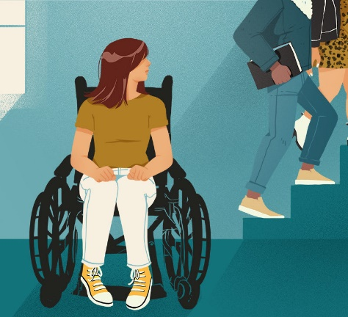
4.2 Attitudes to Disability
4.2 Agweddau at Anabledd
Mae 1 o bob 3 o bobl anabl yn teimlo bod llawer o ragfarn anabledd.
Mae 1 o bob 3 o bobl yn gweld pobl anabl yn llai cynhyrchiol na phobl nad ydynt yn anabl.
Erbyn 2017, roedd 32% o bobl anabl a 22% o bobl nad ydynt yn anabl yn teimlo bod llawer o ragfarn yn erbyn pobl anabl.
Mae 87% o rieni plant anabl hyd at 5 oed wedi teimlo eu bod yn cael eu barnu gan aelodau'r cyhoedd pan fyddant yn mynd allan gyda'u plentyn anabl.
1 in 3 disabled people feel there’s a lot of disability prejudice.
1 in 3 people see disabled people as being less productive than non-disabled people.
By 2017, 32% of disabled people and 22% of non-disabled people felt there was a lot of prejudice against disabled people.
87% of parents of disabled children up to the age of 5 have felt judged by members of the public when they go out with their disabled child.
Notes:
Sleid yn ymwneud ag AC 4.1 Daw'r ffigurau hyn o'r elusen 'Scope’.
Slide relates to AC 4.1. These figures are taken from the charity ‘Scope’.

Slide 17
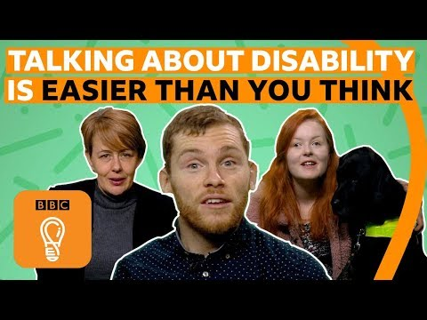
Rhyngweithio â rhywun sydd ag anabledd
Interacting with someone who has a disability
Notes:
Sleid yn ymwneud ag AC 4.2 Mae'r fideo hwn yn cefnogi sut mae pobl ag anabledd eisiau cael eu trin, ond lle maen nhw hefyd yn rhannu eu profiadau negyddol o sut mae eu hanabledd wedi cael ei ystyried.
Slide relates to AC 4.2. This video is in support of how people with a disability want to be treated, but where they also share their negative experiences of how their disability has been regarded.

Slide 18
Ysgrifennu am anabledd a gwahaniaeth: geiriau i'w defnyddio a'u hosgoi:
Writing about disability and difference: words to use and avoid:
To use:
Accessible toilets or accessible parking
Parking for blue or orange badge holders
Care worker
Personal assistant
Enabler
Service user
Client
Friends, family and loved ones
Enabling
Championing
has a diagnosis of
NHS 2022
I'w defnyddio:
Toiledau hygyrch neu barcio hygyrch
Parcio ar gyfer deiliaid bathodyn glas neu oren
Gweithiwr gofal
Cynorthwyydd Personol
Galluogwr
Defnyddiwr gwasanaeth
Cleient
Ffrindiau, teulu ac anwyliaid
Galluogi
Hyrwyddo
â diagnosis o
Notes:
Sleid yn ymwneud ag AC 4.2
Mae'n bwysig bod yn sensitif a defnyddio'r wybodaeth ddiweddaraf am ddefnydd iaith priodol a derbyniol. Mae ystyr geiriau yn newid yn gyson gyda geiriau newydd yn cael eu hychwanegu at ein hiaith bob blwyddyn.
Mae pawb yn wahanol ac efallai na fydd geiriau sy'n arferol i rai yn iawn i eraill.
Os ydych mewn cysylltiad uniongyrchol â rhywun y mae anabledd yn effeithio arno, gofynnwch i'r person ddweud wrthych pa eiriau ac ymadroddion y mae'n gyfforddus â nhw.
Gall rhai geiriau cyffredin ar gyfer y sector gofal fod yn nawddoglyd, yn rheoli ac yn awgrymu gwendid a goddefedd.
Slide relates to AC 4.2.
It is important to be sensitive and to keep up to date with appropriate and acceptable language use. The meaning of words is constantly changing with new words added to our language every year.
Everyone is different and words that are normal for some may not be okay for others.
If you are in direct contact with someone affected by disability, ask the person to tell you which words and phrases they are comfortable with.
Some common words for the care sector can be patronising, controlling and imply weakness and passivity.

Slide 19
I'w hosgoi:
'Cyfeillgar i bobl anabl' neu 'fynediad i'r anabl' (yn amlygu anhawster neu anallu)
'Toiledau anabl' neu 'parcio anabl' (nid yw'r toiledau a'r mannau parcio yn anabl - yn llythrennol)
'Salwch' - yn awgrymu y gallai'r person wella
'Yn dioddef o'
'Goroeswr'
'Â diagnosis o' - barn gweithiwr meddygol proffesiynol yw hwn
'Abl ei gorff' - yn awgrymu nad yw rhai yn abl
'Claf' - yn awgrymu nad yw person yn ddilys
'Pobl normal' - yn awgrymu bod rhai yn annormal
To avoid:
‘Disability friendly’ or ‘disabled access’ (highlights difficulty or inability)
‘Disabled toilets’ or ‘disabled parking’ (the toilets and parking bays are
not disabled- literally)
‘Illness’ - suggests the person could get better
‘Suffers from’
‘Survivor’
‘Diagnosed with’ - this is a medical professional's opinion
‘Abled bodied’ - implies some are not able
‘Invalid’ - implies a person is not valid
‘Normal people’ - implies some are abnormal
NHS 2022
NHS Digital 2022
Notes:
Sleid yn ymwneud ag AC 4.2
Mae'n bwysig bod yn sensitif a defnyddio'r wybodaeth ddiweddaraf am ddefnydd iaith priodol a derbyniol. Mae ystyr geiriau yn newid yn gyson gyda geiriau newydd yn cael eu hychwanegu at ein hiaith bob blwyddyn.
Mae pawb yn wahanol ac efallai na fydd geiriau sy'n arferol i rai yn iawn i eraill.
Os ydych mewn cysylltiad uniongyrchol â rhywun y mae anabledd yn effeithio arno, gofynnwch i'r person ddweud wrthych pa eiriau ac ymadroddion y mae'n gyfforddus â nhw.
Slide relates to AC 4.2.
It is important to be sensitive and to keep up to date with appropriate and acceptable language use. The meaning of words is constantly changing with new words added to our language every year.
Everyone is different and words that are normal for some may not be okay for others.
If you are in direct contact with someone affected by disability, ask the person to tell you which words and phrases they are comfortable with.

Slide 20
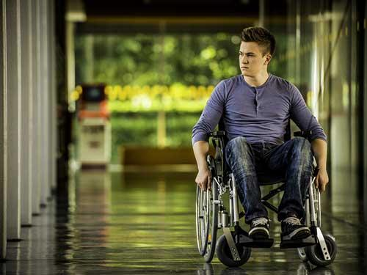
What is Meant by ‘Disabled’?
Beth mae ‘Anabl' yn ei olygu?
People are “disabled” through lack of access to buildings, information, communication or personal support or by the attitudes of others.
Health & Care Learning Wales
Mae pobl yn “anabl” oherwydd diffyg mynediad at adeiladau, gwybodaeth, cyfathrebu neu gefnogaeth bersonol neu gan agweddau pobl eraill.
Dysgu Iechyd a Gofal Cymru
Notes:
Sleid yn ymwneud ag AC 4.1 Daw’r diffiniad hwn o uned 341 Dysgu Iechyd a Gofal Cymru.
Slide relates to AC 4.1. This definition is taken from Health & Care Learning Wales unit 341.

Slide 21
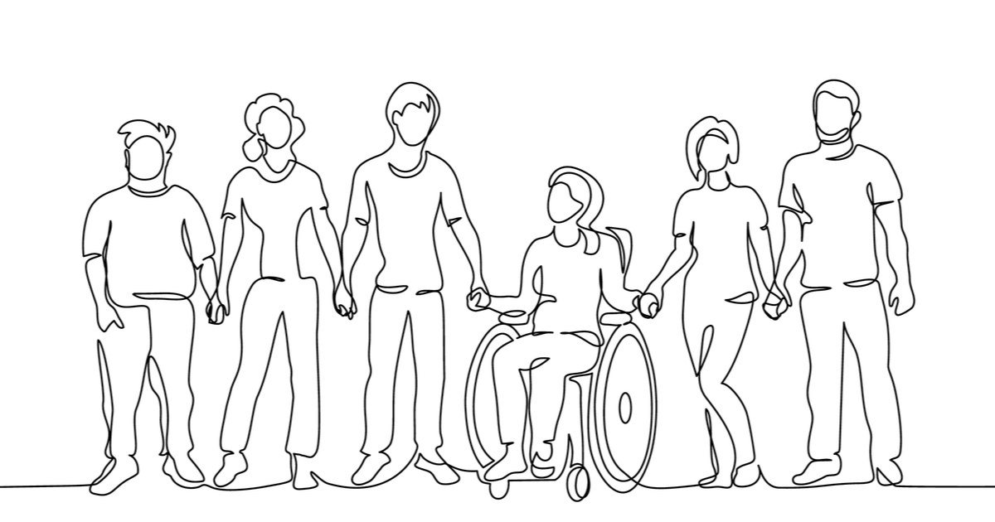
‘Disability’ can also be understood as …
Gall 'anabledd' hefyd gael
ei ddeall fel…
‘…the loss or limitation of opportunities to take part in society on an equal level with others, due to institutional, environmental and attitudinal barriers’.
'…colli neu gyfyngu ar gyfleoedd i gymryd rhan mewn cymdeithas ar lefel gyfartal ag eraill, oherwydd rhwystrau sefydliadol, amgylcheddol ac agweddol'.
Notes:
Sleid yn ymwneud ag AC 4.1: Daw'r diffiniad o wefan Dysgu Iechyd a Gofal Cymru (uned 341). Byddwn yn archwilio 'anabledd' ymhellach yn y sesiwn heddiw drwy edrych ar y modelau Cymdeithasol a Meddygol o anabledd a'r effeithiau y mae'r ddau yn eu cael ar unigolion. Byddwn yn talu sylw arbennig i pam fod unigolion eisiau i’r Model Cymdeithasol gael ei dderbyn yn fwy mewn cymdeithas.
Slide relates to AC 4.1: The definition is taken from Health and Care Learning Wales website (unit 341). We will explore ‘disability’ further into today’s session by looking at the Social and Medical models of disability and the impacts both have on individuals. We will be particularly concerned with why individuals want the Social Model more greatly accepted into society.

Slide 22

The UN Convention of Rights of Persons with Disabilities
Confensiwn y Cenhedloedd Unedig ar Hawliau Pobl ag Anableddau
Cytundeb rhyngwladol yw hwn sy’n diogelu a hyrwyddo hawliau dynol pobl anabl ledled y byd.
Mae'n gosod safonau newydd am sut y dylai llywodraethau a chyrff cyhoeddus sicrhau bod hawliau dynol pobl anabl yn cael eu hamddiffyn a’u hyrwyddo.
Mae'r Confensiwn yn seiliedig ar y model cymdeithasol o anabledd (caiff pobl eu cau allan gan rwystrau a grëir gan gymdeithas).
Mae'r Confensiwn yn cynnwys Erthyglau sy'n arwain partneriaeth ryngwladol: (ymwybyddiaeth, hygyrchedd, hawliau, rhyddid, gwaith ac addysg).
Mae stigma, rhagfarn a gwahaniaethu yn cael eu targedu gan y Confensiwn.
Rhagor o wybodaeth:
www.un.org/development/desa/disabilities/convention-on-the-rights-of-persons-with-disabilities/convention
Is an international agreement about protecting and promoting the human rights of disabled people around the world.
It set new standards for how governments and public bodies should ensure that disabled people’s human rights are protected and promoted.
The Convention is based on the social model of disability (people are excluded by obstacles created by society).
The Convention is made up of Articles that guide international partnership: (awareness, accessibility, rights, freedoms, work and education).
Stigma, prejudice, and discrimination are targeted by the Convention.
Further information:
www.un.org/development/desa/disabilities/convention-on-the-rights-of-persons-with-disabilities/convention
Notes:
Sleid yn ymwneud ag AC 4.1 Mae cyfanswm o 50 Erthygl.
Slide relevant to AC 4.1. There are 50 Articles in total.

Slide 23
4.3 Causes of Physical Impairment
4.3 Achosion Nam Corfforol
' Cynhenid', sy'n golygu bod y salwch neu'r cyflwr meddygol yn un y mae unigolyn wedi'i gael ers ei eni ac nad yw wedi'i etifeddu. Mae enghreifftiau'n cynnwys parlys yr ymennydd a spina bifida.
'Caffaeledig' - anableddau sy'n digwydd ar ôl genedigaeth. Gallant gael eu hachosi gan ddamwain neu ddigwyddiad sy'n achosi anaf, neu salwch, yn hytrach nag anabledd y ganwyd unigolyn ag ef. Mae enghreifftiau'n cynnwys anaf i'r pen, nam neu golled o ran y synhwyrau neu golli aelod/au.
‘Congenital’, which means the illness or medical condition is one that individual has had from birth and is not inherited. Examples include cerebral palsy and spina bifida.
‘Acquired’ disabilities occur after birth. They can be caused by an accident or incident causing injury, or illness, rather than a disability an individual was born with. Examples include head injury, sensory impairment or loss and loss of limb/s.
Notes:
Sleid yn ymwneud ag AC 4.3
Slide relates to AC 4.3.

Slide 24
Causes of Physical Impairment
Achosion Nam Corfforol
Mae anableddau 'niwrolegol' yn effeithio ar allu'r ymennydd i brosesu gwybodaeth, cyfathrebu â gweddill y corff a chychwyn symud. Gall cyflyrau niwrolegol fod yn enetig neu wedi'u caffael, efallai oherwydd anaf i'r ymennydd neu fadruddyn y cefn. Mae enghreifftiau'n cynnwys strôc, sglerosis ymledol, Alzheimer's a thiwmorau ar yr ymennydd.
Mae namau ‘Cynyddol' yn afiechydon neu gyflyrau iechyd sy’n gwaethygu dros amser, gan arwain at ddirywiad cyffredinol mewn iechyd a lles. Mae enghreifftiau'n cynnwys Clefyd Parkinson a Chlefyd Rhwystrol Cronig yr Ysgyfaint (COPD).
‘Neurological’ disabilities affect the brain's ability to process information, communicate with the rest of the body and initiate movement. Neurological conditions can be genetic or acquired, perhaps by a brain or spinal cord injury. Examples include a stroke, multiple sclerosis, Alzheimer’s and brain tumours.
‘Progressive’ impairments are diseases or health conditions that get worse over time, resulting in a general decline in health and well-being. Examples include Parkinson’s and Chronic Obstructive Pulmonary Disease (COPD).
Notes:
Sleid yn ymwneud ag AC 4.3
Slide relates to AC 4.3.

Slide 25
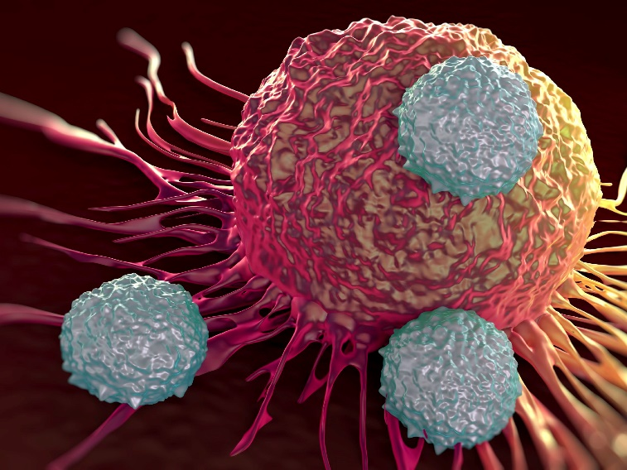
Progressive conditions:
A progressive condition is one that gets worse over time. People with progressive conditions can be classed as disabled.
However, you automatically meet the disability definition under the Equality Act 2010 from the day you’re diagnosed with HIV infection, cancer or multiple sclerosis.
Cyflyrau cynyddol:
Mae cyflwr cynyddol yn un sy'n gwaethygu dros amser. Gellir dosbarthu pobl â chyflyrau cynyddol yn anabl.
Fodd bynnag, rydych yn bodloni'r diffiniad anabledd yn awtomatig o dan Ddeddf Cydraddoldeb 2010 o'r diwrnod y cewch ddiagnosis o haint HIV, canser neu sglerosis ymledol.
Notes:
Sleid yn ymwneud ag AC 4.1 Yn dibynnu ar y diagnosis, gall anhwylder cynyddol symud yn gyflym neu'n araf. Mae enghreifftiau yn cynnwys Clefyd Alzheimer, clefyd Parkinson, Sglerosis Ymledol ac Arthritis Gwynegol a chyflyrau iechyd fel clefyd deubegynol neu iselder. Mae cyflyrau cynyddol yn ddarostyngedig i ddarpariaethau arbennig Deddf Cydraddoldeb 2010
Slide relates to AC 4.1. Depending on the diagnosis, a progressive disorder may move quickly or slowly. Examples include Alzheimer's disease, Parkinson's disease, Multiple Sclerosis and Rheumatoid Arthritis. health conditions such as bipolar or depression. Progressive conditions are subject to the special provisions of the Equality Act 2010

Slide 26
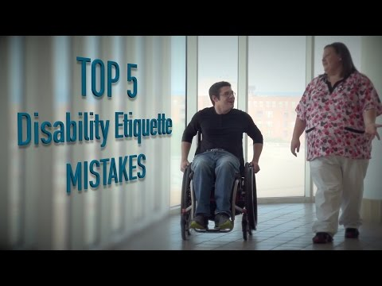
Adnabod y person…nid y nam
Recognising the person…not the impairment
Notes:
Sleid yn ymwneud ag AC 4.4 Mae hwn yn fideo doniol.
Slide relates to AC 4.4. This is a funny video.

Slide 27

Trafodaeth grŵp:
Group discussion:
4.4 What can be done to recognise the centrality of the individual rather than the impairment?
4.4 Beth ellir ei wneud i adnabod canologrwydd yr unigolyn yn hytrach na'r nam?
Mae rhagor o wybodaeth ar gael yma:
Dysgu Iechyd a Gofal Cymru (uned 341).
llyw.cymru/ anableddau
Scope.co.uk
Anabledd. Cymru
Further information can be found:
Health & Care Learning Wales (unit 341).
gov.wales/ disabilities
Scope.co.uk
Disability. Wales
Notes:
Sleid yn ymwneud ag AC 4.4 10 munud
Dylai dysgwyr fod yn nodi:
Dull cyfannol at gymorth, darparu triniaeth i'r unigolyn yn ei gyfanrwydd ac ystyried ffactorau meddyliol a chymdeithasol.
Ffocws ar gryfderau unigolyn.
Cydnabod bod stigma, ofn a gwahaniaethu tuag at bobl â namau corfforol yn dal yn broblem gymdeithasol.
Bod eiriolwr yn gallu helpu. Byddant yn rhoi cymorth priodol ac yn sicrhau bod safbwyntiau a dewisiadau’r unigolyn a’u teuluoedd a’u gofalwyr yn cael eu bodloni.
Hyrwyddo Eiriolaeth ar y Cyd: mae hyn yn cynnwys grŵp o bobl sydd i gyd yn wynebu problem gyffredin ac sydd wedi cael profiadau tebyg yn dod at ei gilydd i weithio ar faterion penodol a sicrhau bod eu lleisiau'n cael eu clywed. Gall y grŵp cyfan ymgyrchu ar fater sy'n effeithio arnynt
Cydnabod gwerth Cydgynhyrchu/Llais a Rheolaeth/ Gweithio Aml-Asiantaeth.
Gwybod, cynghori a chynnal hawliau cyfreithiol.
Slide relates to AC 4.4. 10 mins.
Learners should be identifying:
A holistic approach to support, providing treatment to the individual as a whole and taking into account mental and social factors.
A focus on an individual’s strengths.
Acknowledging that stigma, fear and discrimination towards people with physical impairments is still a social problem.
That an advocate can help. They will give appropriate support and ensure that the individual and their families and carers views and preferences are being met.
Promoting Collective advocacy: involves a group of people who are all facing a common problem and have had similar experiences getting together to work on specific issues and have their voices heard. The group as a whole may campaign on an issue that affects them
Recognising the value of Co-Production/ Voice and Control/ Multi-Agency working.
Knowing, advising and upholding legal rights.

Slide 28
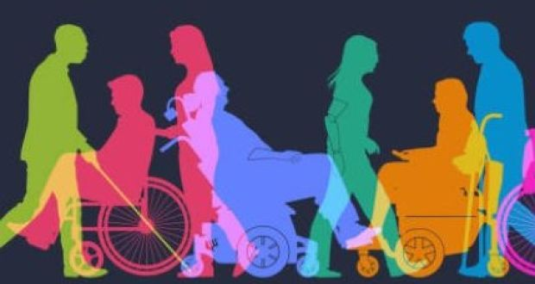
4.5 Effeithiau Cadarnhaol a Negyddol Label o Nam Corfforol
Gall derbyn diagnosis fod yn aml yn ganlyniad cadarnhaol gan y gallai'r unigolyn deimlo rhyddhad y gall ddeall o'r diwedd beth yw'r broblem. Yna gall drafod gyda’i feddyg pa lwybr triniaeth a allai weithio orau iddo.
Gall fod eiriolaeth gyfunol yn ddefnyddiol i unigolion er mwyn helpu i ddatblygu llais a rheolaeth, ymyriadau cadarnhaol, cydgynhyrchu a rhwydweithiau cymdeithasol pwysig.
4.5 Positive & Negative Impacts of a Label of Physical Impairment
Receiving a diagnosis can often be a positive outcome as the individual might feel relieved that they can finally understand what the issue is. They can then discuss with their doctor what course of treatment might work best for them.
Individuals may find collective advocacy useful to help develop voice and control, positive interventions, co-production and important social networks.
Notes:
Sleid yn ymwneud ag AC 4.5
Slide relates to AC 4.5.

Slide 29

Positive & Negative Impacts of a Label of Physical Impairment
Effeithiau Cadarnhaol a Negyddol Label Nam Corfforol
There is still widespread stigma, fear and discrimination towards people with physical impairments.
It can make people feel ‘labelled’.
It may make the illness worse, for example by heightening anxiety.
It may lead to the individual isolating themselves
An individual might lose income, their job, their home and support from family due to lack of understanding, fear and stigma of mental illness.
It may instigate onset of various mental health problems.
Mae stigma, ofn a gwahaniaethu tuag at bobl â namau corfforol yn dal i fodoli.
Gall wneud i bobl deimlo eu bod wedi'u 'labelu'.
Gall wneud y salwch yn waeth, er enghraifft trwy gynyddu gorbryder.
Gall arwain at yr unigolyn yn ynysu ei hun
Gallai unigolyn golli incwm, ei swydd, ei gartref a chymorth gan y teulu oherwydd diffyg dealltwriaeth, ofn a stigma salwch meddwl.
Gall arwain at amrywiaeth o broblemau iechyd meddwl.
Notes:
Sleid yn ymwneud ag AC 4.5 Dylid ystyried y sleid hon ochr yn ochr â gwybodaeth a drafodwyd eisoes yn y sesiwn hon mewn perthynas â’r ddeddfwriaeth a’r hawliau nad yw pobl efallai’n gwybod bod ganddynt hawl i’w harfer. Hefyd, meddyliwch am y farn a fynegwyd gan unigolion yn rhai o'r fideos a welwyd heddiw.
Slide relates to AC 4.5. This slide should be considered alongside information already covered in this session in relation to the legislation and rights that people may not know they are then entitled to exercise. Also, think abut the views expressed by individuals in some of the videos viewed today.

Slide 30
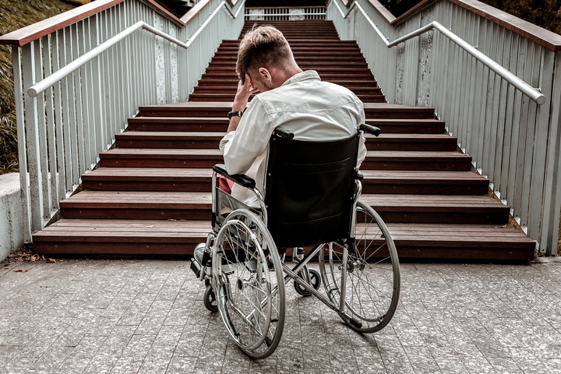
4.6 Effeithiau Posibl: Rhwystrau Cymdeithasol ac Amgylcheddol ar Rywun ag Anabledd Corfforol
4.6 Potential Impacts: Social & Environmental Barriers on Someone with a Physical Disability
Notes:
Sleid yn ymwneud ag AC 4.6
Slide relates to AC 4.6

Slide 31
Potential Impacts
Effeithiau Posibl
Triniaeth, Iaith, Terminoleg a Rhyngweithio
Treatment, Language, Terminology & Interaction
Effeithio ar Symudedd Cymdeithasol
Iechyd Corfforol Gwael
Pwysau Ariannol
Dibyniaeth ar Gymdeithas
Impacted Social Mobility
Poor Physical Health
Financial Pressures
Reliance on Society
Llunio Rhwydweithiau Cymdeithasol
Angen am Eiriolaeth
Straen Emosiynol ar Eraill
Teimlo fel Baich
Shaping Social Networks
A Need for Advocacy
Emotional Strain on Others
Feeling like a Burden
Unigedd
Parch
Sefydiadol/ Rhwystrau Sefydliadol
Poen Corfforol/Materion Symudedd
Datblygu Patrymau Cymdeithasol
Isolation
Institutional
Regard/ Organisational Barriers
Physical Pain/ Mobility Issues
Developing Social Patterns
Eithrio/Ddim yn Cymryd Rhan
Iechyd Meddwl Gwael
Heriau Addysgol
Cyflogaeth
Heriau
Exclusion/ Not Participating
Poor Mental Health
Educational Challenges
Employment
Challenges
Notes:
Sleid yn ymwneud ag AC 4.6 Parch Sefydliadol: sut mae sefydliad yn gweld, trin, addasu (neu beidio), derbyn/peidio â derbyn yr anabledd - gan gynnwys cyfleoedd.
Slide relevant to AC 4.6. Institutional Regard: how an organisation views, treats, adjusts (or not), accepts/ does not accept the disability- including opportunities.

Slide 32
Exercise (10 mins):
Group 1: What Social barriers can you think of that people with a physical disability might encounter, and what impacts might it have on them?
Ymarfer (10 munud):
Grŵp 1: Pa rwystrau Cymdeithasol a allwch chi feddwl amdanynt y gallai pobl ag anabledd corfforol ddod ar eu traws, a pha effeithiau y gallai ei gael arnynt?
Group 2: What Environmental
barriers can you think of that people with a physical disability might encounter, and what impacts might it have on them?
Grŵp 2 : Pa rwystrau Amgylcheddol
a allwch chi feddwl amdanynt y gallai pobl ag anabledd corfforol ddod ar eu traws, a pha effeithiau y gallai ei gael arnynt?
Notes:
Sleid yn ymwneud ag AC 4.6:
Slide relates to AC 4.6:

Slide 33
Model Meddygol o Anabledd a'r Model Cymdeithasol o Anabledd
Medical Model of Disability & the Social Model of Disability
Model Meddygol: yn awgrymu bod methiant neu gyfyngiad corff person yn ei roi ef neu hi dan anfantais. Mae'n edrych ar nam fel rhywbeth y mae angen ei wella a gwneud y person anabl yn iach ac yn 'normal'.
Model Cymdeithasol: yn awgrymu mai rhwystrau sefydliadol, amgylcheddol ac agwedd a godir ac a orfodir gan gymdeithas sy'n achosi anabledd. Mae cyflwr meddygol person yn amherthnasol.
Medical Model: suggests the failure or limitation of a person’s body disadvantages him or her. It looks at impairment as something that needs to be cured and the disabled person made well and ‘normal’.
Social Model: suggests institutional, environmental and attitudinal barriers erected and enforced by society cause disablement. A person’s medical condition is irrelevant.
Notes:
Sleid yn ymwneud ag AC 4.6.
Bathwyd y term 'Model Cymdeithasol o Anabledd' am y tro cyntaf gan Mike Oliver ym 1981 ond datblygwyd y model gan bobl anabl o'u profiadau eu hunain, sef bod y rhan fwyaf o'r problemau yr oeddent yn eu hwynebu wedi'u hachosi gan y ffordd yr oedd cymdeithas yn cael ei threfnu. Yn raddol, mae cymdeithas ehangach y tu hwnt i sefydliadau pobl anabl yn cydnabod ac yn mabwysiadu'r model. Mabwysiadodd Llywodraeth Cymru, er enghraifft, y model yn 2002. Yn 2011 ymatebodd Llywodraeth Cymru i ymgyrch Anabledd Cymru ar gyfer 'Byw'n annibynnol NAWR!' Arweiniodd hyn at Fframwaith Gweithredu ar gyfer Byw'n Annibynnol Llywodraeth Cymru.
Slide relates to AC 4.6.
The term ‘Social Model of Disability’ was first coined by Mike Oliver in 1981 but the model was developed by disabled people from their own experiences, that most of the problems they were facing were caused by the way society was organised. Gradually, wider society beyond disabled people’s organisations is recognising and adopting the model. Welsh Government, for example, adopted the model in 2002. In 2011 Welsh Government responded to the Disability Wales campaign for ‘Independent living NOW!’ This led to Welsh Government’s Framework for Action on Independent Living.

Slide 34
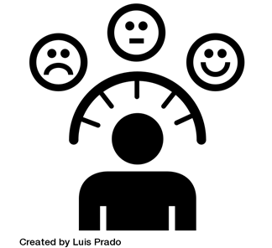



Social Barriers Could Include:
Gallai Rhwystrau Cymdeithasol Gynnwys:
Attitudes & Stigma
Reliance on the medical
Model
Lack of education
Laws
Agweddau a Stigma
Dibyniaeth ar y model
Meddygol
Diffyg addysg
Cyfreithiau
Notes:
Sleid yn ymwneud ag AC 4.6. Mewn perthynas â rhwystrau sy'n berthnasol i'r gyfraith, yr hyn a olygir yw nad yw pawb sy'n ystyried bod ganddynt anabledd neu nam, yn cael eu hamddiffyn o dan y Ddeddf Cydraddoldeb o ran yr hyn a ddiffinnir fel anabledd.
Slide relates to AC 4.6. In relation to barriers being relevant to law, what is meant is that not all people who consider themselves to have a disability or an impairment, find themselves protected under the Equality Act in regard to what is defined as a disability.

Slide 35
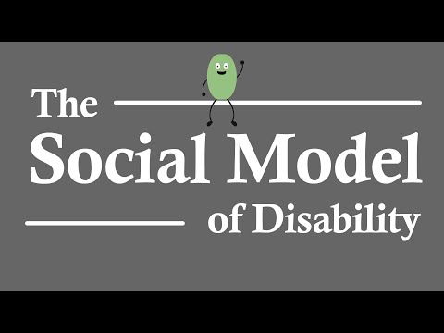
Why is the Social Model of Disability So Important?
Pam fod y Model Cymdeithasol o Anabledd Mor Bwysig?

Slide 36
Environmental Barriers Could Include:
Gallai Rhwystrau Amgylcheddol Gynnwys:
Diffyg dylunio a rhagfeddwl pensaernïol (rampiau, lifftiau, graddiannau, lle ar gyfer symudedd).
Dyluniad a chyfleusterau cyffyrddol neu acwstig gwael (ee diffyg technoleg sain).
Isadeiledd trafnidiaeth leol a dulliau trafnidiaeth gwael.
Cysyniad gweledol gwael (goleuadau, agwedd a hygyrchedd).
Diffyg technolegau cynorthwyol.
Diffyg ymgynghori ag eraill.
Oriau agor a chau.
Mynediad at wybodaeth a chymorth posibl.
Rhagdybiaethau ynghylch anghenion cyfathrebu.
Lack of architectural design and forethought (ramps, lifts, gradients, space for maneuverability).
Poor tactile or acoustic design and facilities (e.g. omission of audio technology).
Poor local transport infrastructure & modes of transportation.
Poor visual concept (lighting, aspect & accessibility).
Lack of assistive technologies.
Lack of consultation with others.
Opening & closing times.
Access to information and possible assistance.
Assumptions about communication needs.

