Slide 1
Ymarferydd Gwasanaethau Cymdeithasol
Deall damcaniaethau a modelau a'u perthynas ag ymarfer sy'n canolbwyntio ar yr unigolyn/plentyn a dulliau sy'n seiliedig ar hawliau
Social Services Practitioner
Understand theories and models and their relationship to person/child centred practice and rights based approaches
Notes:
Welsh
Cyn mynychu, mae'n ofynnol i ddysgwyr gael mynediad at gopi digidol neu gopi caled o'u Cod Ymarfer/Ymddygiad perthnasol gan gynnwys fersiwn 'i Gyflogwyr', rheoliadau RISCA a swydd ddisgrifiad, ac unrhyw ganllawiau ymarfer perthnasol eraill.
.
English
Prior to attending, learners are required to have access to a digital or hard copy of their relevant Code of Practice/Conduct including ‘for Employers’ version, RISCA regulations and job description, and any other relevant practice guidance.

Slide 2















Mae’r adnodd hwn wedi’i ddatblygu mewn partneriaeth â’r Consortiwm Ymarferwyr Gwasanaethau Cymdeithasol (SSP) ar ran Gofal Cymdeithasol Cymru. Mae’r consortiwm yn cynnwys y partneriaid canlynol:
This resource has been developed in partnership by the Social Services Practitioner (SSP) Consortium on behalf of Social Care Wales. The consortium is made up of the following partners:
Gofal Cymdeithasol Cymru a'i gynghorwyr penodedig sy'n berchen ar hawlfraint y deunyddiau hyn. Gall darparwyr dysgu, awdurdodau lleol a darparwyr gwasanaethau gofal yng Nghymru gopïo, atgynhyrchu, dosbarthu neu drefnu bod y Rhaglen Ddysgu Ymarferwyr Gwasanaethau Cymdeithasol (SSP) ar gael fel arall i unrhyw drydydd parti arall ar sail ddielw yn unig. Rhaid i unrhyw bartïon eraill sy’n dymuno copïo, atgynhyrchu, dosbarthu neu fel arall wneud y Rhaglen Ymarferwyr Gwasanaethau Cymdeithasol (SSP) ar gael i unrhyw drydydd parti arall geisio caniatâd ysgrifenedig Gofal Cymdeithasol Cymru ymlaen llaw.
The copyright to these materials rests with Social Care Wales and its appointed advisers. The Social Services Practitioner (SSP) Programme of learning may be copied, reproduced, distributed or otherwise made available to any other third party by learning providers, local authorities and care service providers in Wales on a not-for-profit basis only. Any other parties that wish to copy, reproduce, distribute or otherwise make the Social Services Practitioner (SSP) Programme available to any other third party must seek the prior written consent of Social Care Wales.

Slide 3
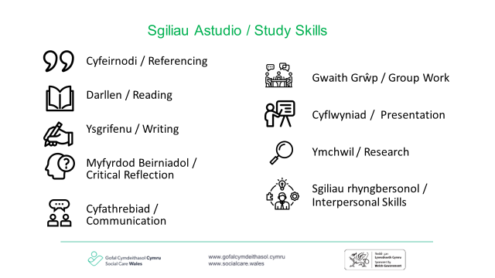

Slide 4
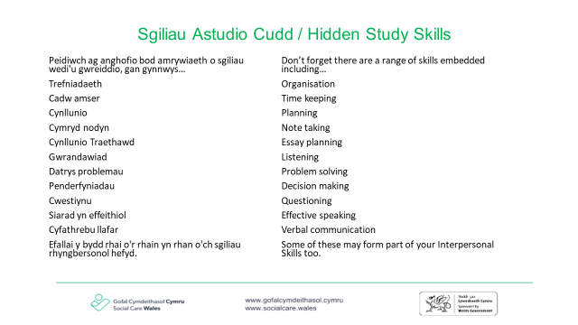

Slide 5
Deilliant Dysgu 4
Learning Outcome 4
Deall pwysigrwydd defnyddio dulliau sy'n canolbwyntio ar yr unigolyn/plentyn ac sy'n seiliedig ar hawliau
Understand the importance of using person/child centred and rights based approaches
Notes:
Welsh
Sleid yn ymwneud ag AC 4.1: Beth yw ystyr y term 'cydgynhyrchu' a sut mae hyn yn cefnogi ymarfer sy'n canolbwyntio ar yr unigolyn/plentyn a dulliau gweithredu sy'n seiliedig ar hawliau
English
Slide relating to AC 4.1: What is meant by the term ‘co-production’ and how this supports person/child centred practice and rights based approaches

Slide 6


4.1 Beth yw ystyr 'Cydgynhyrchu'?
4.1 What is meant by ‘Co-production’?
Dywed Deddf Gwasanaethau Cymdeithasol a Llesiant (Cymru) 2014:
“…ffordd o weithio lle mae ymarferwyr a phobl yn cydweithio fel partneriaid cyfartal i gynllunio a darparu gofal a chymorth”.
The Social Services & Well-Being (Wales) Act 2014 states:
“…a way of working whereby practitioners and people work together as equal partners to plan and deliver care and support”.
Notes:
Welsh
Sleid yn ymwneud ag AC 4.1: Beth yw ystyr y term 'cydgynhyrchu' a sut mae hyn yn cefnogi ymarfer sy'n canolbwyntio ar yr unigolyn/plentyn a dulliau gweithredu sy'n seiliedig ar hawliau
Ymarfer: cynnig i'r grŵp roi enghreifftiau o gydgynhyrchu ar waith. Pa fathau o weithgareddau a chymorth sy'n hyrwyddo 'cydgynhyrchu'.
English
Slide relating to AC 4.1: What is meant by the term ‘co-production’ and how this supports person/child centred practice and rights based approaches
Exercise: propose to the group to give examples of co-production in action. What types of activities and support promote ‘co-production’.

Slide 7
Enghreifftiau o gydgynhyrchu
Examples of co-production
Cynnwys yr unigolyn wrth gynllunio ei ofal a’i driniaeth.
Cefnogi unigolion i ddewis a dweud eu dweud am y gwasanaethau sydd ar gael iddynt (Darparu gwybodaeth).
Gweithio gyda gwahanol gyrff a sefydliadau sy’n cydnabod bod yr unigolyn yn bartner cyfartal (Cydraddoldeb).
Sicrhau bod grwpiau na chlywir yn aml yn cael eu cynnwys (Fforymau).
Cydnabod y gall strwythurau a chynlluniau cyflawni presennol gael eu siapio trwy gynnwys yr unigolyn (Adborth).
Involving the individual in their care and treatment planning.
Supporting individuals to choose and have a say in the services that are available to them (Providing information).
Working with different bodies and organisations that recognise that the individual is an equal partner (Equality).
Ensuring that seldom heard groups are included (Forums).
Recognise that existing structures and delivery plans can be shaped by involvement of the individual (Feedback).
Notes:
Welsh
Sleid yn ymwneud ag AC 4.1: Beth yw ystyr y term 'cydgynhyrchu' a sut mae hyn yn cefnogi ymarfer sy'n canolbwyntio ar yr unigolyn/plentyn a dulliau gweithredu sy'n seiliedig ar hawliau
English
Slide relating to AC 4.1: What is meant by the term ‘co-production’ and how this supports person/child centred practice and rights based approaches

Slide 8
Cefnogi cyfranogiad
Supporting participation
Notes:
Welsh
Sleid yn ymwneud ag AC 4.2: Pam ei bod yn bwysig bod unigolion a gofalwyr yn cael eu cefnogi i: • cael llais a rheolaeth dros eu bywydau • mynegi a chyflawni'r hyn sy'n bwysig iddynt • cymryd rhan mewn ystod werthfawr o weithgareddau ystyrlon sy'n bwysig iddynt • cynnal a datblygu perthnasoedd dwyochrog cadarnhaol • cymryd rhan yn eu cymunedau • byw bywydau llawn a gwerthfawr • rheoli cyfyng-gyngor sy'n codi wrth gydbwyso eu hawliau i fentro â'u diogelwch a'u llesiant
Ar ôl gwylio'r fideo, pam ei bod yn bwysig bod unigolion a gofalwyr yn cael eu cefnogi i:
• cael llais a rheolaeth dros eu bywydau
• mynegi a chyflawni'r hyn sy'n bwysig iddynt
• cymryd rhan mewn ystod werthfawr o weithgareddau ystyrlon sy'n bwysig iddynt.
• cynnal a datblygu perthnasoedd dwyochrog cadarnhaol
• cymryd rhan yn eu cymunedau
• byw bywydau llawn a gwerthfawr
• rheoli cyfyng-gyngor sy'n codi wrth gydbwyso eu hawliau i gymryd risgiau â'u
diogelwch a'u llesiant
English
Slide relating to AC 4.2: Why it is important that individuals and carers are supported to: • have voice and control over their lives • express and achieve what is important to them • participate in a valued range of meaningful activities that are important to them • maintain and develop positive reciprocal relationships • participate in their communities • lead full and valued lives • manage dilemmas that arise when balancing their rights to take risks with their safety and well-being
After watching the video, why is it important that individuals and carers are supported to:
• have voice and control over their lives
• express and achieve what is important to them
• participate in a valued range of meaningful activities that are important to
them
• maintain and develop positive reciprocal relationships
• participate in their communities
• lead full and valued lives
• manage dilemmas that arise when balancing their rights to take risks with
their safety and well-being

Slide 9


4.3 Beth yw ystyr 'Cydsyniad'?
4.3 What is meant by ‘Consent’?
Cydsyniad yw rhoi caniatâd i wneud rhywbeth.
Mewn lleoliadau iechyd a gofal cymdeithasol, mae fel arfer yn golygu bod yr unigolyn yn cydsynio i gymryd rhan mewn gweithgaredd neu i dderbyn rhyw fath o ofal neu driniaeth - gallai hyn olygu cytuno i gael cawod neu fath - cytuno i gymryd meddyginiaeth, yn ogystal â chytuno i rannu eu manylion ag eraill.
Consent is giving permission to do something.
In health and social care settings, it usually means that the individual gives consent to take part in an activity or to accept some kind of care or treatment - this could be agreeing to have a shower or a bath - agreeing to take medication, as well as agreeing to have their details shared with others.
Notes:
Welsh
Sleid yn ymwneud ag AC 4.3: Beth a olygir wrth 'cydsyniad'; amgylchiadau pan fydd yn rhaid cyflawni hyn ac amgylchiadau pan ellir ei ddiystyru
English
Slide relating to AC 4.3: What is meant by ‘consent’; circumstances when this must be attained and circumstances when it can be over-ridden

Slide 10
Cydsyniad dilys
Consent to be valid
Er mwyn i gydsyniad fod yn ddilys, rhaid iddo fod yn wirfoddol a gwybodus, a rhaid i'r sawl sy'n cydsynio fod â'r galluedd i wneud y penderfyniad.
Os nad oes gan berson y galluedd i wneud penderfyniad am ei driniaeth ac nad yw wedi penodi atwrneiaeth arhosol (LPA), gall y gweithwyr gofal iechyd proffesiynol sy'n ei drin fynd ymlaen a rhoi triniaeth os ydynt yn credu ei fod er pennaf les y person.
Ond rhaid i glinigwyr gymryd camau rhesymol i drafod y sefyllfa gyda ffrindiau neu berthnasau'r person cyn gwneud y penderfyniadau hyn.
For consent to be valid, it must be voluntary and informed, and the person consenting must have the capacity to make the decision.
If a person does not have the capacity to make a decision about their treatment and they have not appointed a lasting power of attorney (LPA), the healthcare professionals treating them can go ahead and give treatment if they believe it's in the person's best interests.
But clinicians must take reasonable steps to discuss the situation with the person's friends or relatives before making these decisions.
Notes:
Welsh
Sleid yn ymwneud ag AC 4.3: Beth a olygir wrth 'cydsyniad'; amgylchiadau pan fydd yn rhaid cyflawni hyn ac amgylchiadau pan ellir ei ddiystyru
English
Slide relating to AC 4.3: What is meant by ‘consent’; circumstances when this must be attained and circumstances when it can be over-ridden

Slide 11
Cydsyniad dilys
Consent to be valid
Gwirfoddol (y penderfyniad i gydsynio ai peidio).
Gwybodus (Darparu gwybodaeth).
Galluedd (y gallu i ddeall y penderfyniad i'w wneud).
* Os oes gan oedolyn y galluedd i wneud penderfyniad gwirfoddol a gwybodus i gydsynio i driniaeth benodol neu ei gwrthod, rhaid parchu ei benderfyniad.
* Mae hyn yn dal yn wir hyd yn oed pe byddai gwrthod triniaeth yn arwain at ei farwolaeth, neu farwolaeth ei phlentyn heb ei eni.
Voluntary (the decision to consent or not).
Informed (Providing information).
Capacity (ability to understand the decision to be made).
* If an adult has the capacity to make a voluntary and informed decision to consent to or refuse a particular treatment, their decision must be respected.
* This is still the case even if refusing treatment would result in their death, or the death of their unborn child.
Notes:
Welsh
Sleid yn ymwneud ag AC 4.3: Beth a olygir wrth 'cydsyniad'; amgylchiadau pan fydd yn rhaid cyflawni hyn ac amgylchiadau pan ellir ei ddiystyru
Gwirfoddol: rhaid i'r penderfyniad naill ai i gydsynio neu i beidio â chydsynio i driniaeth gael ei wneud gan y person, ac ni ddylai gael ei ddylanwadu gan bwysau gan staff meddygol, ffrindiau neu deulu.
Gwybodus: rhaid rhoi'r holl wybodaeth i'r person am yr hyn y mae'r driniaeth yn ei olygu, gan gynnwys y manteision a'r risgiau, a oes triniaethau amgen rhesymol, a beth fydd yn digwydd os na fydd y driniaeth yn mynd rhagddi.
Galluedd: rhaid i’r person allu rhoi cydsyniad, sy’n golygu ei fod yn deall y wybodaeth a roddir iddo ac yn gallu ei defnyddio i wneud penderfyniad gwybodus.
Cydsyniad gan blant a phobl ifanc
Os ydynt yn gallu, mae cydsyniad yn cael ei roi fel arfer gan y cleifion eu hunain.
Ond efallai y bydd angen i rywun â chyfrifoldeb rhiant roi cydsyniad i blentyn hyd at 16 oed gael triniaeth.
English
Slide relating to AC 4.3: What is meant by ‘consent’; circumstances when this must be attained and circumstances when it can be over-ridden
Voluntary: the decision to either consent or not to consent to treatment must be made by the person, and must not be influenced by pressure from medical staff, friends or family.
Informed: the person must be given all of the information about what the treatment involves, including the benefits and risks, whether there are reasonable alternative treatments, and what will happen if treatment does not go ahead.
Capacity: the person must be capable of giving consent, which means they understand the information given to them and can use it to make an informed decision.
Consent from children and young people
If they're able to, consent is usually given by patients themselves.
But someone with parental responsibility may need to give consent for a child up to the age of 16 to have treatment.

Slide 12
Pan nad oes angen cydsyniad
When consent is not needed
Efallai na fydd angen cael cydsyniad os yw person:
angen triniaeth frys i achub ei fywyd, ond maent yn analluog (er enghraifft, maent yn anymwybodol).
angen triniaeth frys ychwanegol ar unwaith yn ystod llawdriniaeth.
â chyflwr iechyd meddwl difrifol (heb y galluedd i gydsynio i drin eu hiechyd meddwl (o dan Ddeddf Iechyd Meddwl 1983).
angen triniaeth ysbyty ar gyfer cyflwr iechyd meddwl difrifol, ond wedi hunan-niweidio neu wedi ceisio lladd ei hun tra’n gymwys ac yn gwrthod triniaeth (o dan Ddeddf Iechyd Meddwl 1983)
yn ddifrifol wael ac yn byw mewn amodau anhylan
It may not be necessary to obtain consent if a person:
needs emergency treatment to save their life, but they're incapacitated (for example, they're unconscious).
immediately needs an additional emergency procedure during an operation.
with a severe mental health condition (lacks the capacity to consent to the treatment of their mental health (under the Mental Health Act 1983).
needs hospital treatment for a severe mental health condition, but self-harmed or attempted suicide while competent and is refusing treatment (under the Mental Health Act 1983)
is severely ill and living in unhygienic conditions
Notes:
Welsh
Sleid yn ymwneud ag AC 4.3: Beth a olygir wrth 'cydsyniad'; amgylchiadau pan fydd yn rhaid cyflawni hyn ac amgylchiadau pan ellir ei ddiystyru
English
Slide relating to AC 4.3: What is meant by ‘consent’; circumstances when this must be attained and circumstances when it can be over-ridden

Slide 13
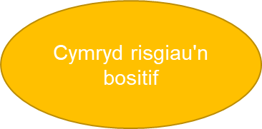


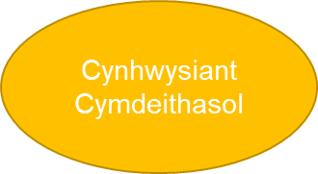
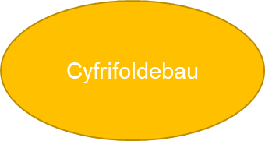


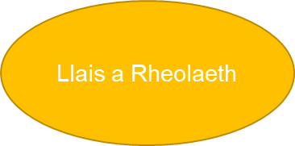
Positive risk- taking
Social Inclusion
Responsibilities
Voice & Control
Notes:
English
Slide relating to AC 4.4: The interrelationship between positive risk taking and responsibilities, voice and control, and social inclusion
“Positive risk” is integral to the wider agendas of: - empowering and promoting the rights of individuals- transforming social care from care management to a relational and strengths-based approach, with the healthcare worker as facilitator, rather than fixer and protector.
• Positive risk taking is supported by the Social Services and Well-being (Wales) Act 2014, the Mental Capacity Act 2005, the Human Rights Act 1998 and the Equality Act 2010; however, risk averse practice, attitudes, systems and culture do often restrict an individuals’ quality of life.
a positive risk-taking approach, decision-making should be:
Balanced, recognising the potential for benefit as well as the risk of harm, and considering the possible emotional, psychological and social impact of each option, as well as the physical.
Defensible, that is well-founded, justifiable and recorded proportionately; not defensive, that is driven by the need to protect ourselves and our agencies.
Collaborative, with people who use services, their families and other professionals, using all available resources to achieve the outcomes that matter most to people.
Welsh
Sleid yn ymwneud ag AC 4.4: Y gydberthynas rhwng cymryd risgiau cadarnhaol a chyfrifoldebau, llais a rheolaeth, a chynhwysiant cymdeithasol
Mae “risg cadarnhaol” yn rhan annatod o’r agendâu ehangach o: - grymuso a hyrwyddo hawliau unigolion - trawsnewid gofal cymdeithasol o reoli gofal i ddull perthynol sy'n seiliedig ar gryfderau, gyda'r gweithiwr gofal iechyd yn hwylusydd, yn hytrach nag yn atgyweiriwr ac yn amddiffynnydd.
• Cefnogir cymryd risgiau cadarnhaol gan Ddeddf Gwasanaethau Cymdeithasol a Llesiant (Cymru) 2014, Deddf Galluedd Meddyliol 2005, Deddf Hawliau Dynol 1998 a Deddf Cydraddoldeb 2010; fodd bynnag, mae arferion, agweddau, systemau a diwylliant gwrth risg yn aml yn cyfyngu ar ansawdd bywyd unigolion.
dull cadarnhaol o gymryd risgiau, dylai’r broses o wneud penderfyniadau fod yn:
Cytbwys, gan gydnabod y potensial ar gyfer budd yn ogystal â'r risg o niwed, ac ystyried effaith emosiynol, seicolegol a chymdeithasol posibl pob opsiwn, yn ogystal â'r corfforol.
Amddiffynadwy, sef â sail dda, y gellir ei chyfiawnhau a'i gofnodi'n gymesur; ddim yn amddiffynnol, sy'n cael ei yrru gan yr angen i amddiffyn ein hunain a'n hasiantaethau.
Cydweithredol, gyda phobl sy’n defnyddio gwasanaethau, eu teuluoedd a gweithwyr proffesiynol eraill, gan ddefnyddio’r holl adnoddau sydd ar gael i gyflawni’r canlyniadau sydd bwysicaf i bobl.
English
Slide relating to AC 4.4: The interrelationship between positive risk taking and responsibilities, voice and control, and social inclusion
“Positive risk” is integral to the wider agendas of: - empowering and promoting the rights of individuals- transforming social care from care management to a relational and strengths-based approach, with the healthcare worker as facilitator, rather than fixer and protector.
• Positive risk taking is supported by the Social Services and Well-being (Wales) Act 2014, the Mental Capacity Act 2005, the Human Rights Act 1998 and the Equality Act 2010; however, risk averse practice, attitudes, systems and culture do often restrict an individuals’ quality of life.
a positive risk-taking approach, decision-making should be:
Balanced, recognising the potential for benefit as well as the risk of harm, and considering the possible emotional, psychological and social impact of each option, as well as the physical.
Defensible, that is well-founded, justifiable and recorded proportionately; not defensive, that is driven by the need to protect ourselves and our agencies.
Collaborative, with people who use services, their families and other professionals, using all available resources to achieve the outcomes that matter most to people.

Slide 14
4.4 -4.6 Egwyddorion gweithio gyda risg
4.4-4.6 Principles of working with risk
Management of risk should promote the independence and social inclusion of individuals at all times.
Recognise that risks change as circumstances change and should be reviewed on a regular basis.
Accept that risk can be minimised, but is unlikely to be eliminated.
Information used and recorded will be as comprehensive and accurate as possible.
Identification of risk carries a duty to do something about it, i.e.- risk management.
Involvement of practitioners from a range of services and organisations helps to improve the quality of risk assessments, risk management and decision-making.
Dylai rheoli risg hybu annibyniaeth a chynhwysiant cymdeithasol unigolion bob amser.
Cydnabod bod risgiau'n newid wrth i amgylchiadau newid a dylid eu hadolygu'n rheolaidd.
Derbyn y gellir lleihau risg, ond ei bod yn annhebygol o gael ei dileu.
Bydd y wybodaeth a ddefnyddir ac a gofnodir mor gynhwysfawr a chywir â phosibl.
Mae nodi risg yn golygu dyletswydd i wneud rhywbeth yn ei gylch, hy rheoli risg.
Mae cynnwys ymarferwyr o ystod o wasanaethau a sefydliadau yn helpu i wella ansawdd asesiadau risg, rheoli risg a gwneud penderfyniadau.
Notes:
Welsh
Sleid yn ymwneud ag AC 4.4: Y gydberthynas rhwng cymryd risgiau cadarnhaol a chyfrifoldebau, llais a rheolaeth, a chynhwysiant cymdeithasol
English
Slide relating to AC 4.4: The interrelationship between positive risk taking and responsibilities, voice and control, and social inclusion

Slide 15
Egwyddorion gweithio gyda risg
Principles of working with risk
Penderfyniadau 'amddiffynadwy' yw'r rhai sy'n seiliedig ar resymu clir, gan roi sylw dyledus i ddeddfwriaeth, polisïau a gweithdrefnau priodol. Maent yn dangos cadw cofnodion clir a manwl gywir a, lle bo modd, caniatâd wedi'i lofnodi.
Dylai cymryd risg gynnwys pawb yn cydweithio i gyflawni canlyniadau cadarnhaol.
Mae cyfrinachedd yn hawl, ond nid yn hawl absoliwt a gellir ei dorri mewn amgylchiadau eithriadol pan ystyrir bod pobl mewn perygl difrifol o niwed neu ei fod er budd y cyhoedd.
Lle mae ymarferwyr ym maes iechyd a gofal cymdeithasol wedi dilyn canllawiau ymarfer, bydd eu hamddiffyniad rhag atebolrwydd a chymorth gan reolwyr yn cael ei wella
‘Defensible’ decisions are those based on clear reasoning, with due regard to appropriate legislation, policies and procedures. They demonstrate clear and precise record keeping and, where possible, signed consent.
Risk-taking should involve everybody working together to achieve positive outcomes.
Confidentiality is a right, but not an absolute right and may be breached in exceptional circumstances when people are deemed to be at serious risk of harm or it is in the public interest.
Where practitioners in health and social care have followed practice guidelines, their protection from liability and support from managers will be enhanced.
Notes:
Welsh
Sleid yn ymwneud ag AC 4.4: Y gydberthynas rhwng cymryd risgiau cadarnhaol a chyfrifoldebau, llais a rheolaeth, a chynhwysiant cymdeithasol
English
Slide relating to AC 4.4: The interrelationship between positive risk taking and responsibilities, voice and control, and social inclusion

Slide 16
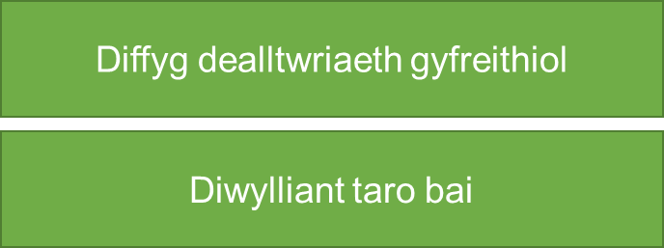





Rhwystrau i gymryd risgiau cadarnhaol mewn gwasanaethau
Barriers to positive risk-taking in services
Lack of legal understanding
Blame culture
A deficit-based view of disabled people
Managerial processes and regulation
Lack of trust of professional judgement
Safeguarding concerns
Notes:
Welsh
Sleid yn ymwneud ag AC 4.4: Y gydberthynas rhwng cymryd risgiau cadarnhaol a chyfrifoldebau, llais a rheolaeth, a chynhwysiant cymdeithasol
Diffyg dealltwriaeth gyfreithiol: diffyg ymwybyddiaeth o’r ddeddfwriaeth sy’n cefnogi cymryd risgiau cadarnhaol, gan gydweithwyr, y cyhoedd ac, yn benodol, gweithwyr iechyd proffesiynol. Megis mewn perthynas â Deddf Galluedd Meddyliol 2005.
Diwylliant taro bai: o yr ofn sydd gan lawer o weithwyr gofal cymdeithasol proffesiynol o gael eu beio gan reolwyr, cydweithwyr a theuluoedd os aiff pethau o chwith.
Golwg ar sail diffyg ar bobl anabl: mae ymarfer gwrth risg wedi ffynnu o fewn diwylliant proffesiynol (a chymdeithasol ehangach) sydd â thuedd i geisio “trwsio” neu amddiffyn pobl sy’n cael eu hystyried yn “agored i niwed” (Charlton, 1998) neu sydd wedi’u gweld “mewn perygl” neu'n “ffynhonnell risg” (Faulkner, 2012).
Prosesau rheoli a rheoleiddio: mae dulliau posibl o reoleiddio ac arolygu ledled y DU yn tueddu i ganolbwyntio ar gwblhau gwaith papur, yn hytrach nag ar brofiad bywyd pobl. Mae hyn yn arwain at brosesau a biwrocratiaeth yn tra-arglwyddiaethu ar ddarpariaeth gwasanaethau, ac yn cyfyngu ar y cyfleoedd sydd gan weithwyr proffesiynol i feithrin perthnasoedd â phobl a’u teuluoedd a deall yr hyn sy’n bwysig iddynt (Warmington et al, 2014).
Diffyg ymddiriedaeth mewn barn broffesiynol: ymagwedd o’r brig i lawr at reoli perfformiad sefydliadol mewn gofal cymdeithasol nad yw’n caniatáu ar gyfer gwneud penderfyniadau cyd-destunol yn y rheng flaen (Patterson et al, 2011). Mae ymarfer yn aml wedi’i anelu at ddiogelu sefydliadau rhag risgiau ariannol ac enw da posibl (Carr, 2011). Mae hyn wedi arwain at golli hyder mewn barn broffesiynol (Furedi, 2011).
Pryderon diogelu: y ffordd y gall dulliau diogelu sy’n atal cysylltiadau emosiynol rhwng pobl sy’n defnyddio gwasanaethau a staff, oherwydd y gellid eu dehongli fel meithrin perthynas amhriodol ar gyfer cam-drin, rwystro model gofal cymdeithasol mwy hyblyg sy’n seiliedig ar berthynas.
English
Slide relating to AC 4.4: The interrelationship between positive risk taking and responsibilities, voice and control, and social inclusion
Lack of legal understanding: lack of awareness of the legislation that supports positive-risk taking, by colleagues, the general public and, in particular, health professionals. Such as in relation to the Mental Capacity Act 2005.
Blame culture: o the fear that many social care professionals have of being blamed by managers, colleagues and families if things “go wrong”.
A deficit-based view of disabled people: risk averse practice has flourished within a professional (and wider social) culture which has a tendency to try and “fix” or protect people who are seen as “vulnerable” (Charlton, 1998) or has seen them as either “at risk” or a “source of risk” (Faulkner, 2012).
Managerial processes and regulation: possible approaches to regulation and inspection across the UK tend to focus on the completion of paperwork, rather than on people’s lived experience. This results in processes and bureaucracy dominating service provision, and restricting the opportunities professionals have to build relationships with people and their families and understand what matters to them (Warmington et al, 2014).
Lack of trust of professional judgement: f a topdown approach to organisational performance management in social care that does not allow for contextual decision-making at the front line (Patterson et al, 2011). Practice is often geared towards protecting organisations from potential financial and reputational risks (Carr, 2011). This has led to a loss of confidence in professional judgement (Furedi, 2011).
Safeguarding concerns: the way in which approaches to safeguarding that discourage emotional connections between people using services and staff, as they could be interpreted as grooming for abuse, can get in the way of a more flexible, relationship-based model of social care.

Slide 17
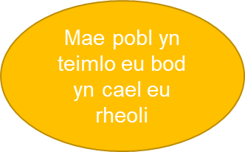
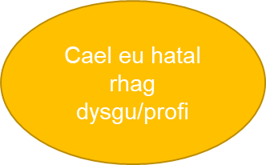
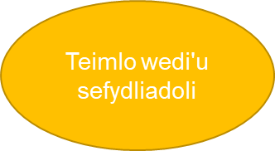
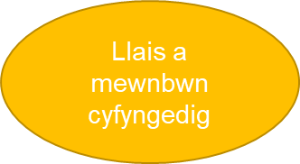
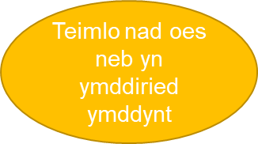
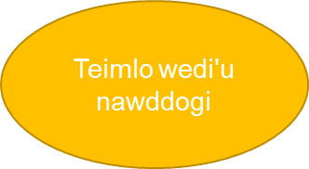
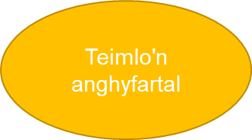
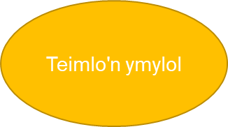
Canlyniadau atal cymryd risgiau
Consequences of preventing risk-taking
People feel controlled
Are prevented from learning/ experiencing
Feel instutionalised
Limited voice & input
Feel untrusted
Feel patronsied
Feel unequal
Feel marginalized
Notes:
Welsh
Sleid yn ymwneud ag AC 4.4 a 4.5: Sleid yn ymwneud ag AC 4.4: Y gydberthynas rhwng cymryd risgiau cadarnhaol a chyfrifoldebau, llais a rheolaeth, a chynhwysiant cymdeithasol. AC 4.5. Pwysigrwydd cymryd risgiau ym mywyd beunyddiol unigolion
Ymarfer: pa fathau eraill o ganlyniadau negyddol y gallwch chi feddwl amdanynt?
English
Slide relating to AC 4.4 & 4.5: Slide relating to AC 4.4: The interrelationship between positive risk taking and responsibilities, voice and control, and social inclusion. AC 4.5. The importance of risk taking in everyday life for individuals
Exercise: what other types of negative outcomes can you think of?

Slide 18
Atal pobl rhag cymryd risgiau
Preventing people from taking risks
Gall gofal sy’n canolbwyntio ar dasgau ac sy'n anhyblyg fod yn rhwystr i gymryd risgiau cadarnhaol, gan ei fod yn lleihau’r cyfle i feithrin perthynas wirioneddol. Ni ddylai gweithgarwch, hamdden, dysgu a rhyngweithio cymdeithasol ystyrlon fod yn bethau moethus ychwanegol, ond yn hytrach yn hawliau dynol sylfaenol (Morgan & Andrews, 2016).
Mae Morgan ac Andrews (2016) yn dadlau y dylid gosod hawliau a dinasyddiaeth pobl y gallai fod angen gofal a chymorth arnynt wrth wraidd fframwaith ar gyfer cymryd risgiau cadarnhaol. Ar hyn o bryd: “Nid yw ymarferwyr yn aml yn meddwl am hawliau, felly maent yn dod yn haws eu torri”.
Care that is task-focused and inflexible can act as a barrier to positive risk-taking, since it reduces the opportunity for genuine relationship-building. Meaningful activity, leisure, learning and social interaction [should not be] luxury extras, rather- fundamental human rights (Morgan & Andrews, 2016).
Morgan and Andrews (2016) argue that the rights and citizenship of people who may need care and support should be placed at the heart of a framework for positive risk-taking. At present: “Practitioners do not often think in terms of rights, so they become more easily violated”.
Notes:
Welsh
Sleid yn ymwneud ag AC 4.4 a 4.5: Sleid yn ymwneud ag AC 4.4: Y gydberthynas rhwng cymryd risgiau cadarnhaol a chyfrifoldebau, llais a rheolaeth, a chynhwysiant cymdeithasol. AC 4.5 Pwysigrwydd cymryd risgiau ym mywyd beunyddiol unigolion
English
Slide relating to AC 4.4 & 4.5: Slide relating to AC 4.4: The interrelationship between positive risk taking and responsibilities, voice and control, and social inclusion. AC 4.5The importance of risk taking in everyday life for individuals

Slide 19
Gwneud penderfyniadau ar y cyd ynghylch risg
Shared decision-making around risk
Mae Morgan a Williamson (2014) yn dadlau ein bod yn fwy tebygol o fod yn amharod i gymryd risg yn ein hymarfer lle rydym yn gwneud penderfyniadau ar ein pen ein hunain. Mewn cyferbyniad, gallai gwneud penderfyniadau ar y cyd, sy’n cynnwys y person, ei deulu, cefnogwyr cymunedol a grŵp aml-asiantaeth o weithwyr proffesiynol, fod yn fwy cefnogol i gymryd risgiau cadarnhaol (Clarke et al, 2011; Manthorpe a Moriarty, 2010; Andrews et al, 2015).
Morgan and Williamson (2014) argue that we are more likely to be risk averse in our practice where we are making decisions on our own. In contrast, shared decision-making, which involves the person, their family, community supporters and a multi-agency group of professionals, may be more supportive of positive risk-taking (Clarke et al, 2011; Manthorpe and Moriarty, 2010; Andrews et al, 2015).
Notes:
Welsh
Sleid yn ymwneud ag AC 4.4 a 4.5: Sleid yn ymwneud ag AC 4.4: Y gydberthynas rhwng cymryd risgiau cadarnhaol a chyfrifoldebau, llais a rheolaeth, a chynhwysiant cymdeithasol. AC 4.5 Pwysigrwydd cymryd risgiau ym mywyd beunyddiol unigolion
English
Slide relating to AC 4.4 & 4.5: Slide relating to AC 4.4: The interrelationship between positive risk taking and responsibilities, voice and control, and social inclusion. AC 4.5The importance of risk taking in everyday life for individuals

Slide 20
Gwneud penderfyniadau ar y cyd ynghylch risg
Shared decision-making around risk
Roedd hyrwyddo gwneud penderfyniadau am risg sy’n gydweithredol, yn aml-asiantaeth ac wedi’i gydgynhyrchu gyda’r unigolyn a’i deulu yn uchel ar agenda’r cyfranogwyr. Yn ddelfrydol, dylai pob parti allu mynegi eu gobeithion a'u hofnau mewn amgylchedd diogel lle gall pobl herio rhagdybiaethau ei gilydd a rhannu atebion posibl.
Promoting decision-making about risk that is collaborative, multi-agency and co-produced with the individual and their family was high on the agenda of participants. Ideally all parties should be able to express their hopes and fears in a safe environment where people can challenge each other’s assumptions and share possible solutions.
Notes:
Welsh
Sleid yn ymwneud ag AC 4.4 a 4.5: Sleid yn ymwneud ag AC 4.4: Y gydberthynas rhwng cymryd risgiau cadarnhaol a chyfrifoldebau, llais a rheolaeth, a chynhwysiant cymdeithasol. AC 4.5 Pwysigrwydd cymryd risgiau ym mywyd beunyddiol unigolion AC 4.6 Effaith unigolion yn cael eu digalonni neu eu hatal rhag cymryd risgiau
Cyfeiriad: Gofal Cymdeithasol Cymru: Risg gadarnhaol a gwneud penderfyniadau ar y cyd, Imogen Blood a Shani Wardle.
English
Slide relating to AC 4.4 & 4.5: Slide relating to AC 4.4: The interrelationship between positive risk taking and responsibilities, voice and control, and social inclusion. AC 4.5 The importance of risk taking in everyday life for individuals. AC 4.6 The impact of individuals having been discouraged or prevented from taking risks
Reference. Social Care Wales: Positive risk and shared decision-making, Imogen Blood and Shani Wardle.

