Slide 1
Uned 443 - Deall ffactorau sy'n cyfrannu at angen am ofal a chymorth ar unigolion a/neu ofalwyr
Unit 443 - Understanding factors that contribute to individuals and/or carers needing care and support
Deilliant Dysgu 3: Deall dementia
Learning outcome 6: Understand dementia

Slide 2
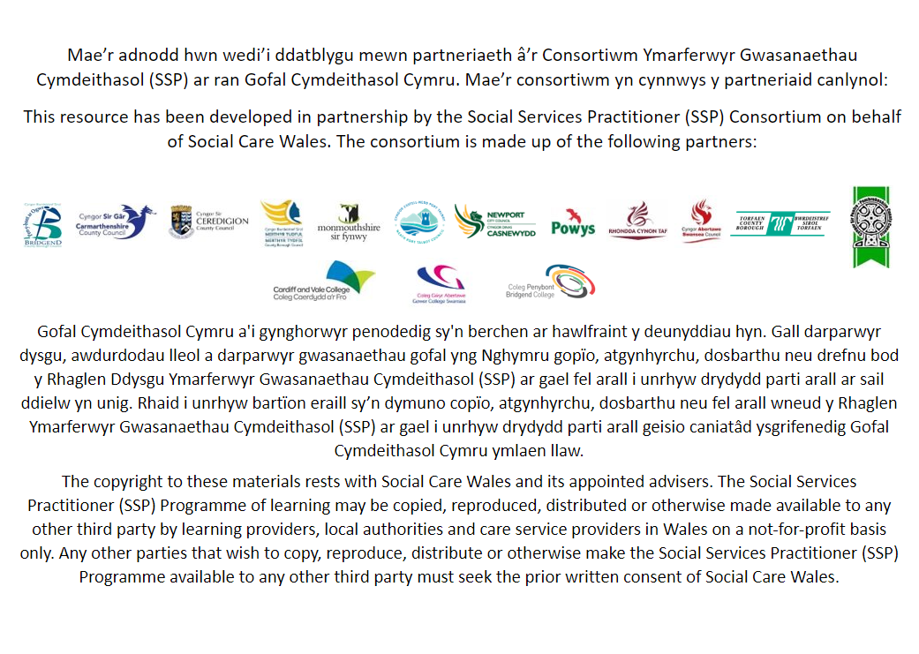

Slide 3
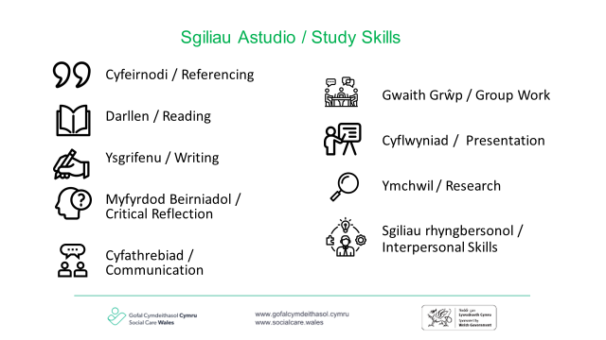

Slide 4
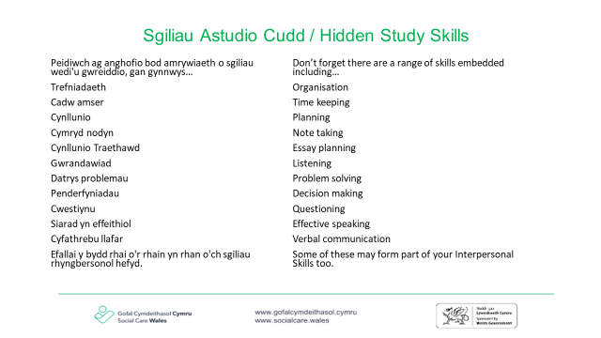

Slide 5
Meini prawf asesu:
Rydych yn deall:
Assessment criteria:
You understand:
6.1 Mathau o ddementia, eu hachosion posibl a’r ystod o effeithiau gwahanol sy’n gysylltiedig â phrognosis unigolyn, ei alluoedd ac iechyd a lles cyffredinol
6.2 Gwahaniaethau a chyffredinolrwydd rhwng y prif fathau o ddementia
6.3 Nam ar y cof a'i effaith ar ddementia
6.4 Sut y gall rhai mathau o ddementia gael effaith dros dro neu barhaol ar alluoedd corfforol a lles
6.5 Symptomau seicotig cyffredin a all ddod i’r amlwg weithiau o ganlyniad i fathau o ddementia
6.6 Sut y gall dementia guddio materion iechyd sylfaenol
6.7 Sut i liniaru’r ffactorau risg cynyddol sy’n gysylltiedig â chynnal lles corfforol a meysydd gofal corfforol
6.8 Yr ystod o wasanaethau, asiantaethau a gweithwyr proffesiynol sy'n darparu cymorth i unigolion sy'n byw gyda dementia
6.9 Modelau a dulliau y gellir eu defnyddio i gefnogi cyfathrebu ac ymgysylltu effeithiol ag unigolion sy'n byw gyda dementia
6.1 Types of dementia, their potential causes and the range of different impacts associated with an individual’s prognosis, their abilities and general health and well-being
6.2 Differences and commonalities between the major types of dementia
6.3 Memory impairment and its impact on dementia
6.4 How some types of dementia can have a transient or permanent impact on physical abilities and well-being
6.5 Common psychotic symptoms that may sometimes manifest as a result of types of dementia
6.6 How dementia can mask underlying health issues
6.7 How to mitigate increasing risk factors associated with maintaining physical well-being and areas of physical care
6.8 The range of services, agencies and professionals which provide support for individuals living with dementia
6.9 Models and approaches that can be used to support effective communication and engagement with individuals living with dementia

Slide 6


6.1 Mathau o ddementia, eu hachosion posibl a’r ystod o effeithiau gwahanol sy’n gysylltiedig â phrognosis unigolyn, ei alluoedd ac iechyd a lles cyffredinol
6.1 Types of dementia, their potential causes and the range of different impacts associated with an individual’s prognosis, their abilities and general health and well-being
Beth yw symptomau dementia?
What are the symptoms of dementia?
Notes:
For guidance please refer to https://www.alzheimers.org.uk/about-dementia/symptoms-and-diagnosis/dementia-symptoms

Slide 7
6.5 Symptomau seicotig cyffredin a all ddod i’r amlwg weithiau o ganlyniad i fathau o ddementia
6.5 Common psychotic symptoms that may sometimes manifest as a result of types of dementia
Mae rhai symptomau seicotig a all ddod i’r amlwg o ganlyniad i fathau o ddementia yn cynnwys:
Rhithweledigaethau
Rhithdybiau
Some psychotic symptoms that can manifest as a result of types of dementia include:
Hallucinations
Delusions
Notes:
Welsh:
Mae rhithweledigaethau yn brofiadau fel gweld, clywed, teimlo, arogli neu flasu pethau nad ydynt yn real. Maent yn fwy cyffredin ymhlith pobl â dementia na'r rhai heb y cyflwr; mae pobl â dementia gyda Lewy Bodies yn aml yn profi rhithwelediadau gweledol, yn nodweddiadol anifeiliaid a phlant bach. Mae’n bwysig sylweddoli bod y profiad yn un real i’r unigolyn ac yn gallu achosi trallod. Gallwn dybio bod person yn cael rhithwelediad, pan mewn gwirionedd mae wedi cam-nodi rhywbeth yn ei amgylchedd.
Disgrifir rhithdybiau fel “credoau sefydlog, ffug”; mae person yn credu bod rhywbeth yn wir. Enghraifft o hyn yw bod y cymdogion yn ceisio eu gwenwyno, neu fod eu partner yn anffyddlon. Yn yr un modd â rhithweledigaethau, mae'n bwysig bod gwybodaeth yn cael ei gwirio, gan y gallai fod yn gamddehongliad o ddigwyddiad yn hytrach na rhithdybiad.
English:
Hallucinations are experiences such as seeing, hearing, feeling, smelling or tasting things that are not real. They are more common in people with dementia than those without; people with dementia with Lewy Bodies often experience visual hallucinations, typically animals and small children. It is important to realise that the experience is real to the individual and can cause distress. We may assume a person is hallucinating, when in fact they have misidentified something in their environment.
Delusions are described as “fixed, false beliefs”; a person believes something to be true. An example of this may be that the neighbours are trying to poison them, or their partner is being unfaithful. As with hallucinations, it is important that information is checked out, as it may be a misinterpretation of an event as opposed to a delusion.

Slide 8

6.3 Nam ar y cof a'i effaith ar ddementia
6.3 Memory impairment and its impact on dementia
Video
Video
Notes:
Welsh:
Nam ar y cof yw un o'r arwyddion cyntaf, mwyaf amlwg o ddementia. Bydd teulu a ffrindiau yn dechrau sylwi ar yr arwyddion, a gall yr unigolyn ei hun hefyd ddod yn ymwybodol o'u hanghofrwydd cynyddol. Gallai hyn fod yn rhywbeth maen nhw newydd ei wneud, fel beth maen nhw wedi’i gael i frecwast, anghofio mynd i apwyntiad ysbyty neu anghofio sut i wneud pethau fel sut i yrru car neu gofio enwau ac ati.
Gall nam ar y cof gael effaith enfawr ar allu'r unigolyn i fyw bob dydd. Gall mynd i’r siop ac anghofio’r hyn sydd ei angen arnynt neu gael trafferth gyda’r geiriau cywir am eitemau arwain at rwystredigaeth i’r unigolyn, a allai gael effaith ar ei iechyd emosiynol. Efallai y byddant yn anghofio pen-blwydd neu ben-blwydd anwylyd, a allai greu gwrthdaro o fewn y teulu, yn enwedig yn ystod cyfnodau cynharach dementia pan nad ydynt efallai wedi cael diagnosis.
Nam ar y cof: arwyddocâd cof tymor byr wrth gofrestru gwybodaeth a’r 3 phrif gategori o gof hirdymor Cof semantig (galluogi cofio ffeithiau), Cof episodig (cofio digwyddiadau a phrofiadau ac emosiynau) a Cof gweithdrefnol (cof ymhlyg yn gysylltiedig â swyddogaeth echddygol fel llofnodi ein henw, gyrru car ac ati.)
English:
Memory impairment is one of the first, most apparent signs of dementia. Family and friends will start to notice the signs, and the individual themselves might also become aware of their increased forgetfulness. This might be something they have just done, such as what they have had for breakfast, forgetting to attend a hospital appointment or forgetting how to do things like how to drive a car or remembering names etc.
Memory impairment can have a huge impact on the individual’s ability to go about their daily living. Going to the shop and forgetting what they need or struggling with the right words for items can lead to frustration for the individual, which could have an effect on their emotional health. They may forget a birthday or anniversary of a loved one, which could create conflict within the family, particularly during the earlier stages of dementia when they may not have been diagnosed.
Memory impairment: significance of short term memory in registering information and the 3 main categories of long term memory Semantic memory (enabling the recall of facts), Episodic memory (recall of events and experiences and emotions) and Procedural memory (implicit memory linked to motor function such as signing our name, driving a car etc.)

Slide 9

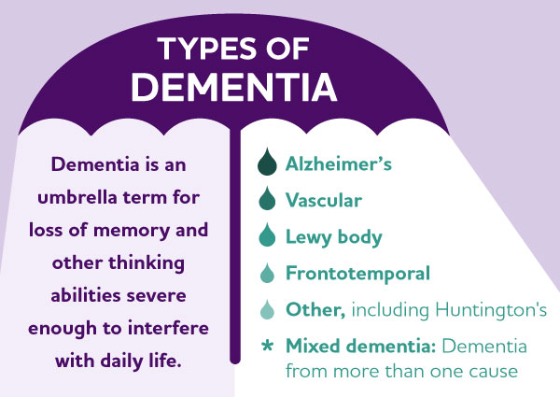
6.2 Gwahaniaethau a chyffredinolrwydd rhwng y prif fathau o ddementia
6.2 Differences and commonalities between the major types of dementia
Defnyddio adnoddau sydd ar gael i nodi'r gwahanol fathau o ddementia. Amlygwch y gwahaniaethau a'r pethau cyffredin.
Use resources available to identify the different types of dementia. Highlight the differences and commonalities.
https://socialcare.wales/resources-guidance/improving-care-and-support/people-with-dementia/what-is-dementia-an-introduction
Notes:
Welsh:
Clefyd Alzheimer yw’r math mwyaf cyffredin o ddementia, a gall ddigwydd gyda mathau eraill o ddementia, y cyfeirir ato fel Dementia cymysg. Mae'n cael ei achosi gan broteinau yn cronni yn yr ymennydd (amyloid a Tau) sy'n achosi niwed i gelloedd yr ymennydd, gan arwain at newidiadau strwythurol i'r ymennydd.
Mae dementia fasgwlaidd yn cael ei achosi gan broblemau gyda chyflenwad gwaed i'r ymennydd, yn aml oherwydd strôc neu glefyd pibellau bach.
Mae Lewy Bodies yn broteinau bach iawn sy'n achosi niwed i gelloedd yr ymennydd, gan arwain atDementia gyda Lewy Bodies. Ceir Lewy bodies hefyd yng nghlefyd Parkinson.
Mewn dementia Frontotemporal mae proteinau penodol yn cronni yn y rhannau o'r ymennydd sy'n gyfrifol am bersonoliaeth, emosiwn ac ymddygiad (llabed blaen) a chyfathrebu (llabed temporal), sy'n arwain at gelloedd yr ymennydd yn marw.
Gwahaniaethau a chyffredinolrwydd rhwng y prif fathau o ddementia
Mae clefyd Alzheimer yn effeithio ar gof unigolyn, felly efallai y bydd yn anghofio digwyddiadau, enwau ac wynebau diweddar. Gallant ddrysu neu ffwndro o ran amser o'r dydd, gallant fynd ar goll mewn amgylchedd a oedd unwaith yn gyfarwydd neu brofi anawsterau wrth ddod o hyd i'r geiriau cywir. Wrth i'r clefyd ddatblygu bydd y symptomau'n dod yn fwy arwyddocaol ac yn cael mwy o effaith ar weithgareddau bob dydd fel ymolchi a gwisgo, symud o gwmpas yn ddiogel, bwyta ac yfed.
Gall pobl â dementia fasgwlaidd brofi rhai neu bob un o'r symptomau a welir mewn person â Chlefyd Alzheimer, ond gallant brofi symptomau ychwanegol, yn dibynnu ar ble mae'r niwed wedi digwydd yn yr ymennydd (ee newidiadau mewn personoliaeth, neu broblemau symud).
Symptom cyffredin o Ddementia gyda Lewy Bodies yw newidiadau i symudiadau yr ydym yn aml yn eu cysylltu â chlefyd Parkinson, megis anystwythder neu gryndod. Gall pobl hefyd brofi rhithweledigaethau a phroblemau cysgu, ac mae galluoedd yn aml yn amrywio yn ystod y dydd.
Mae yna wahanol fathau o Ddementia Frontotemporal, a bydd y symptomau a welir yn wahanol, yn dibynnu ar ba ran o'r ymennydd yr effeithir arni. Mae symptomau cyffredin yn cynnwys newidiadau i bersonoliaeth, ymddygiad a hwyliau ac anawsterau cyfathrebu.
English:
Alzheimer’s disease is the most common form of dementia, and can occur with other types of dementia, referred to as Mixed dementia. It is caused by the build-up of proteins in the brain (amyloid and Tau) which cause damage to brain cells, resulting in structural changes to the brain.
Vascular dementia is caused by problems with blood supply to the brain, commonly due to a stroke or small vessel disease.
Lewy Bodies are tiny proteins which cause damage to brain cells, resulting in Dementia with Lewy Bodies. Lewy bodies are also found in Parkinson’s disease.
In Frontotemporal dementia there is a build-up of specific proteins in the areas of the brain responsible for personality, emotion and behaviour (frontal lobe) and communication (temporal lobe), which results in the brain cells dying.
Differences and commonalities between the major types of dementia
Alzheimer’s disease affects an individual’s memory, so they may forget recent events, names and faces. They may become confused or disorientated to the time of day, may get lost in once familiar surroundings or experience difficulties in finding the right words. As the disease progresses the symptoms will become more significant and have greater impact on everyday activities such as washing and dressing, moving around safely, eating and drinking.
People with vascular dementia may experience some or all of the symptoms seen in a person with Alzheimer’s Disease, but may experience additional symptoms, dependent upon where the damage has occurred in the brain (e.g. changes in personality, or movement problems).
A common symptom of Dementia with Lewy Body is changes to movement which we often associate with Parkinson’s disease, such as stiffness or tremor. People may also experience hallucinations and sleep problems, and abilities commonly fluctuate throughout the day.
There are different types of Frontotemporal Dementia, and the symptoms seen will be different, depending on which part of the brain is affected. Common symptoms include changes to personality, behaviour and mood and communication difficulties.

Slide 10

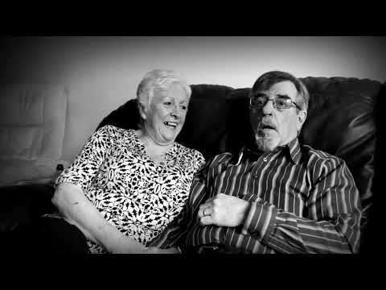
6.4 Sut y gall rhai mathau o ddementia gael effaith dros dro neu barhaol ar alluoedd corfforol a lles
6.4 How some types of dementia can have a transient or permanent impact on physical abilities and well-being
Gweithgaredd myfyrio
Sut gall dementia effeithio ar iechyd a lles corfforol a meddyliol unigolion?
How may dementia impact on an individuals’ physical and mental health and well-being?
Notes:
Welsh:
Gall dementia gael effaith ar unigolion mewn sawl ffordd:
Gallu Corfforol – Gall dementia effeithio ar allu unigolyn i gerdded neu sefyll a’i allu i fwyta, yfed a bod yn ymataliol, a gall pob un ohonynt arwain at broblemau iechyd ychwanegol, fel rhwymedd, heintiau dŵr, niwmonia a briwiau pwyso.
Iechyd Meddwl – Mae Gorbryder ac Iselder yn gyffredin ymhlith pobl sy’n byw gyda dementia, yn enwedig yn y camau cynnar lle mae’n bosibl y bydd y person yn cydnabod bod ei allu yn newid. Bydd rhai pobl yn profi symptomau seicotig fel rhithweledigaethau neu rithdybiau.
Lles– Gall pryderon iechyd corfforol a meddyliol gael effaith negyddol ar ymdeimlad y person o les. Gall y person ddod yn ynysig yn gymdeithasol o ganlyniad, gan waethygu'r broblem ymhellach.
English:
Dementia can have an impact on individuals in many ways:
Physical Ability – Dementia may affect an individual’s ability to walk or stand and their ability to eat, drink and be continent, all of which can potentially lead to additional health problems, such as constipation, water infections, pneumonia and pressure sores.
Mental Health – Anxiety and Depression are common in people living with dementia, particularly in the early stages where the person may recognise their changing ability. Some people will experience psychotic symptoms such as hallucinations or delusions.
Well-being – Both physical and mental health concerns can have a negative impact on the person’s sense of well-being. The person may become socially isolated as a result, compounding the problem further.

Slide 11
6.6 Sut y gall dementia guddio materion iechyd sylfaenol
6.6 How dementia can mask underlying health issues
Sylwer – Mae'n bwysig cydnabod y gallai symptomau fod yn digwydd o ganlyniad i broblem iechyd sylfaenol arall; er enghraifft, gall dryswch fod yn arwydd o haint llwybr wrinol.
Gallai deliriwm fod yn ddiddyfnu o alcohol neu feddyginiaeth neu wedi'i achosi gan haint. Os oes gan unigolyn ddementia, gall symptomau ei ddeliriwm bara am sawl wythnos ar ôl i’r haint gael ei drin
Note – It’s important to recognise that symptoms could be occurring as a result of another underlying health issue; for example, confusion may be a sign of a urinary tract infection.
Delirium could be withdrawal from alcohol or medication or caused by an infection. If an individual has dementia, the symptoms of their delirium can last for several weeks after the infection has been treated
Notes:
Welsh:
Mae rhai cyflyrau a all ddynwared symptomau dementia. Os oes gan berson ddementia, efallai y bydd cyflwr y gellir ei drin yn cael ei fethu.
Gellir camgymryd arwyddion a symptomau penodol am ddementia. Os yw rhywun wedi drysu efallai y byddwch yn cymryd yn ganiataol fod ganddo ddementia; fodd bynnag, gallai fod yn haint llwybr wrinol neu ddeliriwm.
Gall deliriwm gael ei achosi gan adferiad ar ôl llawdriniaeth, diddyfnu o alcohol neu feddyginiaeth ond gall y symptomau fod yn newidiadau mewn hwyliau, anniddigrwydd a newidiadau mewn patrymau cwsg.
Gall trawma i'r pen sy'n arwain at ddryswch neu newidiadau gwybyddol gael ei ddrysu gyda dementia, neu glefydau'r afu a'r arennau a all arwain at namau gwybyddol oherwydd tocsinau yn y gwaed.
Os yw rhywun wedi cael strôc, yna gall arwyddion dryswch, problemau symudedd a methu â chyfathrebu'n glir hefyd gael eu drysu ar gyfer dementia.
Gall dementia guddio materion iechyd corfforol sylfaenol oherwydd ni all yr unigolyn ddisgrifio'r hyn sy'n bod arno oherwydd efallai na fydd yn gallu dewis y geiriau cywir neu'n gallu cyfathrebu ei boen neu anghysur.
English:
There are certain conditions which may mimic the symptoms of dementia. If a person has dementia, a potentially treatable condition may be missed.
Specific signs and symptoms can be mistaken for dementia. If someone is confused you might assume they have dementia; however, it could be a urinary tract infection or a delirium.
Delirium can be caused by post-operative recovery, alcohol withdrawal or medication but the symptoms can be mood changes, irritability and sleep pattern changes.
A trauma to the head resulting in confusion or cognitive changes can be confused for dementia, or liver and kidney diseases which can result in cognitive impairments due to toxins in the blood.
If someone has had a stroke then the signs of confusion, mobility problems and not being able to communicate clearly can also be confused for dementia.
Dementia can mask underlying physical health issues because the individual can’t describe what’s wrong with them as they may not be able to choose the right words or be able to communicate their pain or discomfort.

Slide 12
6.7 Sut i liniaru’r ffactorau risg cynyddol sy’n gysylltiedig â chynnal lles corfforol a meysydd gofal corfforol
6.7 How to mitigate increasing risk factors associated with maintaining physical well-being and areas of physical care
Pa strategaethau allech chi eu defnyddio i gefnogi unigolyn â dementia i hybu lles corfforol?
What strategies could you use to support an individual with dementia to promote physical well being?
Notes:
Welsh:
Meysydd gofal corfforol: rheoli heintiau, maeth - diet a hylif, symudedd a throsglwyddo diogel, hybu ymataliaeth, gofal croen a hyfywedd meinwe, iechyd y geg, iechyd gweledol a chlywedol, iechyd rhywiol, asesu cwsg a rheoli poen
Gyda'r gwahanol fathau o ddementia ac ar y gwahanol gamau daw risgiau sy'n gysylltiedig â chynnal lles corfforol unigolion.
Gall yr unigolyn fod yn profi poen, sy'n arwydd o broblem sylfaenol, nad yw'n cael ei gwirio, oherwydd gallu'r person i hunan-adrodd poen yn ddibynadwy. Mae’n bosibl y byddwn yn camddehongli ymddygiadau poen fel anniddigrwydd, encilio, neu gyflymu fel symptom o’r dementia a cholli’r boen.
Gall peidio â nodi problemau ymataliaeth arwain at heintiau a hylendid gwael, gan arwain at broblemau gofal croen fel briwiau pwyso.
Gallai peidio â chael y maetholion digonol, oherwydd anawsterau bwyta ac yfed, neu'r unigolyn yn anghofio bwyta achosi colli pwysau, bod yn agored i friwiau pwyso, dryswch ac yn y pen draw dirywiad cyffredinol yn iechyd unigolyn.
Gall hylendid y geg gwael arwain at boen, haint a phroblemau maeth. Gallai gofal traed gwael arwain at broblemau symudedd, gan gynyddu'r risg o gwympo.
Mae'n hanfodol bod yr holl wiriadau iechyd yn cael eu cynnal.
Mae risgiau hefyd o ddadhydradu a diffyg maeth o ganlyniad i anghofio yfed neu fwyta a/neu beidio ag adnabod teimladau o syched neu newyn a risgiau ychwanegol yn ymwneud â meddyginiaeth, er enghraifft, colli / cymryd gormod neu ar adegau anghywir ac ati.
Gall technoleg gynorthwyol fod yn strategaeth i gefnogi hyn. Gweler cymhwyster ymarfer proffesiynol Lefel 4
English:
Areas of physical care: management of infection, nutrition - diet and fluid, mobility and safe transfer, continence promotion, skin care and tissue viability, oral health, visual and auditory health, sexual health, sleep assessment and management of pain
With the different types of dementia and at the different stages come risks associated with maintaining the physical well-being of individuals.
The individual may be experiencing pain, indicative of an underlying problem, that goes unchecked, due to the person’s ability to reliably self-report pain. We may misinterpret pain behaviours such as irritability, withdrawal, or pacing as a symptom of the dementia and miss the pain.
Incontinence problems not being identified can lead to infections and poor hygiene, leading to skin care problems like pressure sores.
Not having the adequate nutrients, due to difficulties with eating and drinking, or the individual forgetting to eat could cause weight loss, vulnerability to pressure sores, disorientation and eventually a general decline in an individual’s health.
Poor oral hygiene may result in pain, infection and problems with nutrition. Poor foot care could result in problems with mobility, increasing risks for falls.
It is vital that all health checks are maintained.
There is also risks of dehydration and malnutrition as a result of forgetting to drink or eat and /or not recognising feelings of thirst or hunger and additional risks related to medication, for example, missing / taking too much or at wrong times etc.
Assistive technology can be a strategy to support this. Please see Level 4 professional practice qualification
Sources:
https://socialcare.wales/resources/good-work-dementia-learning-and-developmentframework
https://socialcare.wales/resources/national-dementia-vision-for-wales
https://socialcare.wales/resources/dementia-more-than-just-memory-loss

Slide 13
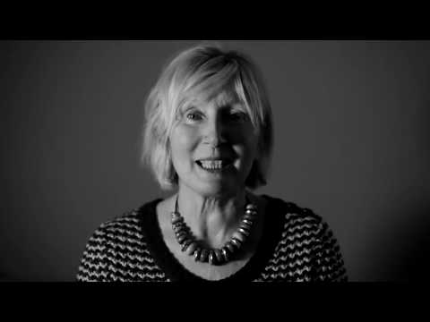
6.9 Modelau a dulliau y gellir eu defnyddio i gefnogi cyfathrebu ac ymgysylltu effeithiol ag unigolion sy'n byw gyda dementia
6.9 Models and approaches that can be used to support effective communication and engagement with individuals living with dementia
Mae’r ffordd yr ydym yn cynnig gofal a chymorth i unigolyn sy’n byw gyda dementia yn cael effaith enfawr.
Dylai dulliau gweithredu fod yn:
Galluogi
Cefnogol
Cyfathrebu
Ymatebol
Canolbwyntio ar yr unigolyn
The way in which we offer care and support to an individual living with dementia has a huge impact.
Approaches should be:
Enabling
Supportive
Communicative
Responsive
Person centred
Notes:
Welsh:
Mae dull galluogi yn galluogi'r unigolyn i wneud cymaint drosto'i hun ag y gall. Mae'r athroniaeth o wneud pethau gyda'r unigolyn yn hytrach nag i'r unigolyn yn sicrhau ei fod yn parhau i ddefnyddio sgiliau a galluoedd a gedwir. Os byddwn yn cymryd drosodd, bydd sgiliau'n cael eu colli'n gyflymach.
Gall addasu ein cyfathrebiad i ddefnyddio mwy o arwyddion ac ystumiau, geiriau ac ymadroddion syml, a defnydd priodol o gyffyrddiad fod o gymorth. Hyd yn oed pan fydd geiriau’n mynd yn anodd, bydd yr unigolyn yn sylwi ar lais tawel a chyfeillgar (ac os ydych chi’n mynd yn flin neu’n rhwystredig!).
Gall amgylcheddau cadarnhaol, megis goleuadau da, ychydig iawn o dynnu sylw oddi wrth sŵn cefndir, y defnydd o arwyddion a chyferbyniad lliw, helpu hefyd.
Mae angen inni adnabod arwyddion o drallod yn yr unigolyn â dementia, efallai cynnydd mewn ymddygiadau cynhyrfus ac ymateb yn unol â hynny, gan wybod pryd i gynnig cysur a phryd i roi’r gorau i’r hyn yr ydym yn ei wneud a cherdded i ffwrdd.
English:
An enabling approach allows the individual to do as much for themselves as they are able. The philosophy of doing things with the individual rather than to the individual ensures that they continue to use retained skills and abilities. If we take over, skills will be lost more quickly.
Adapting our communication to use more signs and gestures, simple words and expressions, and the appropriate use of touch can help. Even when words are becoming difficult, the individual will notice a calm and friendly voice (and if you are becoming cross or frustrated!).
Positive environments, such as good lighting, minimal distraction from background noise, the use of signs and colour contrast, can also help.
We need to recognise signs of distress in the individual with dementia, perhaps an increase in agitated behaviours and respond accordingly, knowing when to offer comfort and when to stop what we are doing and walk away.
Resources
https://www.dementiacarematters.com/
https://teepasnow.com/

Slide 14
6.8 Yr ystod o wasanaethau, asiantaethau a gweithwyr proffesiynol sy'n darparu cymorth i unigolion sy'n byw gyda dementia
6.9 Modelau a dulliau y gellir eu defnyddio i gefnogi cyfathrebu ac ymgysylltu effeithiol ag unigolion sy'n byw gyda dementia
6.8 The range of services, agencies and professionals which provide support for individuals living with dementia
6.9 Models and approaches that can be used to support effective communication and engagement with individuals living with dementia
https://twitter.com/i/status/1438137644131622915
Tasg ymchwil:
Nodi gwasanaethau lleol a chenedlaethol sy'n darparu cymorth i unigolion sy'n byw gyda dementia a'u gofalwyr.
Trafod y modelau a dulliau y gellir eu defnyddio i gefnogi cyfathrebu ac ymgysylltu effeithiol ag unigolion sy'n byw gyda dementia
https://twitter.com/i/status/1438137644131622915
Research task:
Identify local and national services that provide support for individuals living with dementia and their carers.
Discuss the models and approaches they promote to support effective communication and engagement with individuals living with dementia
Notes:
Welsh:
Mae hwn yn gyfle i gysylltu â sefydliadau lleol a allai ddarparu adnoddau ac ati, mae potensial yma i wahodd siaradwyr gwadd gan gynnwys defnyddwyr gwasanaeth a’u teuluoedd.
English:
This is an opportunity to link in with local organisations who may be able to provide resources etc., there is potential here for inviting guest speakers including service users and their families

Slide 15
Adnoddau
Resources
https://www.alzheimers.org.uk/sites/default/files/pdf/the_dementia_guide.pdf
https://socialcare.wales/cms_assets/file-uploads/Good-Work-Dementia-Learning-And-Development-Framework.pdf
https://www.alzheimers.org.uk/sites/default/files/pdf/the_dementia_guide.pdf
https://socialcare.wales/cms_assets/file-uploads/Good-Work-Dementia-Learning-And-Development-Framework.pdf

