Slide 1
Asesiad
Uned 444 Cefnogi'r broses asesu a chynllunio gofal a chymorth
Deilliant Dysgu 3
Canolbwyntio ar Blant
Assessment
Unit 444 Support the assessment and care and support planning process
Learning Outcome 3
Focusing on Children

Slide 2


Slide 3
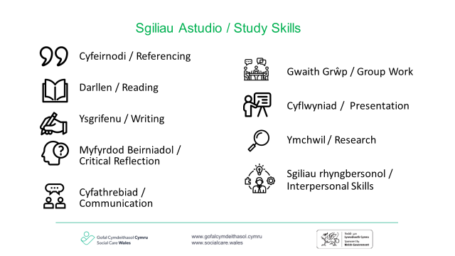

Slide 4
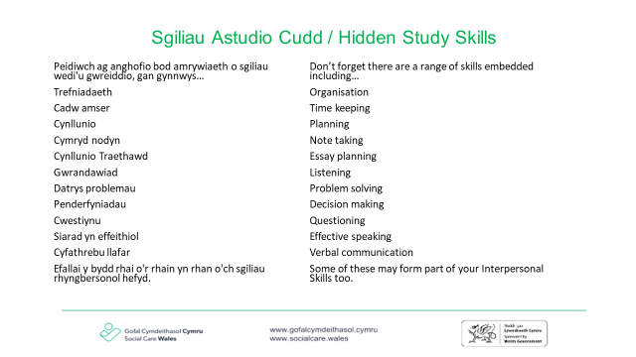

Slide 5
Nod
Aim
Ystyried ein rôl a’n cyfrifoldeb wrth gefnogi’r broses asesu wrth weithio gyda phlant a’u teuluoedd
To consider our role and responsibility when supporting the assessment process when working with children and their families
Notes:
atgoffwch y myfyrwyr eu bod wedi ystyried cymhwysedd yn Narlith 1
remind students that they considered eligibility in Lecture 1

Slide 6
Amcan
Objective
I gynyddu fy nealltwriaeth o'r broses asesu
To increase understanding of the assessment process

Slide 7
Darlith yr wythnos ddiweddaf
Last weeks lecture
Dull sy'n canolbwyntio ar gryfder
Sgwrs yr hyn sy’n bwysig
Paratoi ar gyfer asesiad
Pwy ddylai fod yn rhan o'r asesiad?
Rheoli heriau
Gwerthoedd
Strengths based approach
What matters conversation
Preparation for assessment
Who should be involved in the assessment?
Managing challenges
Values
Notes:
Rydych wedi cymhwyso'r meini prawf cymhwysedd i sefyllfa plentyn yn narlith gyntaf yr Uned
Mae llawer o'r cysyniadau a archwiliwyd yr wythnos diwethaf yn berthnasol i'n gwaith gyda phlant
darllenwch drwy'r rhestr gan roi enghreifftiau o sut mae hyn yn cysylltu â phlant
you have applied the eligibility criteria to a child’s situation in the first lecture of the Unit
Many of the concepts explored last week apply to our work with children
read through the list providing examples of how this connects to children

Slide 8
Astudiaethau dan gyfarwyddyd
Directed study
Darllenwch drwy'r astudiaeth achos ar Nathan ac atebwch y cwestiynau
Read through the case study on Nathan and answer the questions
Notes:
Yr hwylusydd i ddosbarthu'r astudiaeth achos
Facilitator to hand out the case study

Slide 9
Ymarfer Grŵp
Group Exercise
Rhannwch yn grwpiau o 3 o bobl nad ydych chi fel arfer yn eistedd gyda nhw.
cyflwynwch eich hunain a darganfyddwch pwy sydd wedi cyfarfod â'r person mwyaf enwog
y person hwnnw i ddechrau gyda rhannu beth yw'r peth mwyaf a ddysgodd a'i gwestiwn mwyaf
Get into groups of 3 with people you do not normally sit with
Introduce yourselves and find out who has met the most famous person
That person to start with sharing what their biggest learning and biggest question
Notes:
Hwylusydd - sleid wedi'i hanimeiddio.
dosbarthu sticeri i'r myfyrwyr ysgrifennu eu hatebion arnynt, yr hwylusydd i gasglu'r rhain a'u hychwanegu at ddwy golofn ar y siart troi - Dysgu..............cwestiynau. Mae angen ysgrifennu hwn a'i rannu yr wythnos nesaf fel taflen.
Mae hwn yn ymarfer 20 munud
Myfyrwyr i symud o gwmpas yr ystafell ddosbarth - unwaith y bydd myfyrwyr yn eu grwpiau symudwch ymlaen at y cyfarwyddiadau.
mae gan fyfyrwyr 10 munud felly byddwch yn ddisgybledig yn eich grwpiau i sicrhau bod pawb yn cael cyfle i rannu
10 munud yn rhoi adborth i'r grŵp cyfan – Hwylusydd i gasglu adborth ar y siart troi.
Yr hwylusydd hefyd i gasglu themâu sy'n cysylltu â'r canlyniadau dysgu
Facilitator – slides are animated
hand out stickies for students to write their answers on, facilitator to collect these and add to two columns on flip chart- Learnings……………questions. This needs to be written up and shared next week as a handout.
This is a 20 minute exercise
Students to move around the classroom. Once students are in their groups move on to the instructions.
Students have 10 minutes so be disciplined in your groups to ensure everyone has the opportunity to share
10 minutes feeding back to the whole group – Facilitator to capture feedback on flip chart.
Facilitator to also capture themes linking to the learning outcomes

Slide 10
Ymarfer parau
Pairs exercise
Beth all fod y rhwystrau posibl i adeiladu perthynas broffesiynol gyda phlentyn?
Sut allech chi oresgyn y rhain?
What might be the potential barriers to building a professional relationship with a child?
How might you overcome these?
Notes:
Ymarfer 5 munud
5 minute exercise

Slide 11
Sut mae cadw’r plentyn wrth galon y broses asesu?
How do we keep the child at the heart of the assessment process?
Meddu ar wybodaeth am ddatblygiad plentyn.
Ffocws clir ar ddiben yr asesiad
Cynnwys y person(au) gyda CRh yn y broses
Dysgu am y plentyn
Dal llais y plentyn ym mhopeth a wnaf
Have a knowledge of child development
Clear focus on the purpose of the assessment
Involve the person(s) with PR in the process
Learn about the child
Capture the child’s voice in everything I do
Notes:
hwylusydd – mae animeiddiadau ymlaen.
Gofynnwch y cwestiwn cyntaf a chasglu adborth ar sut mae myfyrwyr yn cadw'r plentyn wrth galon yr asesiad?
Yna rhannwch eich barn ar sut rydych wedi rheoli hyn e.e
Datblygiad plentyn – mae hyn wedi fy helpu i gael llinell sylfaen/syniad o’r hyn y dylai plentyn fod yn ei gyflawni a lefel ei ddealltwriaeth. Er enghraifft byddwn yn defnyddio geiriau a lluniau ar gyfer plentyn 6 oed, yn y person cyntaf ac nid o reidrwydd gyda phlentyn 14 oed.
Pwrpas - rydw i, y plentyn a'r rhiant person â chysylltiadau cyhoeddus yn glir ynglŷn â'r ffocws a'r pwrpas
dal llais y plentyn drwy gynnwys yr hyn mae’n ei ddweud – ystyriwch eiriolaeth yma ar gyfer pob plentyn er enghraifft bydd angen eiriolwr ar blentyn 8 mis oed i sicrhau bod ei lais yn cael ei glywed – gallai hyn fod yn deulu, teulu estynedig/gweithiwr.
facilitator – animations are on.
Ask the first question and gather feedback on how students are keeping the child at the heart of the assessment ?
Then share your thoughts on how you have managed this e’g
Child development – this has helped me to have a base line/idea of what a child should be achieving and their level of understanding. For example I would use words and pictures for a 6 year old, in the first person and not necessarily with a 14 year old.
Purpose- both myself, the child and parent person with PR are clear about the focus and purpose
capture the child’s voice by including what they say – consider advocacy here for all children for example a child who is 8 months old will need an advocate to ensure that their voice is heard- this might be family, extended family/worker.

Slide 12
Rhwystrau i blant yn cael gafael ar gymorth
Barriers to children accessing support
mewn grwpiau o 3
trafodwch a chytuno ar rai o'r rhwystrau a sut y gallech eu goresgyn
In groups of 3
Discuss and agree what some of the barriers might be and how you might overcome them

Slide 13
Rhwystrau posibl
Potential barriers
Tlodi
Unigedd
Rhieni ddim eisiau i chi siarad â'u plentyn ar ei ben ei hun
Rhieni ddim yn cydnabod bod problem
Plant ddim yn cydnabod bod problem
Poverty
Isolation
Parents not wanting you to talk to their child alone
Parents not recognising there is a problem
Children not recognising there is a problem
Notes:
Mae animeiddiadau hwyluswyr ymlaen.
darllenwch drwy bob un gan ofyn i fyfyrwyr am enghreifftiau o sut y gallent fynd i'r afael â'r rhwystrau hyn
Tlodi - cael sgwrs am incwm cyfredol a gweithio gyda'r rhiant ac asiantaethau eraill i wneud y mwyaf o gyllid -
ystyried taliadau uniongyrchol
ynysu: genogram i egluro rhwydwaith sydd wedi'i gysylltu'n naturiol. Gofyn cwestiynau megis – pwy oedd y 5 person diwethaf i chi gysylltu â nhw? Pan gawsoch chi newyddion da / newyddion drwg / pwy oedd y person cyntaf i chi ffonio. Ar eich pen-blwydd gyda phwy ydych chi'n siarad - Archwiliwch pa mor anodd yw hi i rannu gwybodaeth amdanoch chi'ch hun gydag eraill.
ddim yn siarad gyda phlant- Mam, Dad beth sy'n eich poeni fwyaf amdana i'n siarad gyda'ch plentyn? A oes unrhyw beth nad ydych am i mi siarad amdano? ac ati
ddim yn adnabod y broblem - Mam / Dad allwch chi ddweud wrthyf yn eich geiriau eich hun pam rydw i yma heddiw ? Beth wnaeth i'r person wneud atgyfeiriad i'r gwasanaeth hwn? etc
Plant ddim yn cydnabod bod problem- Eglurwch pam eich bod chi yno. Gofynnwch gwestiynau i'r plentyn i fod yn gliriach am y pryder gyda ffocws ar yr hyn sy'n gweithio'n dda. Er enghraifft, lle mae yna bryderon ynghylch grwpiau cyfeillgarwch gofynnwch beth yw'r peth gorau am eich ffrindiau? Sut maen nhw'n eich helpu a'ch cefnogi? ac ati
Facilitator animations are on.
read through each one asking students for examples on how they might address these barriers
Poverty- have a conversation about current income and working with the parent and other agencies to maximise finances - consider direct payments
Isolation - genogram to clarify naturally connected network. Asking questions such as – who were the last 5 people you contacted? When you had some good news/bad news/ who was the first person you phoned. On your birthday who do you speak to - Explore how hard it is to share information with others about yourself.
not talking to children – Ask parents what is your biggest worry about me talking to your child? Is there anything you do not want me to talk about? etc
not recognising the problem - Mum /Dad can you tell me in your own words why I am here today ? What was it that made the person make a referral to this service ? etc
Children not recognising there is a problem- Clarify why you are there. Ask the child questions to be clearer about the worry with a focus on what is working well. For example where there are worries over friendship groups. Ask what is the best thing about your friends? How do they help and support you? etc

Slide 14
Gwrthsafiad
Resistance
O safbwynt proffesiynol, gall 'gwrthsafiad' ymgorffori gwadu, osgoi, cydymffurfio cudd a gelyniaeth.
Wiffin (2010)
From the professional point of view, ‘resistance’ can incorporate denial, avoidance, disguised compliance and hostility.
Wiffin (2010)
Notes:
Wiffin (2010) - Family perspectives on safeguarding and on relationships with children’s services, LONDON, Office of the Children's Commissioner.

Slide 15
Sut gallai gwrthsafiad ddangos ei hun?
How might resistance show itself?
Trwy fod yn barod i ystyried meysydd 'diogel' neu flaenoriaeth isel i'w trafod yn unig.
Trwy beidio â dod i apwyntiadau
Trwy fod yn rhy gydweithredol gyda gweithwyr proffesiynol.
Trwy fod yn ymosodol ar lafar/neu'n gorfforol.
Trwy leihau'r problemau.
(Egan, 1994)
By only being prepared to consider 'safe' or low priority areas for discussion.
By not turning up for appointments
By being overly co-operative with professionals.
By being verbally/and or physically aggressive.
By minimising the issues.
(Egan, 1994)

Slide 16
Gweithio gyda gwrthsafiad
Working with resistance
Pa sgiliau mae Ruth yn eu defnyddio i weithio gyda rhieni gwrthsafol?
What skills does Ruth use to work with resistant parents?
https://www.youtube.com/watch?v=wgQEoB9UbmY

Slide 17
Pendantrwydd
Assertiveness
'Mae'n golygu gallu gwneud eich cyfraniadau eich hun yn hyderus tra'n gwerthfawrogi a pharchu'r cyfraniad a wneir gan eraill' (Moss.2017:29)
‘It involves being able to make your own contributions confidently whilst valuing and respecting the contribution made by others’ (Moss.2017:29)
Notes:
This applies to both the individual and ourselves as workers
helping the individuals we are supporting to understand information, their assessment and the reasons why decisions have been made.
Individually think about a situation where you have found it difficult to assert yourself, why was this ?

Slide 18
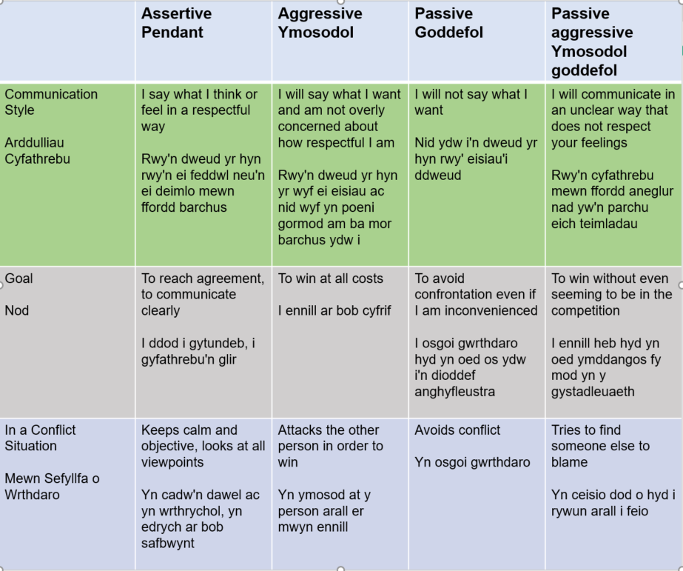
Assertiveness can be divided into four styles of behaviour (adapted from McBride 1998:13)
Gellir rhannu pendantrwydd yn bedwar math o ymddygiad (addaswyd o McBride 1998:13)

Slide 19
Ymatebion pendant
Assertive responses
Mae tad yn dweud wrth ei weithiwr gofal na fynychodd slot noson rieni ei blentyn oherwydd ei fod yn cyd-daro â'i hoff raglen deledu.
Sut allech chi ymateb?
A father tells his care worker that he did not attend his child’s parents’ evening slot because it coincided with his favourite television program.
How might you respond?
Notes:
gofynnwch i'r myfyrwyr ystyried y pedwar math o ymddygiad ac ysgrifennu ymateb i'r tad
3 munud ar eu pennau'u hunain
5 munud o rannu gyda'r person nesaf atynt
gofyn am wirfoddolwyr i rannu eu hymatebion.
ask students to consider the four styles of behaviour and write a response to the father
3 minutes on their own
5 minutes to share with the person next to them
ask for volunteers to share their responses.

Slide 20
Examples of challenging and being assertive
Enghreifftiau o herio a bod yn bendant
Mae tad yn dweud wrth ei weithiwr gofal na fynychodd slot noson rieni ei blentyn oherwydd ei fod yn cyd-daro â'i hoff raglen deledu.
Ymateb pendant… “Mae’n ddrwg gen i glywed hynny. Nid wyf yn siŵr a yw hyn orau i'ch merch. Sut ydych chi'n meddwl y gallai hi fod yn teimlo?"
Ymateb goddefol….”O ydy mae'n rhaglen dda yn tydi?”
Ymateb ymosodol… “Rydych chi'n jocian. Onid oes gennych unrhyw syniad sut mae'ch merch yn teimlo. Stopiwch feddwl amdanoch chi'ch hun am unwaith."
Ymateb ymosodol goddefol….” Ac rydych chi'n meddwl bod hynny'n bwysicach na llesiant eich plentyn ydych chi? (Cournoyer 2010)
A father tells his care worker that he did not attend his child’s parents’ evening slot because it coincided with his favourite television program.
Assertive response… “I am sorry to hear that. I am not sure that this is best for your daughter. How do you think she might be feeling?”
Passive response….”Oh yes it is a good programme isn’t it?”
Aggressive response… “You are kidding. Have you no idea about how your daughter feels. Stop thinking about yourself for once.”
Passive aggressive response….”And you think that’s more important than your child’s wellbeing do you? (Cournoyer 2010)

Slide 21
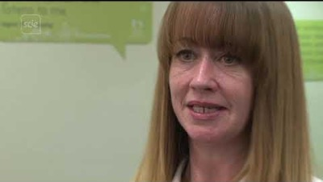
Defnyddiwch ddull sy'n canolbwyntio ar gryfder
Using a strengths based approach
Notes:
Tra bod myfyrwyr yn gwylio'r fideo hwn, gofynnwch iddyn nhw ysgrifennu sut maen nhw'n gwneud gwahaniaeth yn eu gwaith gyda phlant ac oedolion
Pontio i'r sleid nesaf
Gwnaethom archwilio pendantrwydd yr wythnos diwethaf a sut y gallem strwythuro sgwrs i weithio trwy heriau.
sut fyddech chi'n ymateb i'r sefyllfa hon?
Whilst students are watching this video ask them to write down how they are making a difference in their work with children and adults
Transition to next slide
We explore assertiveness last week and how we might structure a conversation to work through challenges.
how would you respond to this situation?

Slide 22
Gwaith grŵp
Group work
Trafodwch dechnegau/ffyrdd eraill o weithio gyda phlant a'u teuluoedd
Cyfeiriwch at Gonfensiwn y Cenhedloedd Unedig ar Hawliau'r Plentyn
Enwebwch rywun i roi adborth
Discuss other techniques/way of working with children and their families
Reference the United Nations Convention on the Rights of the Child
Nominate someone to feedback
Notes:
Yr hwylusydd i gofnodi adborth ac i ymhelaethu ar yr hyn sy'n cael ei rannu.
Facilitator to record feedback and to amplify what is being shared.

Slide 23
Astudiaethau dan gyfarwyddyd
Directed study
Darllenwch drwy God Ymarfer Rhan 4 Deddf Gwasanaethau Cymdeithasol a Llesiant (Cymru) 2014 - Diwallu Anghenion
Pam mae cydgynhyrchu yn bwysig wrth ddatblygu cynlluniau gofal a chymorth?
Sut ydych chi'n cysylltu â theuluoedd, ffrindiau, rhwydweithiau a'r gymuned ar hyn o bryd wrth ddarparu cymorth i'r unigolyn?
Sut ydych chi’n adolygu cynlluniau gofal a chymorth ar hyn o bryd? Pwy arall sy'n rhan o'r broses hon?
Dewch â chopi gwag o gynllun gofal a chymorth a ddefnyddir gan eich asiantaeth
Read through Social Services and Wellbeing (Wales) Act 2014 Code of Practice Part 4 – Meeting Needs
Why is co-production important when developing care and support plans?
How do you currently connect with families, friends, networks and the community in providing support to the individual?
How do you currently review care and support plans? Who else is involved in this process?
Bring a blank copy of a care and support plan used by your agency

