Slide 1



Lefel 3 GChDDP: Ymarfer a Theori
Uned 331
Rhwydwaith y Hydref 2023

Slide 2



Cynrychiolwyr ac arbenigwyr pwnc CBAC a City & Guilds fydd yn cefnogi ac yn hwyluso'r digwyddiad hwn.
CBAC
Amy Allen-Thomas
Swyddog Pwnc – Gofal, Chwarae, Dysgu a Datblygiad Plant
Lefel 2 GChDDP: Craidd
Lefel 2 GChDDP: Ymarfer a Theori
Lefel 3 GChDDP: Ymarfer a Theori
CBAC
Lianne Haymer
Uwch Arholwr – Gofal, Chwarae, Dysgu a Datblygiad Plant
Lefel 3 GChDDP: Ymarfer a Theori
Mae City & Guilds a CBAC yn parhau i gydweithio ac yn gweithio mewn partneriaeth â'r cyrff canlynol fydd hefyd yn cyfrannu at y digwyddiad hwn:
Cymwysterau Cymru
Gofal Cymdeithasol Cymru
Addysg a Gwella Iechyd Cymru

Slide 3
Recordio Sain
Mae'n ofynnol i'r cyflwynydd recordio sain o'r digwyddiad hwn. Mae hon yn reolaeth sydd wedi'i chynllunio i sicrhau bod CBAC yn gallu dangos cydymffurfiaeth ag Amodau Cydnabod rheoleiddiol; yn benodol, amodau sy'n ymwneud â chyfrinachedd deunyddiau asesu.
Bydd y recordiad ar gael i'r rheoleiddiwr cymwysterau os bydd angen, ond ni fydd yn cael ei rannu ag unrhyw drydydd partïon eraill. Bydd y recordiad yn cael ei storio'n ddiogel gan CBAC am gyfnod o dair blynedd ac yna'n cael ei ddinistrio'n barhaol.
Sylwch NA chaniateir i gynrychiolwyr wneud recordiad sain neu fideo o unrhyw agwedd ar y digwyddiad hwn.

Slide 4

Defnyddio Teams
Yn ystod y sesiwn Teams hon, byddai'n fuddiol i bawb lynu at yr egwyddorion canlynol:
Troi microffonau i ffwrdd tra nad ydych yn siarad
Defnyddiwch y nodwedd 'codi eich llaw' i ofyn cwestiwn neu defnyddiwch y “chat”
Rhowch eich camera ymlaen os ydych yn dymuno gwneud hynny.
Problemau technegol:
Os ydych chi’n cael problemau technegol gyda'ch sain neu'ch camera gwe, mae hyn yn aml y tu hwnt i'n rheolaeth, ond, yn y man cyntaf, rydym yn eich cynghori i adael ac ailymuno â'r cyfarfod neu gysylltu â'ch cefnogaeth TG.

Slide 5
Deunyddiau
Bydd y PPT yn yn cael ei anfon at y cyfeiriad(au) ebost a roddwyd pan wnaethoch chi gofrestru ar gyfer y digwyddiad hwn.

Slide 6

Nodau ac amcanion
Yn y sesiwn ar-lein hon bydd cyfle i'r rheini sy'n cymryd rhan wneud y canlynol:
Gwrando ar adborth yr Uwch Arholwr ac adolygu atebion enghreifftiol ar Uned 330 o arholiad mis Ionawr 2022
Cyfleoedd i holi cwestiynau i'r cynghorydd technegol a'r arbenigwyr pwnc
Blwch Post newydd ar gyfer cymwysterau CBAC GChDDP
gchddp@cbac.co.uk

Slide 7
Ystadegau Haf 2023
 | Ar-sgrin yn unig
Nifer y cofrestriadau | 213
Marc cymedrig | 56.2
Rh | 67
T | 50
L | 34

Slide 8
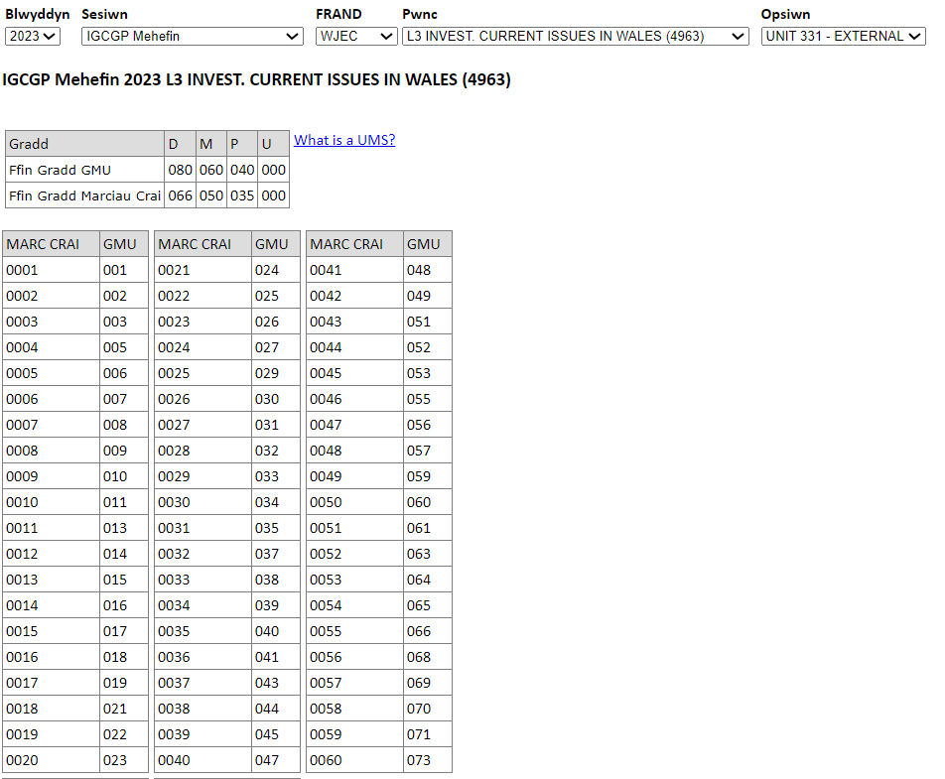

Cyfrifiannell GMU
https://www.wjecservices.co.uk/MarkToUMS/default.aspx?l=cy
Gradd gyfun GMU Uned 330 a 331

Slide 9
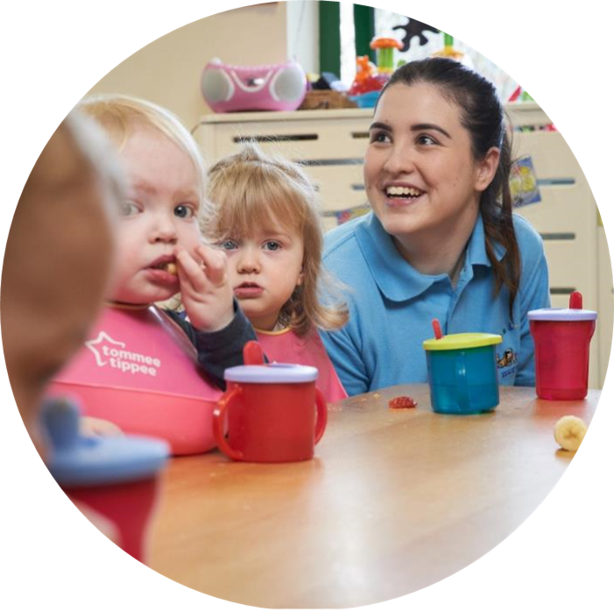
Uned 331 – Haf 2023
Pecyn Cymorth

Slide 10
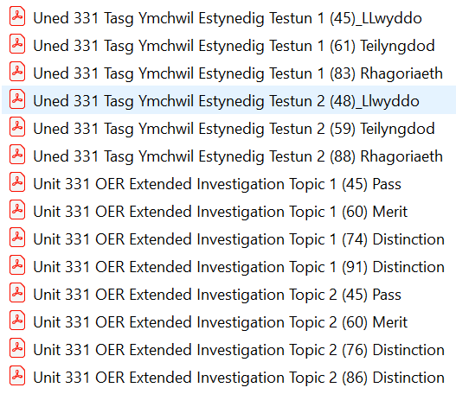
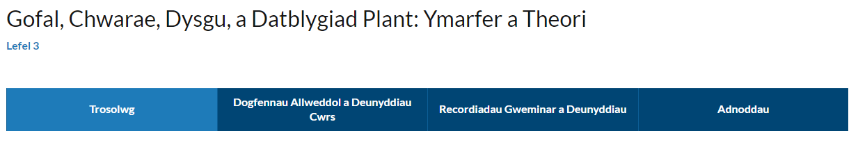
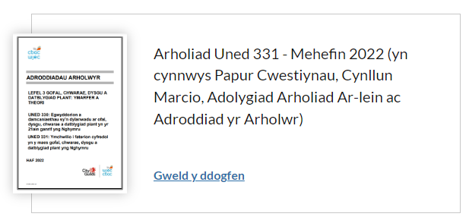
Pecyn Cymorth
Lefel 3: Gofal, Chwarae, Dysgu, a Datblygiad Plant: Ymarfer a Theori (dysguiechydagofal.cymru)
Testun 1
Testun 2
Cynllun Marcio
Haf 2023

Slide 11
Adborth gan yr
Uwch Arholwr
Uned 331 - Haf 2023

Slide 12
Adborth Lefel Uchel
Dylid nodi’r teitl a’r testun dewisol yn glir ar dudalen gyntaf y papur er mwyn sicrhau bod ffiniau'r dasg yn glir.
Dylid nodi rhif canolfan yr ymgeisydd, rhif yr ymgeisydd a rhif y dudalen ar bob tudalen a gyflwynir.
Rhaid i dasgau 1, 2, 3, 4, 5, 6 gael eu labelu'n glir i nodi ffiniau tasgau.
Ni all ymgeiswyr gynnwys cysylltau at ragor o wybodaeth, arolwg neu holiaduron gan eu bod y tu hwnt i ffin y cynllun marcio. Rhaid trafod unrhyw wybodaeth bellach a geir o ymchwil gyda'r tasgau gosod.
Sylwch ar y dystiolaeth sydd ei hangen gan gynnwys ystyried y 'rhaid cynnwys neu y gallai gynnwys' i sicrhau bod ymdriniaeth dda â'r cynllun marcio
Rhaid i drafodaethau am ddeddfau, deddfwriaeth a fframweithiau ymwneud â Chymru a chael eu cyfeirio'n briodol.
Dylid darparu rhestrau cyfeirio ar ddiwedd yr ymchwiliad cyfan
Mae arddull gyfeirio Harvard yn ddewis priodol ar gyfer cyfeirnodi.
Dylai canolfannau ganiatáu ar gyfer unigoliaeth yn yr ymchwiliad.
Dylid nodi’r cyfrif geiriau yn glir heb gynnwys y rhestr gyfeirio na'r llyfryddiaeth.
Ni ddylai'r cyfrif geiriau fod yn fwy na 5500. Ni fydd tasgau sy'n fwy na'r lwfans hwn yn cael eu marcio.
Mae'r maes testun yn ganolog i'w hymchwiliad cyfan. Mae'r papur asesu wedi'i farcio yn ei gyfanrwydd ac mae'n rhaid iddo gysylltu â dewis testun drwy gydol pob tasg. .
Bydd cyflwyno deunydd a gopïwyd yn uniongyrchol o lyfrau neu ffynonellau eraill heb gydnabyddiaeth yn cael ei adael heb ei farcio.
Mae angen i ymgeiswyr osgoi defnyddio tablau a phwyntiau bwled.
Dylid osgoi profformas, papur arholiad uned 331 yw prif ffynhonnell y canllawiau ar gyfer cwblhau'n llwyddiannus.
Mae'n ofynnol i ganolfannau uwchlwytho dogfennau Word yn hytrach na dogfennau pdf.
Dylai ymgeiswyr ond ymgymryd â meysydd trafod y maent yn gallu eu trafod yn effeithiol fel dewis unigol yn hytrach na dewis y ganolfan.

Slide 13
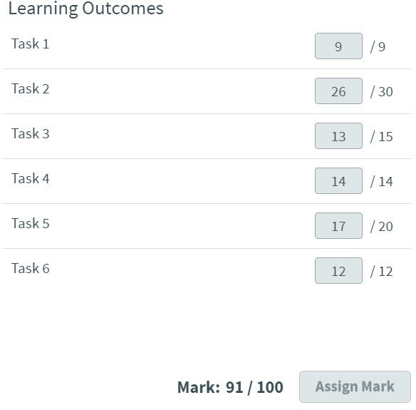
Testun 1 a sylwadau cyffredinol Phrif Arholwyr
Testun 1
Mae amrywiaeth o gynlluniau, mentrau a rhaglenni wedi cael eu cyflwyno i gefnogi datblygiad cadarnhaol mewn plant 0–19 oed.
Gwnewch ymchwil ar sut mae cynlluniau, mentrau a/neu raglenni cyfredol yn gallu hybu iechyd a llesiant.
Adborth yr Uwch Arholwr
Mae'r ymchwiliad wedi cynnig enghraifft ardderchog o'r dull methodolegol y dylid ei ddefnyddio wrth ymgymryd ag ymchwiliad mawr. Mae'r ymgeisydd yn amlwg wedi ymchwilio i'w destun a'i faes penodol ymhell cyn yr arholiad, ac mae canlyniadau'r gwaith caled a'r ymdrech wedi talu ar ei ganfed. Mae'r marciau a roddwyd drwyddi draw wedi bod yn y band marciau uchaf ar gyfer pob tasg. Rhoddwyd marciau uchel i'r tasgau gan fod y meysydd trafod yn cysylltu'n glir â'r meysydd tystiolaeth sy'n ofynnol ar gyfer pob tasg, ac mae'r gwaith ymchwil a dysgu a wnaed wedi'i ddatblygu'n llwyddiannus ym mhob maes. Mae tystiolaeth glir o'r gwaith ymchwil a wnaed a darparwyd cyfeirnodi clir drwy gydol yr ymchwiliad cyfan.
Deilliannau Dysgu

Slide 14
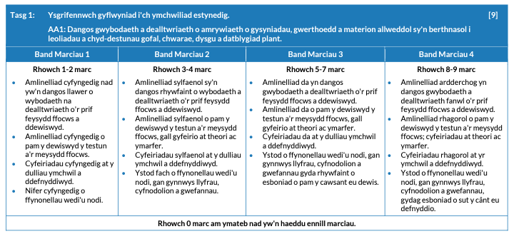
Testun 1 - Tasg 1 a'r cynllun marcio
Ysgrifennwch gyflwyniad i'ch ymchwiliad estynedig. Amlinellwch y canlynol:
• y prif feysydd ffocws rydych wedi dewis ymchwilio iddynt mewn perthynas â'r testun o'ch dewis
• pam rydych wedi dewis y testun a'r meysydd ffocws; efallai yr hoffech gyfeirio at ddiddordeb personol, cynnwys a addysgwyd, gweithgareddau ymgysylltu â'r sector a lleoliad gwaith y dulliau ymchwil a ddefnyddiwyd gennych
• y ffynonellau a ddefnyddiwyd fel rhan o'r gwaith o ymchwilio i'r testun a'r meysydd ffocws.
[9 marc]
Fel canllaw, dylech anelu at ysgrifennu tua 450 o eiriau ar gyfer yr adran hon

Slide 15
Testun 1 - Tasg 1 ateb yr ymgeisydd gyda sylwadau’r Uwch Arholwr
For this investigation, I have chosen to research the Healthy Schools Wales Programme and how it promotes health and wellbeing. This programme is delivered through Public Health Wales on behalf of the Welsh Government to enable a whole school approach to promoting health and wellbeing. There are 20 schools across Caerphilly that achieved this award. Healthy Schools programme has 7 key health areas which are Food and Fitness, Mental and Emotional Wellbeing, personal development and relationships, environment, substance use and misuse, safety and Hygiene. I will be concentrating on Mental and emotional wellbeing for my first focus area and Food and Fitness for my second .
My Focus area of mental and emotional wellbeing was chosen because since the COVID 19 pandemic there has been a huge increase in children having bad mental health. This has been proven by research that states "the coronavirus pandemic worsened the condition of 80% of young people with a history of mental health needs" (YoungMinds, 2020). This shows that mental health has become a huge concern and caused more younger children to relapse. Also, this focus area was chosen because I want to pursue a career that focuses on mental health and wellbeing.
My second focus area of Food and Fitness was chosen because I have spoken to many colleagues and they have all noticed an increase in children neglecting their health and not being aware of how to take responsibility for their own health. The Government found that "1in S children start primary school overweight or obese rising to more than a third by the time they leave" (GOV.UK, 2017). This shows 1 just how many children need more support within this area and how much of an impact it is having on younger children's lives throughout school years. Within this focus area I will be touching upon obesity within children.
In order to do this piece of work, I have carried out lots of research in multiple ways. I spoke to colleagues to get their personal opinions along with my own thoughts. I have looked into research and statistics online, specifically the Government websites to get accurate information. I have carried out my own research and spoke to the school nurse to ensure health professionals were included to have the difference with education and health opinions. I looked at the guidance on healthy eating so I am educated on the topics I have chosen. I have looked into theorists and current legislations to back up my points.
Carrying out this investigation will allow me to have a higher level of knowledge and this will then benefit me as I will use the information I find t support children in my future career as a mental health nurse. By developing my knowledge of these areas, it wilt hopefully enable me to complete my nursing degree successfully.
Adborth yr Uwch Arholwr
​
Mae Tasg 1 wedi'i gosod yn ofalus. Mae manylion y testun a ddewiswyd a'r meysydd penodol wedi'u cynnwys yng nghyflwyniad yr ymchwiliad. Mae meysydd trafod cadarn wedi'u nodi ac mae cyfeirnodi ffynonellau tystiolaeth wedi'i gynnwys. Darparwyd trosolwg da iawn o'r rhesymau dros y dewis o destun a nodwyd y defnydd a wneir yn y dyfodol o'r wybodaeth a gafwyd drwy gydol yr ymchwil, gan gysylltu ag ymarfer ategol.
Rhoddwyd 9 marc allan o 9

Slide 16
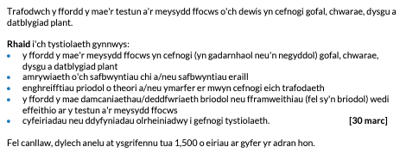
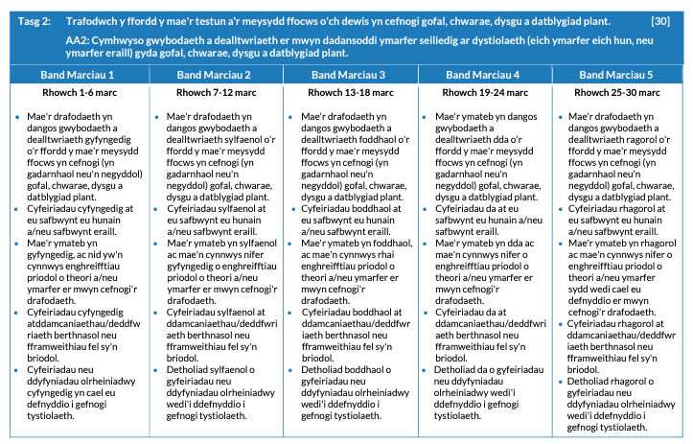
Testun 1 - Tasg 2 a'r cynllun marcio

Slide 17
Testun 1 - Tasg 2 ateb yr ymgeisydd
Both of my focus areas link well to the Wellbeing of Future Generations Act 2015. This is because this piece of legislation is about "improving the social, economic, environmental and cultural wellbeing of wales" (Welsh Government, 2021). This means that the Government want Wales to altogether be a better place for communities to live in and for people to thrive. This legislation will make the public bodies listed within the act think more about the long term alongside working better with communities and other individuals. Another point about this legislation is that it looks to prevent problems and come up with a 'joined-up approach' towards health and wellbeing. There are 7 wellbeing goals within this piece of legislation. One of them being 'a Healthier Wales'. This goal describes a society that should maximise individuals 'physical and mental wellbeing'. From this the Government are ensuring that future children will be healthy, in which supports the Healthy Schools programme because a healthy body means a healthy mind so therefore children will be more open to learning. This goal will impact all of the other areas and will have a knock-on effect. This is because if children are healthy all around then other things will fall into place. For example, if a child has good health and wellbeing then they are therefore more likely to remain resilient and overcome any challenges they may face. In which that then meets another goal from this Act which is 'a Resilient Wales'. Both this piece of legislation and the Healthy Schools programme look towards what can be done to provide for the future and the generations to come not just what needs to happen now. From my personal experience in a primary school placement a child started taking part in more athletic clubs after school and after awhile of the child partaking in these we as staff noticed a huge difference in the other areas of development also and the child's attitude towards class time. She showed more perseverance and resilience when attempting other tasks or challenges inside and outside of the classroom.
A child having resilience is vital when it comes to other areas of development especially mental and emotional wellbeing. In my personal opinion resilience is needed to help a child bounce back and if they do not have good resilience they will suffer mentally and emotionally when a challenge occurs. Michael Rutter's psychological theory talks about resilience and the impact it has on children. He believes that what doesn't kill someone will make them a stronger individual. He believes that resilience can lead to 'emotional regulation' in which means that a child is able to control their emotions and be more comfortable with them.
The Healthy Schools programme links to the United Nations Convention of Rights of the Child. This piece of legislation outlines the rights children have. From research I found that this act was created to 'protect the rights of children' and ensure that they receive all of these things or are able to act •in these ways. There are 54 articles in total within the UNCRC in which underpin what rights children have however the last 11 articles are more on how adults and relevant professionals can support children to enjoy their rights. There are 7 core aims within this act that outline what is wanted for the children of now and the future. These meets the aims of the Healthy Schools programme as it meets core aim number 3 and 6. Core aim 3 is 'best possible health and free from abuse victimisation & exploitation' so it supports children's health and wants them to be healthier. Next, core aim number 6 is 'safe community and home which supports physical & emotional wellbeing' in which links as it wants a healthier mind and body for children. From speaking to the school nurse in my placement, she believes that since COVlD 19 some of these rights had been neglected and a lot of children suffered mentally as well as physically. She told me that approximately 70% of children in the school admitted to feeling very low and having experienced low self esteem and worrying about their body image more than previous times. Maslow's hierarchy supports children's mental wellbeing and self-esteem as he believes there to be 5 needs within the hierarchy, Esteem being one of them. In my opinion, I believe this to be correct as children were being introduced to more television and social media platforms grew during the COVID 19 pandemic. This was highlighted when more and more younger children were being introduced to social medias such as Tiktok and lnstagram. Although these apps were not introduced to cause harm only for entertainment purposes only, they caused more mental damage to children than good. This is shown from research I found from the mental health charity websites saying that "In our survey, 25% of young people (13% of boys and 37% of girls) said celebrities have caused them to worry about their body image" (Mental Health Foundation). One of the biggest influences on body image for children is exposure to unrealistic bodies through films, books and social medias. Children are being introduced too young to social medias in today's society in which highlights another factor as to why mental health in children is becoming a bigger concern as years go on. This links to article 12 which highlights about children's views and expression of their feelings. This is because during isolation in the pandemic there was no one outside of a child's household that they could speak to or felt they could reach out to. So, for the children that did not have a good relationship or bond with the individuals inside their household they suffered mentally by holding in those feelings. Michael Rutter empasises the significance of attachment and that if a child fails to develop an attachment that it is privation. This shows that a child who has not got good connections will be more likely to have less resilience, affecting their mental wellbeing negatively. By children having a bad body image they are more likely to develop an eating disorder such an anorexia or bulimia.
parhau …

Slide 18
Testun 1 - Tasg 2 ateb yr ymgeisydd gyda sylwadau’r Uwch Arholwr
The school nurse of my placement told me that eating disorders within children are becoming more common throughout the recent years and are becoming a higher concern. The Healthy Schools scheme included 'mental and emotional wellbeing' as a way to work towards this area as its been highlighted more and more in recent years. Previously, "we thought that depression largely affected only adults and that 'feeling down' or 'sad' was an inevitable part of the growing-up process" (Prever, MP, 2006) showing that an older generation would believe that children cannot suffer with mental health conditions as young as they do now. To support this "A new Survey finds that an astounding 42 percent of those born between 1990- 2010 - Gen Z - have been diagnosed with a mental health condition" (Psychiatric}. This demonstrates that society now have a higher chance of facing a mental health disorder than in previous times when older generations didn't believe in mental health and thought that children were just making it up.
Things in this society has been changing and children at a younger age group such as preschool have started to be observed for their mental health for the first time in recent years and it was found that "one in eight children aged 2 to 4 years had at least one mental disorder" (NHS, 2018). To overcome this in my daycare placement we have started to introduce circle time in the mornings in which children have the opportunities to talk to us about feelings and we can educate them on this to promote emotional wellbeing. There has also now been put in place a Healthy preschool scheme as the government have realised that younger children are needing this support as well as the older children. In a comprehensive school then a child may have more emotional wellbeing support in place for the children to access. Previously when I had work experience in a comprehensive school they started to incorporate more lessons based on mental health to educate children about the topic. This meets the new curriculum which includes emotional health and wellbeing.
In Schools that participate in the Healthy Schools scheme, children usually do PE lessons which consist of an hour each week. This is compulsory however there are available after school activities in which children can participate in to get extra fitness. Children should be completing their own physical activities at home alongside this as the NHS tells us that "children and young people need to do two types of physical activity each week: aim for an average of at least 60 minutes of moderate or vigorous intensity physical activity a day" (NHS,2021). This shows that schools should be doing more exercise with children each week. An hour each week is not enough for children to be physically fit hence why children are becoming obese. A new study finds that children are becoming less active as they go through primary school from the statistics of "by age 11, children are doing more than an hour less of physical activity a week than at age 6" (BHF} showing that as children age they partake in less and less physical activity which could be because of a range of factors. Susan Isaacs believes that children need fresh air and outdoor play takes a vital part of young children's development and is extremely beneficial for them. Isaacs was influenced heavily by Frobel's educational ideas. In my current placement of a daycare, we promote as much outdoor ply as possible with children aged 2-4 as we believe they learn more looking at the outside world and using natural resources. If a child starts the routine of physical exercise and outdoor play earlier it will encourage it for the future which links back to the Healthy schools scheme as they want children to have better fitness for the future.
Adborth yr Uwch Arholwr
​
Mae'r ymateb hwn yn dangos dealltwriaeth werthfawr o'r testun a'r meysydd penodol a ddewiswyd. Ceir tystiolaeth dda o feddwl yn ddadansoddol a dangosir trafodaethau cadarn o amrywiaeth o safbwyntiau. Mae'r trafodaethau a'r cysylltiadau at safbwyntiau amrywiol yn cefnogi'r ffynonellau tystiolaeth sy'n ofynnol ac maen nhw'n cael eu datblygu â gwerth uchel drwy gydol tasg 2.
Rhoddwyd 26 marc allan o 30

Slide 19
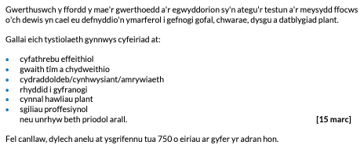
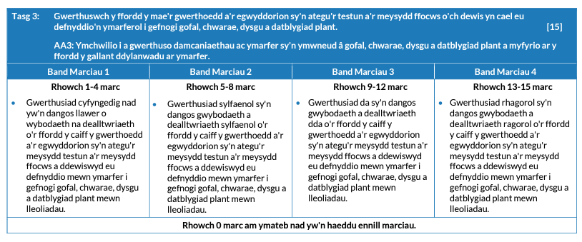
Testun 1 - Tasg 3 a'r cynllun marcio

Slide 20
Testun 1 - Tasg 3 ateb yr ymgeisydd gyda sylwadau’r Uwch Arholwr
In order to support children's health and wellbeing effectively it is vital that practitioners uphold certain values and principles. Working closely with parents and having a strong partnership is vital in childcare settings because it will help practitioners to see the bigger picture. It also allows practitioners to get the best possible outcomes for the child and reassure parents. This can be done by sending home letters, involving parents in parents' evenings or giving them opportunities to be involved in learning. However, if this is not done there will not be effective communication for the child to progress at home as well as in the setting because there will not be consistency or routines that are similar. Effective communication is vital because it allows direct support to be put in place and clear understanding in situations. This can be done by professionals being prepared and allowing children time to talk. For example, in my placement all staff including myself communicate with a speech and language therapist so that we continue to encourage the same approaches as they do with that child. Children need effective communication now more than ever whether they are younger or older, this could be actively listening to them or observing. This is shown through the statistics of "Now, five children in a classroom of 30 are likely to have a mental health problem" (The Children's Society, 2022}. In my current placement we have a 'partnership with parents' policy that ensures children are best supported by practitioners and families. If this policy is not kept to then information could be missed or misinterpreted which may affect a child's development. An example of this is that if a child has bad situations going on at home such as parents divorcing, a younger child may not understand therefore parents would need to inform the setting so that information can be passed on. If this situation was applied to a child in comprehensive, they may deal with things differently as they will understand the situation better and be more aware of the reasoning behind it. In my placement, a child was acting quiet therefore I spoke to the child; however, the child was still young so I needed to speak with the parents. I found out that the child's grandparent had passed away and the child was struggling to comprehend it. If I hadn't of spoke to the parents then I wouldn't have been able to support that child in the best way.
Alongside working with parents, it is important to work with other professionals and respect their input. This is important because other professionals will have other knowledge and specified knowledge in other areas. For example, a child who is suffering with their mental health should be supported by a counsellor or a mental health support worker as they will have specified advice and a better understanding as that is their area of specialties. This can be done through multiagency working to provide the best outcomes for children. If a child needs support for their health and are struggling with obesity then they might receive support from the doctors for advice on what to do and keep checks on their overall health however Dr Charlotte Hardman explains that "obesity and emotional problems are intertwined" (BBC NEWS, 2019) therefore that child would need to see a professional whose area is mental health. This evidence shows that obesity cannot be treated in isolation and a more holistic approach needs to be adopted. This links to the Healthy Schools scheme because it looks at both mental and physical health as two separate areas which is good however they need to remember that these areas all have a knock-on effect. Similar in the ways that Maslow's Hierarchy works as you need all of the needs met to reach self-actualisation.
It is vital that children's needs and interests are put first. This can be done by giving children choices or options. For example, giving them opportunities to talk rather than forcing them and letting them decide how much they tell you. This links into supporting individual needs as it is ensuring that each situation is dealt with in ways that suits the child best ensuring the child is happy. Under the SSWWA 2014, every child needs a voice, this includes advocacy. By doing this, it relates to article 13 of the UNCRC which is "the right to freedom of expression" (Unicef) as it gives children opportunities. Ensuring children are comfortable with talking to you is vital because some children may prefer other approaches. If this was applied to a child with speech and language difficulties they may prefer art therapy however if it is an older child then they may feel comfortable with talking and undergo psychoanalysis (talking therapy). If a child centered approach is not followed then the advice will not be specific to situations and may not benefit the child.
Adborth yr Uwch Arholwr ​
​
Mae pwysigrwydd gwerthoedd ac egwyddorion proffesiynol wedi'u nodi'n eglur, ac maen nhw wedi'u strwythuro mewn modd rhesymegol. Mae'r dull hwn wedi darparu gwerthusiad rhagorol o'r meysydd tystiolaeth allweddol, a dangoswyd gwybodaeth a dealltwriaeth dda o'r meysydd testun a drafodwyd.
Rhoddwyd 13 marc allan o 15

Slide 21
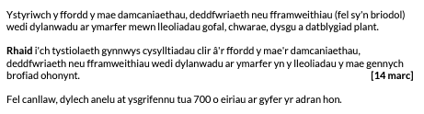
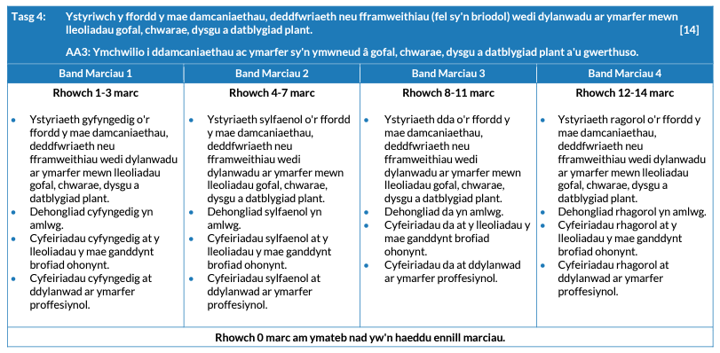
Testun 1 - Tasg 4 a'r cynllun marcio

Slide 22
Testun 1 - Tasg 4 ateb yr ymgeisydd gyda sylwadau’r Uwch Arholwr
Maslow's Hierarchy of needs is a psychological theory in which explains human motivation based of the different level of needs within his pyramid. This supports my focus area of mental and emotional wellbeing because it shows what an individual needs to reach self actualisation and one of the basic needs to get to this point is good self-esteem. If an individual has a good self-esteem they are more likely to have better mental wellbeing. The order of these starts from basic needs moving then to advanced needs. It is my conclusion that although this theory is widely used in different settings, there is not enough evidence behind this theory to support his ideas and there is not enough evidence to show these needs are in hierarchical order. Another limitation of this theory is that it is very hard to scientifically test because there was a very limited number of individuals samples to back up what Maslow said about self-actualisation. On the other hand, this theory supports basic needs being met first which is human nature. For example, a child who is hungry and thirsty is given the option to have food or toys. They will choose food first as that is a basic need then the toys second. This shows that Maslow's theory is accurate in the fact that individuals need food, sleep and shelter before anything else. It is also relevant in all fields whether that's education or healthcare which support children holistically. Carl Rogers, a humanistic psychologist agreed with this theory however he added that in order for an individual to grow they need to have an environment that provides them with genuineness, empathy and acceptance. Carl Rogers theory is however too positive when regarding human behaviour as he believes that every individual will choose positive paths in life however choice and free will is limited for some. Another theorist that focuses on motivation is Herzberg, he differs with this as Maslow believes that satisfaction comes from fulfilment of all these needs however Herzberg acknowledges the factors that cause satisfaction and dissatisfaction therefore he differs.
I believe that it is vital for children to have positive attachments when it comes to their emotional wellbeing as it helps children to have support and have someone to speak to openly. Bowlby supports this because his theory states that attachments with caregivers have a tremendous impact on childhood and adulthood. This has a positive impact on childcare practice because there has been evidence to show that attachments early on can benefit a child later in life emotionally and socially. This is shown through "Early attachment relations are thought to be crucial for later social relationships and for the development of capacities for emotional and stress regulation, and self-control." (NICE, 2016). A limitation of this attachment theory is that while Bowlby suggests the attachment with the mother is vital, other theorists such as Emerson believe that this attachment can be with anyone and there will be more than just that one attachment. Rutter critisises Bowlby's theory as there was no distinguishing between deprivation and privation. Rutter explains the bond of the attachment is the most important. Children need attachments with key workers as this will ensure they are looked after and can talk to someone if they need the emotional support. An example of this in my placement is a child who struggled with ACE's and lacked attachments so we therefore provided her with a key worker and she started getting comfortable that bond allowed her to thrive and openly speak about what was troubling her.
The Wellbeing of Future Generations Act 2015 supports my focus areas because it looks towards the future for health and wellbeing and wants better outcomes in these areas. A positive impact of this approach is it makes people feel in control. This is done by looking at what matters to them therefore being centered on what people want. In placement, if a child was suffering mentally and needed support rather than choose for them how to get better we give them options so they feel in control. A weakness of this legislation is that there is not enough funds and staff to follow this. In my primary school setting, we do not have a wellbeing specialist it is just the school nurse that looks into wellbeing too. This can sometimes work however sometimes children need more specialised help.
Adborth yr Uwch Arholwr ​
​
Mae Tasg 4 yn rhoi dehongliad rhagorol o'r damcaniaethau, y ddeddfwriaeth a'r fframweithiau perthnasol gyda chysylltiadau perthnasol â Rhaglen Ysgolion Iach Cymru. Ceir cyfeiriadau rhagorol at ymarfer a'r profiadau gwerthfawr a gafwyd drwy weithio gyda phlant mewn rôl broffesiynol.
Rhoddwyd 14 marc allan o 14

Slide 23
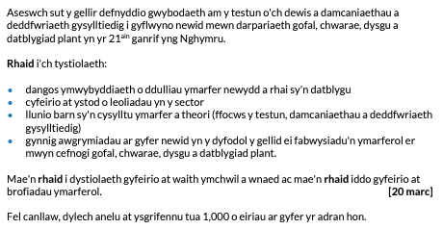
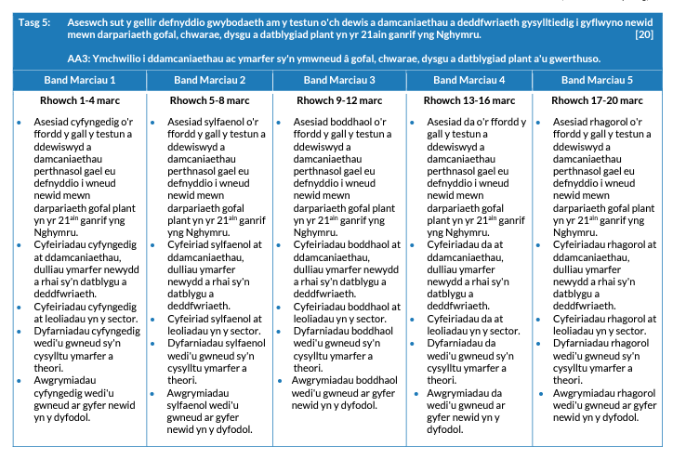
Testun 1 - Tasg 5 a'r cynllun marcio

Slide 24
Testun 1 - Tasg 5 ateb yr ymgeisydd
Since the Health Schools Wales has come about, mental and emotional wellbeing within education settings has started to become more recognised. However, there is a lot of changes to be made. An example of how change can happen is new training and courses can be provided for staff such as counselling courses or courses to expand educator's knowledge on children's mental health and how best to support them. There is a new approach called THRIVE or FLOURISH being introduced into schools in which I personally believe should be in every school. From talking to staff in settings that use this, staff told me that it had benefitted 90% of children within the settings and has become a success. These courses and approaches would help promote good wellbeing in children and support one of the aims of Healthy Schools.
Adding on to this, settings could have specific staff. In primary schools or comprehensives even, there are specified ALN staff so in the future we could possibly bring in health and wellbeing staff. This is needed as mental health and wellbeing is a huge concern at this current time therefore if a professional can dedicate their time to mental health then improvements can be made. Possibly even key workers for children who have suffered ACE's or past traumas could be provided as an extra support in place. There are key workers in place for children with speech and language difficulties and physical disabilities etc. therefore this could help children to open up and talk about their feelings. Think is supported by Bowlby's theory in which he talks about key workers for children being beneficial. Currently, there is not enough staff aware of how to deal with emotional wellbeing therefore in the future schools could have a trained professional that is specific to children's mental health in schools or they could complete lessons in the classes each week to ensure children's emotional wellbeing. The Government and NHS is recognizing children's mental health more now than ever and is trying to put in place support to deal with this. For example, ''The NHS.is investing an additional £79 million into children's mental health services because of the increased demand during the pandemic" (NHS England, 2022) showing that there are things being put in place from schemes recognising it such as the Healthy Schools to try to overcome this current issue.
From my research about how children have been struggling with their food and fitness levels, I believe that PE lessons need to be increased and there needs to be more hours dedicated to physical education. The Healthy Schools Scheme is working to promote good health by promoting food and fitness therefore we have this in place. Previously, physical education was not seen as important as other subjects however it is vital towards children's health, if a child is healthy they will also be more open to learning. Times have gotten worse as w have gone along c\nd parents are not seeing physical education as important for their children. This is shown from a study by the Youth Sport Trust saying "Only 38% of parents know that young people should be active on average for 60 minutes every day -down from 48% last year'' (Youth Sport Trust, 2022). This shows how PE is overlooked by parents and since COVID 19 parents are not as worried about it. By having more PE lessons a week or increasing the hours it will allow for better routines. Routines will also benefit children as it will help them to stay calm and have a better mindset knowing what is coming. This shows how vital it is to have enough exercise as "A Quarter of year 6 pupils are obese" (Youth Sport Trust, 2022) demonstrating that change needs to happen. In my placement of a primary school, we completed a survey with the children in older classes and asked them about whether they believe they get enough physical exercise at home or in school times, the results showed that over 70% of children feel as though they don't do enough. After this, my setting started to add in more afterschool clubs that included physical activity as if children are doing it together through games it makes it more enjoyable for them. With change in the new curriculum hopefully things will change and parents can be more educated as well as the staff.
parhau …

Slide 25
Testun 1 - Tasg 5 ateb yr ymgeisydd gyda sylwadau’r Uwch Arholwr
Another example of something that could bring about change is by having new policies or having specific health and wellbeing policies. This would provide more support and educate staff on how they can deal with situations in a professional way. It also means staff will use the same ways of dealing with things which will create consistency and make things work better while allowing for better outcomes. An example of this is, in my daycare placement we always communicate as staff to ensure we are using the same approaches for situations for children to understand how things work and it won't change depending on which staff member deals with the situation. A policy on this may be different in a daycare compared to a comprehensive school as there is a huge gap in level of maturity and understanding. This means that a policy in comprehensives may be working with just the individual whereas in a daycare it may be focused on getting parents involved to help understand situations.
From my research, I can gather than more recourses and different support options need to be in place for the future. This is because schools need to give children a bigger option of what support is available to them not just automatically refer them to CAHMS for example. By giving children the option and allowing them to choose what support they receive it help children to be more open to the idea of it and feel included in decisions, building their self-esteem. An option for children in preschools or primary schools could include music therapy or art therapy. In comparison to this, children in comprehensive schools may take part in hypnotherapy or talking sessions as they can explain at a better level and have more understanding about emotions. To meet individual needs, smaller groups or one-to-one sessions for wellbeing may be useful for children who feel uncomfortable in big groups.
Adborth yr Uwch Arholwr
​
Mae Tasg 5 yn asesu'r manteision dros newid a'r ymarfer o gefnogi newid mewn darpariaeth gofal plant. Mae pwyslais clir ar y gwelliannau ar gyfer y dyfodol y gellir eu datblygu o fewn y sector gofal plant yn ogystal ag asesiad manwl o'r llwybr i gyflawni'r newidiadau hyn.
Rhoddwyd 17 marc allan o 20

Slide 26
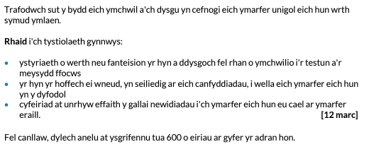
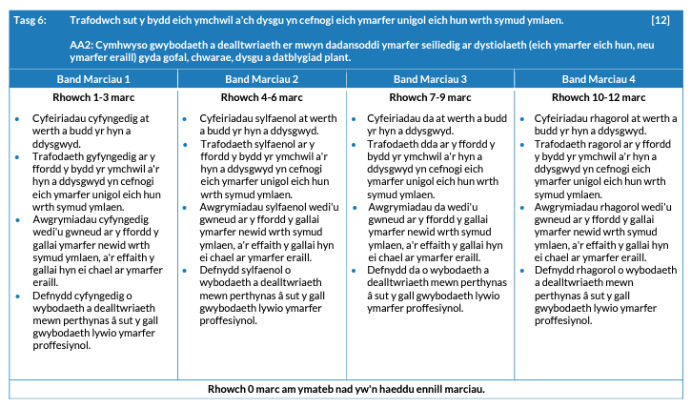
Testun 1 - Tasg 6 a'r cynllun marcio

Slide 27
Testun 1 - Tasg 6 ateb yr ymgeisydd gyda sylwadau’r Uwch Arholwr
From this investigation, I have learnt many things that will help me to work with children in the future such as how much of a problem health and wellbeing is within children at this current time. This research has shown me how many children need support for physical or mental and emotional wellbeing from statistics such as "around 1 in 8 children and young people experienced behavioural or emotional problems growing up" (NHS). This may influence others practice by looking more into mental health and coming up with different strategies to suit individual needs and different age groups. I can use this information to advice parents confidently. This may mean that the setting provides more support groups after school time where parents can get involved or effective communication can take place as there will be a stronger partnership with parents if we advise them and provide them with knowledge.
Before carrying out this research, I did not realise the extent of how many children were struggling with obesity and how little physical activity children are getting since COVID. I have learnt that since the pandemic children are not as active as they used to be due to a range of factors which include social media and screens. A quote found to support this says "researchers found that children spent an average of 7. 7 hours a day in front of a screen, up from pre-pandemic estimates of 3.8 hours per day" (CNN, 2021). I could use this information to support other staff members and inform them by making a presentation on my findings to help other practitioners be aware on how to support children's health. This will make a positive difference to the procedures in my settings because they can be adapted to fit all children and policies can be updated.
From following my findings, I have now appreciated the holistic impact of the recent pandemic on children. After finding out statistics I decided to look into theorists and strategies that would support children in which can be beneficial to me in supporting children in the future as I will have more ideas of how to help children in the correct ways. This research means that I can now have a better understanding of how many different ways children can be supported. This research has enabled me to have a good foundation for my future career and better base knowledge. It has confirmed to me why I want to become a mental health nurse and how interested I am in supporting children within the health and wellbeing-based area.
Carrying out research on the Healthy Schools scheme allowed me to discover that all focus areas affect each other in similar ways that the legislation of the Wellbeing of Future Generations Act 2015 aims all has a knock-on effect. By this, I learnt that obesity and emotional wellbeing is linked as you cannot treat obesity without looking to support a child's emotional health alongside it. Although it needs to be helped I can also see how tackling obesity within children can cause more harm, I found that "despite these physical, social and emotional consequences, there is a risk that tackling obesity will stigmatise obese children and do more harm than good" (Aggleton et al, PA et al, 2010). This can improve my practice as I will be aware of the sensitivity of this and approach it so it does not single out children who are obese but provide support in other ways. I could do sessions in class where obesity and health conditions are spoke about so all children can understand it rather than just have basic knowledge of it. This would then improve chiidren's self esteem so they feel welcomed. This means that children can be educated and able to make decisions about their own health. This meets the ways of working in the legislation 'Wellbeing of Future Generations Act 2015' as making children responsible for their own health at an earlier age, it allows for early intervention to relieve pressure on our NHS for the future. If a child had a physical disability then they would therefore need more support in order to take responsibility for their own health.
Adborth yr Uwch Arholwr ​
​
Mae Tasg 6 yn dangos sut mae'r ymchwiliad cyfan wedi datblygu sylfaen wybodaeth gadarn o safbwynt yr ymgeiswyr, a sut mae'r gwaith ymchwil a wnaed wedi cefnogi gwell dealltwriaeth o'r testun a'r meysydd penodol a ddewiswyd. Mae'r dasg hon yn rhoi trafodaeth glir o werth yr ymchwil a'r dilyniant yn y dyfodol i lywio'r ymarfer.
Rhoddwyd 12 marc allan o 12

Slide 28
Testun 1 - Llyfryddiaeth
• 4. Children and young people - GOV.UK (www.gov.uk) [Accessed 19/04/2023]
• https://www.youngminds.org.uk/about-us/media-centre/mental-health-statistics/ rAccessed 19/04/23]
• Obesity and depression 'hand-in-hand' in children - BBC News [Accessed 19/04/2023]
• Children's Mental Health Statistics I The Children's Society (childrenssociety.org.ukl (Accessed 19/04/23]
• Adverse Childhood Experiences (ACEs) and Attachment - Royal Manchester Children's Hospital (mft.nhs.ukl [Accessed 19/04/23]
• https://www.thriveapproach.com/news/whole-school-approach-to-menta I-health [Accessed 19/04/23]
• Physical activity guidelines for children and young people - NHS (www.nhs.uk) rAccessed19/04/2023]
• Physical Activity Facts I Healthy Schools I CDC [Accessed 19/04/2023)
• Number of children getting enough physical activity drops by 40% - GOV.UK (www.gov.uk)[Accessed 19/04/2023]
• child obesity booklet-English.pdf (senedd.wales) rAccessed 19/04/2023]
• Eating disorders: what's behind the rise? I Community Practitioner [Accessed 19/04/2023)
• Eating disorders: what's behind the rise? I Community Practitioner [Accessed 19/04/2023)
• Maslow's hierarchy of needs pyramid: Uses and criticism (medicalnewstoday.com) [Accessed 26/04/2023]
• UNCRC summary-1 l.pdf (unicef.org.uk) [Accessed 26/04/2023]
• How lockdown affected children's stress and anxiety i Children's Commissioner for England(childrenscommissioner.gov.uk) [Accessed 09/02/2023]
• Body image in childhood (mentalhealth.org.ukl [Accessed 26/04/2023]
• Obesity and depression 'hand-in-hand' in children - BBC News [Accessed 19/04/2023]
• Children's Mental Health Statistics I The Children's Society (childrenssociety.org.ukl (Accessed 19/04/23]
• Adverse Childhood Experiences (ACEs) and Attachment - Royal Manchester Children's Hospital (mft.nhs.ukl [Accessed 19/04/23]
• https://www.thriveapproach.com/news/whole-school-approach-to-menta I-health [Accessed 19/04/23]
• Physical activity guidelines for children and young people - NHS (www.nhs.uk) rAccessed19/04/2023]
• Physical Activity Facts I Healthy Schools I CDC [Accessed 19/04/2023)
• Number of children getting enough physical activity drops by 40% - GOV.UK (www.gov.uk)[Accessed 19/04/2023]
• child obesity booklet-English.pdf (senedd.wales) rAccessed 19/04/2023]
• Eating disorders: what's behind the rise? I Community Practitioner [Accessed 19/04/2023)
• Eating disorders: what's behind the rise? I Community Practitioner [Accessed 19/04/2023)
• Maslow's hierarchy of needs pyramid: Uses and criticism (medicalnewstoday.com) [Accessed 26/04/2023]
• UNCRC summary-1 l.pdf (unicef.org.uk) [Accessed 26/04/2023]
• How lockdown affected children's stress and anxiety i Children's Commissioner for England(childrenscommissioner.gov.uk) [Accessed 09/02/2023]
• Body image in childhood (mentalhealth.org.ukl [Accessed 26/04/2023]
• https://theoneplanetlife.com/four-things-wrong-with-the-well-being-of-future-generations-act/ [Accessed 27/04/2023]
• Children's mental health - Every Mind Matters - NHS (www.nhs.uk} [Accessed 27/04/2023]
• Children's screen time nearlv doubled during the pandemic I CNN [Accessed 27/04/2023]
• Aggleton et al, PA, CD, IW, 2010, Promoting Health and Wellbeing through Schools, Oxon, Routledge
• Mainstone-cotton, SM-C, 2021, Supporting children with social, emotional and mental health needs in the early years, Oxon, Routledge.
• Prever, MP, 2006, Mental Health in Schools, London, A SAGE Publications.
• The Welsh Assembly Government, 2010, Thinking Positively, Document no.089/2010, Cardiff.
• Welsh Government, 2020, Curriculum for Wales guidance.

Slide 29
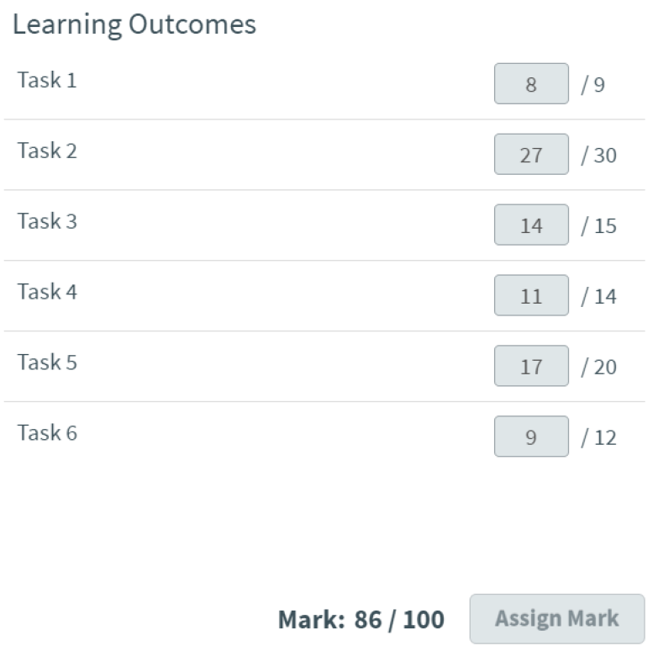
Testun 2 a sylwadau cyffredinol Phrif Arholwyr
Testun 2 - Mae damcaniaethau am ddatblygiad ymddygiad yn gallu cael eu defnyddio i gefnogi dull cadarnhaol (positive approach) at ymddygiad plant.
Gwnewch ymchwil ar sut mae damcaniaethau’n gallu cefnogi gwybodaeth a dealltwriaeth o ymddygiad.
Adborth yr Uwch Arholwr
Ar y cyfan, rhoddwyd yr ymchwiliad testun 2 hwn yn y ddau fand marciau uchaf. Mae'r ymchwiliad hwn yn darparu ystod dda o dystiolaeth sy'n berthnasol ac yn cysylltu'n gyson â'r testun a'r meysydd penodol a ddewiswyd. Mae wedi'i gyfeirnodi'n dda drwyddi draw. Mae'r radd gyffredinol a roddwyd yn cyfateb i radd rhagoriaeth deilwng iawn.
Deilliannau Dysgu

Slide 30
Testun 2 - Tasg 1 a'r cynllun marcio
Ysgrifennwch gyflwyniad i'ch ymchwiliad estynedig. Amlinellwch y canlynol:
• y prif feysydd ffocws rydych wedi dewis ymchwilio iddynt mewn perthynas â'r testun o'ch dewis
• pam rydych wedi dewis y testun a'r meysydd ffocws; efallai yr hoffech gyfeirio at ddiddordeb personol, cynnwys a addysgwyd, gweithgareddau ymgysylltu â'r sector a lleoliad gwaith y dulliau ymchwil a ddefnyddiwyd gennych
• y ffynonellau a ddefnyddiwyd fel rhan o'r gwaith o ymchwilio i'r testun a'r meysydd ffocws.
[9 marc]
Fel canllaw, dylech anelu at ysgrifennu tua 450 o eiriau ar gyfer yr adran hon

Slide 31
Testun 2 - Tasg 1 ateb yr ymgeisydd gyda sylwadau’r Uwch Arholwr
For my extended investigation I gravitated towards choosing Topic 2 which requires researching how theories can support knowledge and understanding of behaviour. I decided against Topic 1 because I felt that I already possessed a great amount of knowledge of the subject and I wanted to stretch and challenge myself by choosing Topic 2. My main focus areas for my chosen topic are Bandura’s Social Learning Theory, Skinner’s Operant Conditioning theory and Bronfenbrenner’s Ecological Systems Theory. These three areas that I will explore were chosen because I have a personal interest in further developing my current knowledge on the topic area. During my childrens learning play and development course I have had the opportunity to study theories from Helen Bilton to Lev Vygotsky and although I am knowledgeable I would like to further extend my understanding of learning and behaviour theories.
Over the last three years I have accumulated insight into a variety of theories and theorists and it is highlighted through practice how important knowledge really is to help us understand children's development. For example through my placement I observe in the daily routine how the settings incorporate theories through positive reinforcement or the use of outdoor play, heuristic play or forest schools. “Theories help us understand how children develop and learn. They’re used to predict future behaviours and guide teaching methods” (Main,no date)Thus highlighting how valuable they are to our practice as practitioners. Understanding theories allows us to understand children which is very advantageous in the job role of a child caregiver because they are the people who will aid a child’s development to allow them to meet their potential. I think that familiarity of theories is a helpful part of becoming a competent and capable qualified practitioner. It allows for an in depth look into how children think, learn and develop and allows for you to help the child on a holistic level to achieve and succeed in meeting milestones and their developmental outcomes. It is interesting to see through theories the impact of environments and behaviours on the children for instance in my setting i have witnessed a substantial difference in behaviour both positive and negative when children are taken outside to complete a task instead of inside, children’s learning methods differ which greatly affects how they respond and their behaviour, “The outdoor learning approach can benefit a wide range of children’s learning needs, including the needs of children on the autism spectrum or with emotional or behavioural difficulties, an can benefit children with a range of learning styles (Haymer,2022) This support what i have witnessed in my setting.
Within my extended investigation I will be using a mixture of both primary and secondary sources. My primary sources will be my own viewpoints taken from personal experience like my placements as well as viewpoints from colleagues in my settings. For my secondary sources I will be using an array of media sources from Government websites, published journals, Articles and textbooks from my college course. I believe my sources to be reliable because the topics are behavioural theories which means the articles are published by universities and professional theorists.
Adborth yr Uwch Arholwr
Mae Tasg 1 yn nodi'r meysydd trafod a'r rhesymau dros eu dewis, gan fynegi amrywiaeth o brofiadau proffesiynol. Mae'r dasg hon yn nodi'r ymatebion â ffocws manwl sy'n ofynnol ar gyfer yr ymchwiliad ac yn nodi'r amrywiaeth o ffynonellau a fydd yn cael eu defnyddio'n rhan o sylfaen dystiolaeth yr ymchwil. Mae'r cyflwyniad hwn yn rhoi ffocws i'r ymchwiliad cyfan ac mae'n rhoi eglurder i'r llwybrau ymchwilio i'w harchwilio.
Rhoddwyd 8 marc allan o 9

Slide 32
Testun 2 - Tasg 2 a'r cynllun marcio

Slide 33
Testun 2 - Tasg 2 ateb yr ymgeisydd
The New Curriculum for Wales impacts learning environments and experiences in many different ways, some of which are positive while others negative. The curriculum sets out frameworks and guidelines for many different education settings including schools settings, pupil referral units and funded non-maintained nursery settings. The curriculum applies to children in these settings between the ages of 3 to 18 (Welsh Government (30/09/2021). The key focus of the curriculum is to create learning environments which support children to learn and develop. One positive influence of the New Curriculum for Wales is that it supports and allows schools to create their own curriculum (Welsh Government (30/09/2021). This is a positive because it allows schools to create a curriculum that best supports the students of their individual school, not the entirety of Wales. Curriculum requirements show what each schools individual curriculum should work towards developing, they are the four purposes;
“ambitious , capable learners, ready to learn throughout their lives
Enterprising, creative contributors, ready to play a full part in life and work
Ethical, informed citizens of Wales and the world
healthy , confident individuals ready to lead fulfilling lives as values members of society” (Welsh Government (10/01/2022)
The curriculum requirements ensure a more consistent approach in Schools across
Wales (Welsh Government (30/09/2021). A weakness of the curriculum is that due to creating their own curriculum, schools may put more emphasis on different purposes or schools could have different understanding of what the four purposes actually mean. A benefit of schools having a curriculum that is unique to each school is that it allows settings the opportunity to offer children a larger range of experiences which are relevant to the children attending the school and in turn support children’s development. This could be trips, activities or guest speakers. The New Curriculum for Wales helps to set out routines in settings. This is a strength to the curriculum because children will be able to learn and understand what the next steps that will happen are. Dreikurs, R an Austrian Educator and psychiatrist, believes that the importance of routine is that;
“Routine gives a feeling of security. An established routine also provides a sense of order from which freedom grows.” (Exploring your mind (26/12/2016).
From my own experience in a Cylch Meithrin I am able to see that children enjoy knowing what they are about to do. At snack time, the children all sit on a mat and name what they are doing next leading up to eating their fruit, “sit on the mat, toilet, wash hands, milk and fruit”. Another benefit of the curriculum is that children are able to socialise through play and working together whilst learning. The value of this is that it helps children with developing their social and communication skills and empathy. Whilst the curriculum will be individual for each school, a weakness is that it is not individual for each child's development and style of learning. The pace of the lessons could be too fast or too slow. This could lead to children either struggling with their work or becoming distracted or bored. Within this type of learning environment teaching is static and is instructor-led. The Reggio Emilia approach opposes this style of teaching, believing that children all have unique learning needs and that adults and the learning environment should change in order to meet the children’s needs and natural interests (Goodwin (19/10/2017).
An alternative form of learning environment available is home education. This form of education takes place in the home and is facilitated by the parents or caregivers. A strength of this type of learning environment is that it is extremely flexible. Lessons and activities can be changed and adapted in order to meet the needs of a child as an individual rather than as part of a group. The learning does not have to follow a specific curriculum or guidelines which allows it to follow the interests of the child. Radford, B who is a home educating parent, said in an article for the BBC;
“I think home educated children have more confidence, and they’re curious, they want to know, they want to learn, they don’t see learning as a major chore. It is a chore, sometimes they don’t want to learn. But they also have the freedom to then expand into what they want to learn.” (Lewis, B (22/10/2021).
In home education the learning environment is the home. The benefit of this is that the child may feel more comfortable in the setting, they will not have to spend long periods of time away from their parents. A possible weakness of this style of learning could be that the child may suffer from separation anxiety or struggling to do activities without their parents. This may cause children’s social development to suffer. One theory which supports this type of learning environment is John Bowlby’s theory of attachment. Bowlby’s theory agrees that the relationship between parents and children is important for children’s healthy development and care (Ray. B D (10/01/2011). John Bowlby said;
parhau …

Slide 34
Testun 2 - Tasg 2 ateb yr ymgeisydd
My second focus area is Operant Conditioning theory. Developed by pioneer B.F Skinner, it consists of the use of reinforcement to alter behaviour. An important concept of behavioural psychology similar to Classical conditioning, founded by Ivan Pavlov, they both suggested that learning can be done through conditioning with subjects able to adapt to their environment. Operant Conditioning focuses on reinforcement or punishment after a behaviour. Notably positive reinforcement in a setting would be after a child has completed a task their given dojo points, this example allows the child to feel accomplished and with giving a reward the child is more likely to repeat the behaviour associating completion of work to being rewarded. Skinner identified three types of response or operant that can follow behaviour: Neutral operants - responses from the environment that neither increase nor decrease the probability of a behaviour being repeated, Reinforcers - responses from the environment that increase the probability of a behaviour being repeated. Reinforcers can be either positive or negative, Punishers - responses from the environment that decrease the likelihood of a behaviour being repeated. Punishment weakens behaviour. (Haymer,2022)
From personal experience in my placements I have found that different settings offer different rewards schemes, some schools use dojo points, extra play time, ‘wow’ box where a child will choose a toy from a basket or will take the class mascot home for the weekend. The most effective modes of rewards are praise, stickers and stamps as the children enjoy showing them to others and they are able to take them home to show their parents. With praising the children they feel acknowledged and seen therefore they are more likely to continue modelling similar behaviour in order to be praised once more. I too believe that they are the most effective way to positively reinforce behaviour. Positive reinforcement can occur more naturally or deliberately. In particular saying thank you after someone opens the door for you would be an example of natural positive reinforcement. Deliberately would be giving them a sticker after you asked them to tidy up. All theories include both positive and negative aspects, a positive being the importance of knowledge and understanding of theories to determine behaviour and how children learn and develop.
The use of theories within the classroom emphasises why scientific research is so significant when working with children, having awareness of previous and current theories allows you as a practitioner to implement effectively. A weakness of this theory is that like all theories it is not guaranteed to work with everyone, as we already know each child is different which is why it's so important to have awareness of a number of theories so they can be implemented to the individual child. Positive reinforcement is not guaranteed to be a permanent solution or effective; some children will alter behaviour momentarily in order to receive praise or a reward and then revert back to negative behaviour. Another issue with this theory is that “Punished behaviour is not forgotten - it’s suppressed. The behaviour returns when punishment is no longer present” (Haymer,2022). Much like my previous theory, this current theory cannot be extended through investigation due to ethical concerns. Skinner conducted an experiment using rats as it explained negative reinforcement, he called it the ‘Skinner box’. “As the rat moved about the box it would accidentally knock the lever, the current would be switched off, the rats quickly learned to go straight to the lever after being out in the box a few times'' (Haymer,2022) Experimenting with animals would be frowned upon in this day and age so similar experiments cannot be conducted. A psychiatrist by the name of William Glasser a developer of The Choice Theory counter argues that “Choice theory contends that we are internally motivated, not externally motivated by rewards and punishment” (Sullo,2011) I do not entirely disagree with this statement but i think that both theories are accurate, i believe that children do choose their behaviour but at the same time it can be altered for some through recognition, praise, rewards and punishment.
parhau …

Slide 35
Testun 2 - Tasg 2 ateb yr ymgeisydd gyda sylwadau’r Uwch Arholwr
Contemporary theorist Urie Bronfenbrenner, the originator of the Ecological Systems Theory, believes that social environments affect a child’s holistic development. From this he formulated the 5 systems surrounding every child; Microsystem - immediate environment - Family,friends,direct influence, Mesosystem - Connections - education,healthcare,broader influence, Exosystem - Indirect environment - friends of family, familiar people, Macrosystem - Social and cultural values - attitudes customs of cultural group, Chronosystem - Changes over time - hereditary, environmental and biological factors (psychology notes,2021) This theory focuses on who is around the child much like Bandura’s Social Learning Theory it also focuses on how behaviour can change from social factors. This theory is especially prevalent in settings because professionals often have direct contact with parents or family members in order to keep them updated on their child. An example of theory in a setting would be a parent notifying a practitioner that a child did not sleep much the previous night. With that information our approach to the child and their behaviour would be altered and their behaviour would be explained because they will be tired, also it allows for us to put things in place for the child in order to promote the child’s learning. “It considers all areas of influence, these include cultural and social values”(Social Sciences,2020)
This theory has been positively recognised not only because of its accuracy but because of its inclusivity in recognising cultural aspects of a child’s life and the impact it could have on the child. This promotes Article 14 “Children have the right to think and believe what they want and to practise their religion, as long as they are not stopping other people from enjoying their rights. Parents should guide their children on these matters.” and also Article 29 “Education should develop each child’s personality and talents to the full. It should encourage children to respect their parents, their own and other cultures and the environment.” (Welsh
Government,2020) Within a setting it is very beneficial to understand the systems surrounding each child, to know how to react to certain behaviours and approach the child in a positive manner. There are lots of factors to consider through using the Ecological Systems Theory that will allow for practitioners to offer the best practice that suits the child individually, especially if we knew that a child was muslim. The setting would offer alternatives that best suit their needs and also celebrate cultures and religion around the classroom using books or cultural objects and clothing in the role-play area. Settings can promote equality and diversity through knowledge and understanding of children's backgrounds and cultures.
Adborth yr Uwch Arholwr
​
Mae Tasg 2 yn darparu ystod dda o safbwyntiau a phrofiadau personol y damcaniaethau a all gefnogi gwybodaeth a dealltwriaeth o ymddygiadau. Ceir cysylltiadau da i fynegi sut mae'r meysydd penodol yn cefnogi rhyngweithiadau cadarnhaol neu negyddol ymddygiadau, ac mae'r rhain wedi'u cefnogi'n dda drwy ddefnyddio enghreifftiau a damcaniaeth. Mae'r dasg hon yn rhoi eglurder i'r meysydd ymchwil a'r gwaith ymchwiliol sy'n cefnogi'r maes testun hwn.
Rhoddwyd 27 marc allan o 30

Slide 36
Testun 2 - Tasg 3 a'r cynllun marcio

Slide 37
Testun 2 - Tasg 3 ateb yr ymgeisydd gyda sylwadau’r Uwch Arholwr
Effective communication is the foundation of a great working relationship in all settings. Without communication we as providers would not be able to support children to reach their full potential. Whether communicating with other staff members, parents or the children themselves, the need to communicate allows for us to share our knowledge and understanding in order to positively approach children and the behaviour they exhibit. Communicating effectively strengthens your relationships with parents, children and other staff which is needed in order to provide children with the best possible learning experiences. Through effective communication children’s rights are being upheld as it allows for them, in reference to Article 12 of The United Nations Convention on the Rights of the Child, “Children have the right to say what they think should happen, when adults are making decisions that affect them,and have their opinions taken into account.” Upholding these rights and allowing the children to communicate how they feel or what they think reinforces trust in the relationship between practitioner and child and will allow them to feel safe and secure which in turn leads them to be less likely to engage in negative behaviour. Bandura’s Social Learning Theory is a great example of why communication is so important in my own experience. Effective communication has been instrumental in my progression as a qualifying worker, effective communication is needed for me to be able to complete my practical work within settings. Communication is needed between myself and my assessor as well as the class teacher in order to highlight any strengths and weaknesses that I may have which results in an improvement in my own practice. Skinner’s theory of Operant Conditioning encourages effective communication through praising children. Praising children openly encourages them to repeat the behaviour. In order for a practitioner to have a positive approach to children’s behaviour they need the ability to communicate with other staff in the settings and through communication they can share knowledge of theories or gathered from parents in order to adapt their practice and successfully implement. Another theory that I believe to strongly link to with effective communication would be The Ecological Systems, Urie Bronfenbrenner.
With this theory focusing on the child’s surroundings we know that in order for us to understand the impact on a child we first need to know what is going on around the child. To find this out a the family members would communicate it through multiple means either telling the teacher, a phone call or a little message. An example of this would be if a child is going through a transition like a divorce the parent would bring awareness to the caregiver who would then put things in place to create a comfortable environment for the child. Understanding the child and why they behave the way they do helps us to implement things in the classroom to make it more suited for their needs, like talking to the child, supplying books where the protagonist has divorced parents etc. I have witnessed effective communication an astounding amount of times but a favourable example would be a child who is suffering from an illness or allergy. Communication is fundamental in these situations as the child is at risk, asthma or food allergies need to be communicated to all staff like the dinner ladies in order to safeguard the child.
Understanding Equality, Inclusion and Diversity is very important, especially implementing it in your own practice and in the classroom. From my own experience I am aware of why it is a key principle of children’s care learning and development. Equality means everyone gets equal opportunities not the same, extra time to complete a task would be an example of equality, it ensures that children have the means to be successful but not given the same resources as someone who doesn’t need it. I have seen the impact of inclusion and diversity first hand in my settings when the classroom was supplied with an array of books featuring a variety of skin tones. A little girl of darker complexion picked up the book and shouted ‘she looks like me’ with a smile on her face. Something as miniscule as opting for those books in the classroom changed not only how the child felt and behaved the rest of the day but also promoted inclusion and acceptance from the other children. My setting promotes equality, inclusion and diversity through the celebration of cultural events and traditions. We have celebrated Diwali, Lunar new year and Eid Mubarak. Through celebrating these and getting the children involved through creative activities like creating diya lamps and a giant dragon costume and having a parade it opens the children’s eyes to other cultures and extends their knowledge and understanding of the world around them. We had a new student who was a little girl from Ukraine. Due to having limited vocabulary, communicating with her mother was the key to understanding how she felt, what she liked and disliked etc. From this we could communicate with her and create a safe and stimulating environment while she adapted to surroundings and developed her English language. To ensure that not only the student but also the parent felt included when making a mothers day card, we created a custom that said happy mothers day in Ukrainian in order to promote equality, inclusion and diversity. Bronfenbrenner’s macrosystem focuses on culture and values which are a key factor to the children’s learning and behaviour development, when children feel acknowledged they are more likely to exhibit positive behaviour. Similarly to Bandura’s theory, ‘monkey see, monkey do’ if children see others embracing cultural differences they’re more likely to model the same behaviour.
Adborth yr Uwch Arholwr ​
​
Mae'r dasg hon yn darparu dull methodolegol o fynd i'r afael â'r meysydd testun gofynnol. Mae dealltwriaeth gadarn o'r gwerthoedd a'r egwyddorion sy'n sail i'r meysydd testun a ddewiswyd ac sy'n ymwneud â'r damcaniaethwyr Bandura, Skinner a Bronfenbrenner. Mae ystod glir i'r drafodaeth ym meysydd gwybodaeth ddamcaniaethol a rhoddwyd sylw o lefel dda iawn iddi.
Rhoddwyd 14 marc allan o 15

Slide 38
Testun 2 - Tasg 4 a'r cynllun marcio

Slide 39
Testun 2 - Tasg 4 ateb yr ymgeisydd gyda sylwadau’r Uwch Arholwr
Through gaining comprehension and understanding of a variety of theories and approaches, individuals as well as settings can take the knowledge acquired and use it to adapt their own practice. Notably using awareness of Heuristic play an individual can alter their practice to incorporate this as the value of this to a child’s development is crucial. Social Learning Theory influences how we approach and how we understand the process from observation to modelling helps us to know when to acknowledge both negative and positive behaviour as in the form of displaying negative behaviour as a practitioner aware of this theory i would respond accordingly knowing that the child is modelling from what they have observed therefore im less likely to punish said behaviour. Through the influence of this theory we’re able to adapt and incorporate this into the classroom, for instance gamification or simulations as “Gamification and simulations help teachers turn their classroom into a more interactive experience, turning activities into games”. (Western Governors University,2020) Altering tasks to be more interactive and gamelike has an effect on children’s behaviour. Interactive learning can help children to concentrate and deter negative behaviour.
I think that Operant Conditioning is heavily used within the majority of settings as positive reinforcement is something that has been used for a long time. Rewards through stickers and charts have been used in classrooms as a behaviour deterrent for years, and I remember clearly why it is so successful. It’s due to children needing to be acknowledged, some children lack that at home so it is fundamental in tackling any inappropriate behaviour. The influence in my own practice of Operant Conditioning theory has led me to be a little lenient with some displays of negative behaviour and as a setting I've seen that equally they aim to avoid negative reinforcement and promote positive reinforcement. My personal practice has been heavily influenced by my grasp of theories and it increased my awareness of the benefits of role modelling. A combination of understanding these three theories encourages professionals to take a holistic view and approach to children's behaviour. It focuses on all areas and values to develop a child’s ethos. Theories influence not only our understanding but also previous and current legislation, frameworks and policies. Within my current setting their behaviour policy focuses on upholding the children's rights referring to The United Nations Convention on the Rights of the Child articles to ensure the children “Reach for the stars”(Behaviour Policy,2021). Similarly to Skinner’s theory the policy highlights “Positive behaviour is promoted, acknowledged, shared and celebrated”(Behaviour Policy,2021). This also directly links with Bronfrenner’s Ecological Mesosystem as the policy and the recognition is in the school. The school's policies are the foundation for setting expectations within the school, they also help to keep the parents aware of how the school is promoting and aiding in the children’s development. Another school policy linked with the awareness of the child’s Ecological Systems is my current settings food and drink policy. This policy influences the children’s behaviour massively as we already know nutrition and hydration is a vital factor in a person’s behaviour, if children are not eating or drinking a set amount they can struggle with concentration, become aggressive or have limited motivation and fatigue. Implementing policies and procedures allows children’s rights to be upheld which is the most important factor of their education. Well-being of Future Generations (Wales) Act 2015 introduced to “help create a Wales that we all want to live in, now and in the future” (Welsh Government,2015).
The idea is to improve the social, economic, environmental and cultural well-being of Wales. This was implemented to give future generations the best quality of life because of the increase in poverty and climate change. It consists of seven wellbeing goals to show the Wales they want to see. The seven goals include; A prosperous Wales, A resilient Wales, A healthier Wales, A more equal Wales, A Wales of cohesive communities, A Wales of vibrant culture and thriving Welsh language, A globally responsible Wales (Welsh Government,2015) This influenced practices massively, especially their policies. It also influenced practice and curriculum, schools and day nurseries became more environmentally aware, introducing recycling, composting, growing of fruit and vegetables and gardening clubs. It also increased the use of the welsh language in Wales which has dramatically changed since I was in school. It is now incorporated into everything you do as a practitioner from greetings to questions in the morning; ‘Sut mae tywydd heddiw?”. Children’s welsh language has drastically improved supporting bilingualism.
Adborth yr Uwch Arholwr
​
Mae Tasg 4 yn rhoi eglurder i'r drafodaeth drwy ystyriaeth ysgrifenedig dda o'r safbwyntiau damcaniaethol, a'r effeithiau deddfwriaethol ar ymarfer. Darperir ystod dda o dystiolaeth i bwysleisio effaith newidiadau a gwelliannau sylweddol mewn ymarfer, megis hawliau plant, llesiant a dylanwadau strategaethau atgyfnerthu ymddygiadau cadarnhaol.
Rhoddwyd 11 marc allan o 14

Slide 40
Testun 2 - Tasg 5 a'r cynllun marcio

Slide 41
Testun 2 - Tasg 5 ateb yr ymgeisydd
Developing your familiarity of theories through exploring what the theories are, why they are instrumental and how to implement them into the classroom should be the foundation of our personal practice. In order to change your own practice you first need to understand why theories are relevant and the impact that they have on the child’s learning, play and development as well as their ethos. The implementation of change has been seen predominantly as the years progress, with the changing of the world comes the changing of curriculums, practices, policies and procedures. As seen when comparing Social Learning Theory and Operant Conditioning, the times change. Legislation progression and altering the way we think leads us to understand the immorality of the experiments conducted to support theories, thus being the reasoning as to why Bandura and Skinner can further develop their theory. Knowledge of the Ecological systems Theory and having an in depth understanding of the Ecological Systems will allow settings to offer events that prioritise interaction with the child’s surrounding systems. I think that it is important for settings to encourage interlinking the three systems; Microsystems, the child's immediate influences, Mesosystem, education influences and Macrosystem which is cultural group and values. Focusing on the holistic development of these areas will allow for the child to develop to the best of their ability and reach their full potential. This could be implemented in a setting through coffee mornings, the parents joining the children for breakfast clubs or holding other events. My current setting displayed a great example of this when the children went on a school trip to the local dairy farm that supplies the dairy products to the school. This was beneficial for the parents as they were able to bond with their guardians whilst simultaneously expanding their knowledge and understanding of the world. This trip also saw a remarkable change in how the children behaved. As a practitioner if any negative behaviour was displayed we were able to step back and allow the parents or carers to discipline. Any behavioural issues we were able to positively approach through positive reinforcement and distraction.
Operant Conditioning can be used to change the way we approach behaviour through our understanding of positive reinforcement and punishment. The theory suggests that an issue with punishment is “it creates fear that can lead to undesirable behaviours e.g fear of school” (Haymer,2022) this is the opposite of what a provider would want for children. Our aim is to create a comfortable, safe and stimulating environment for all children to learn. I think having an insight into Operant Conditioning can alter how we perceive the use of punishment and how we use it. I think the theory will have qualified practitioners and settings gravitate towards the use of positive reinforcement over punishment.
Understanding Albert Bandura’s Social Learning Theory will change how members of staff conduct themselves. This theory highlights the practitioner as ‘role models’ and also how children pick up everything through observation. Personally my practice will change in my awareness of children’s ability to imitate and model behaviour that I exhibit. This will lead me to be extra careful with how I present myself so open, friendly and kind. Modelling this kind of behaviour will lead children to imitate and develop.
Settings have recently been introduced to the ‘New Curriculum for Wales’ which has changed from the ‘Foundation Phase’, it aims for a child-centred approach and now includes four purposes that are the focal point of the curriculum to become; “Ambitious and capable learners, Enterprising, creative and contributors, Ethical, informed citizens and Healthy, confident individuals”. (Welsh Government,2022).
parhau …

Slide 42
Testun 2 - Tasg 5 ateb yr ymgeisydd gyda sylwadau’r Uwch Arholwr
This has influenced practice significantly recently as it differs largely from previous curriculums. The curriculum is said to be “designed by teachers” and “designed for all children”(Welsh Government,2022) to suit their needs and help them reach their full potential. It aims to focus on aiding them in a ‘fast-changing world’ through providing them with insight, skills and experiences. My experience so far from this change has been a little bit of a struggle as I was so used to the inner workings of the foundation phase. I have witnessed in schools that they are also finding it difficult to adjust to this change as they feel they lack the resources to fully implement this. From personal experience I have seen firsthand how schools are trying to implement this new curriculum however I do believe that the settings are not getting enough information and resources to live up to the new curriculum’s standards, within the classroom it feels very disorganised. Staff are really struggling to implement this without receiving the appropriate support and training to do so. I would suggest offering staff training and bettering their grasp of not only the new curriculum but also how to bring it into the classroom effectively. I also think there is a lack of communication which can be easily fixed with additional support from other settings and outside sources. I have recently experienced firsthand how schools are promoting the new curriculum through the settings routine. I have noticed that in line with the curriculum areas of learning; humanities, science and technology, settings allow the children more opportunities to learn outdoors and independently, I have also experienced, alongside the children, the opportunity to witness the life of chicks. The class were able to see up close the incubation of chicks and watch them hatch.
As told by the Welsh Government “The world around us is full of living things which depend on each other for survival” (Welsh Government,2022) This expanded their knowledge and understanding of the world which links directly to what the new curriculum is looking to achieve. They want to develop children’s insight that will be useful as they grow. Having recently implemented the ‘New Curriculum for Wales’ it is already successfully changing, as practitioners, how we view success. Rather than attaining academic success it focuses more on an individuals goals as well as their learning journey which reinforces the importance of child-centred learning
Adborth yr Uwch Arholwr
​
Mae'r dasg hon yn darparu asesiad gwerthfawr a chytbwys o amrywiaeth o strategaethau newydd a datblygol sydd yn anelu i gefnogi plant mewn ymarfer. Ceir ystod dda o dystiolaeth i gefnogi'r drafodaeth o sut mae damcaniaeth a deddfwriaeth wedi dylanwadu ar ymarfer ac wedi arwain at y newid cyfredol i'r ddarpariaeth ac at y newidiadau yn y dyfodol. Defnyddiwyd rhywfaint o ffynonellau wedi'u cyfeirnodi, ond gellid bod wedi datblygu cyfeirnodi priodol ymhellach i gefnogi'r canfyddiadau a nodwyd o fewn y gwaith ymchwil.
Rhoddwyd 17 marc allan o 20

Slide 43
Testun 2 - Tasg 6 a'r cynllun marcio

Slide 44
Testun 2 - Tasg 6 ateb yr ymgeisydd gyda sylwadau’r Uwch Arholwr
From this investigation I have increased my expertise on multiple behavioural theories linked to a child’s learning play and development. From Social Learning Theory to Operant Conditioning and Ecological Systems I feel that already there is improvement in my confidence in becoming a capable and competent qualified early years practitioner. The theories have given me an in depth insight into why awareness of relevant theories should be the foundation of a childcare practitioner. From knowledge and understanding of these theories in particular I am able to use it to alter my own personal practice to help children to learn and develop the best in my care. From Social Learning Theory I have learnt the impact that you have as a provider on a child. My understanding of observation, imitation and modelling has been expanded which is beneficial to my own practice as it will alter how I approach behaviour. I now view myself not only as a caregiver but also a ‘role model’ which is why I will be adapting my own practice in order for me to be a positive role model that displays only positive behaviour for the children to imitate. I was surprised while investigating B.F Skinner’s theory of Operant Conditioning as I was unaware of how much this current theory is implemented in, not only my practice but in the settings around me. Skinner’s theory has been a means of approaching and reinforcing positive behaviour throughout the settings that I have visited and it's a vital part of the children’s development as it acknowledges them and their success.
Throughout this investigation the knowledge I have gained has changed my perspective on how I approach behaviour and try to combat it. From looking at Operant Conditioning Theory alone I have discovered how ineffective the use of punishment is on a child. From this I will gravitate towards positively reinforcing behaviour over punishing. I think in regards to Urie Bronfenbrenner’s Ecological Systems Theory, I have learnt the most. Ecological Systems is a way of explaining behaviour, an example of this would be if a child is suffering from a transition like moving house, their behaviour may differ slightly from their usual self and they may become easily agitated and. I think that successfully comprehending this theory will lead me to make suggestions on my own future practice as well as others. I think I have progressed in terms of knowledge the most with this theory and from this I will be able to approach behaviour in a more positive manner and make recommendations on practice for example recommending building relationships with parents and carers through organising events. From Ecological Systems I have learnt the importance of interacting with the child’s surrounding environment in order for a child-centred approach.
Through this extended investigation I now realise how your knowledge and understanding of theories can support a positive approach to children’s behaviour. I have gained awareness in theories and how they are or can be implemented in practice to support positive behaviour. I plan to take this new found insight into my own practice and guide others around me to potentially alter their own practice to better understand children and allow them to reach their full potential.
Adborth yr Uwch Arholwr
​
Mae Tasg 6 wedi dwyn ynghyd yr amrywiaeth o ffynonellau ymchwil a ddefnyddiwyd, y canfyddiadau a throsolwg casgliadol o'r ymchwiliad cyfan. Mae meysydd allweddol yn cael sylw drwy drafodaethau'n seiliedig ar awgrymiadau ar gyfer ymarfer yn y dyfodol. Ceir cydnabyddiaeth o gynnydd personol drwy'r ymchwiliad yn ogystal ag effaith y wybodaeth a'r ddealltwriaeth a enillwyd. Dangoswyd lefel dda o ymwybyddiaeth o ddatblygiad proffesiynol a'r sgiliau a enillwyd y gellir eu defnyddio mewn ymarfer yn y dyfodol.
Rhoddwyd 9 marc allan o 12

Slide 45
Testun 2 - Llyfryddiaeth
Bibliography:
Garth Primary school(2021) Behaviour policy, Available at:
https://primarysite-prod-sorted.s3.amazonaws.com/garth-primaryschool/uploadedDocument/81daacd2-35cd-413b-88c2-o3a4eo39a19e/behaviourpolicy-garth-2021.pdf. (Accessed 12th April 2023)
Haymer, L.(2022) Level 3 Children’s Care, Play, Learning and Development: Theory Cardiff. WJEC Eduqas
(2020) How Social Learning Theory works in education, available at: https://www.wgu.edu/blog/guide-social-learning-theory-education2005.html#close (Accessed 11th April 2023)
Social Sciences (2020) When it comes to weaknesses, strengths, and biases Uri Bronfenbrenner’s Ecological System Theory, what are the implications for helping professionals?, Available at:
www.enotes.com/homework-help/when-comes-uri-bronfenbrenner-ecologicalsystem-465806
(Accessed 21st April 2023)
Sutton, J(2021) What is Bandura’s Social Learning Theory, Available at: www.positivepsychology.com/social-learning-theorybandura/#:~:text=Albert%20bandura’s%20social%20learning%20theory,imitating%2 0the%20behaviour%20of%20others.
Welsh Government(2022) A guide to the new Curriculum for Wales, Available at: www.hwb.gov.wales/api/storage/4e66c555-73aa-44ee-93e5-1eb12906f1d2-220208parents-carers-pdf (Accessed 18th April 2023)
Welsh Government(2020) A summary of The United Nations Convention, Available at:
www.gov.wales/sites/default/files/publications/2021-11/uncrc-summary-poster.pdf (Accessed 14th April 2023)
Welsh Government(2015) Well-being of Future Generations (Wales) Act 2015, Available at:
www.futuregenerations.wales/wp-content/uploads/2017/02/150623-guide-to-the-fgact-en.pdf
(Accessed 18th April 2023)
(2021) What is Bronfenbrenner’s Ecological Systems Theory, Available at: https://www.psychologynoteshq.com/bronfenbrenner-ecological-theory/.
(Accessed 14th April 2023)

Slide 46

Dyddiad cyflwyno
8fed Rhagfyr
Trwy lanlwytho Surpass

Slide 47
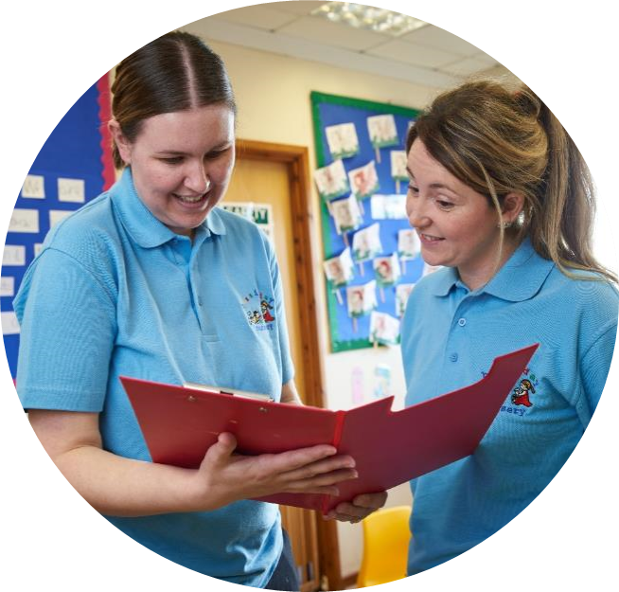
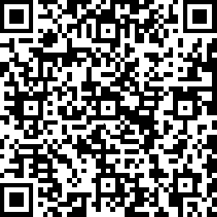
Gwerthuso'r Digwyddiad
https://www.surveymonkey.co.uk/r/WJEConline2023-24

Slide 48

Diolch
Thank you

Slide 49
Manylion cyswllt:
Cysylltwch â’n Swyddogion Pwnc arbenigol, Cynghorydd Technegol a’r tîm cymorth gweinyddol ar gyfer eich pwnc gydag unrhyw ymholiadau.
CBAC
Amy Allen-Thomas - Swyddog Pwnc
Tania Lucas – Swyddog Cefnogaeth Pwnc
GChDDP@cbac.co.uk
City & Guilds
Suzi Gray – Cynghorydd Technegol
Ansawdd: hclw.quality@cityandguilds.com
Cymorth i Gwsmeriaid/Cyffredinol: hclw.customer@cityandguilds.com

