Slide 1
Lefel 2 GChDDP: Ymarfer a Theori
(Uned 216)
Rhwydwaith Gwanwyn 2024

Slide 2
Cynrychiolwyr ac arbenigwyr pwnc CBAC a City & Guilds fydd yn cefnogi ac yn hwyluso'r digwyddiad hwn.
CBAC
Amy Allen-Thomas
Swyddog Pwnc – Gofal, Chwarae, Dysgu a Datblygiad Plant
Lefel 2 GChDDP: Craidd
Lefel 2 GChDDP: Ymarfer a Theori
Lefel 3 GChDDP: Ymarfer a Theori
Mae City & Guilds a CBAC yn parhau i gydweithio ac yn gweithio mewn partneriaeth â'r cyrff canlynol fydd hefyd yn cyfrannu at y digwyddiad hwn:
Cymwysterau Cymru
Gofal Cymdeithasol Cymru
Addysg a Gwella Iechyd Cymru
CBAC
Sian Bevan
Uwch Arholwr – Gofal, Chwarae, Dysgu a Datblygiad Plant
Lefel 2 GChDDP: Ymarfer a Theori

Slide 3
Recordio Sain
Mae'n ofynnol i'r cyflwynydd recordio sain o'r digwyddiad hwn. Mae hon yn reolaeth sydd wedi'i chynllunio i sicrhau bod CBAC yn gallu dangos cydymffurfiaeth ag Amodau Cydnabod rheoleiddiol; yn benodol, amodau sy'n ymwneud â chyfrinachedd deunyddiau asesu. Bydd y recordiad ar gael i'r rheoleiddiwr cymwysterau os bydd angen, ond ni fydd yn cael ei rannu ag unrhyw drydydd partïon eraill. Bydd y recordiad yn cael ei storio'n ddiogel gan CBAC am gyfnod o dair blynedd ac yna'n cael ei ddinistrio'n barhaol. Sylwch NA chaniateir i gynrychiolwyr wneud recordiad sain neu fideo o unrhyw agwedd ar y digwyddiad hwn.

Slide 4
Defnyddio Teams
Yn ystod y sesiwn Teams hon, byddai'n fuddiol i bawb lynu at yr egwyddorion canlynol: Troi microffonau i ffwrdd tra nad ydych yn siarad Defnyddiwch y nodwedd 'codi eich llaw' i ofyn cwestiwn neu defnyddiwch y “chat” Rhowch eich camera ymlaen os ydych yn dymuno gwneud hynny.
Problemau technegol: Os ydych chi’n cael problemau technegol gyda'ch sain neu'ch camera gwe, mae hyn yn aml y tu hwnt i'n rheolaeth, ond, yn y man cyntaf, rydym yn eich cynghori i adael ac ailymuno â'r cyfarfod neu gysylltu â'ch cefnogaeth TG.

Slide 5
Deunyddiau
Bydd y PPT yn yn cael ei anfon at y cyfeiriad(au) ebost a roddwyd pan wnaethoch chi gofrestru ar gyfer y digwyddiad hwn.

Slide 6
Nodau ac amcanion
Bydd y sesiwn ar-lein yn rhoi cyfle i gyfranogwyr i:
Wrando ar adborth Prif Arholwr ar Uned 216 arholiad Ionawr 2024.
Darllen ac ystyried ymatebion ymgeiswyr cyn y sesiwn a chynnig marciau yn unol â'r cynllun marcio wrth baratoi.
Cymryd rhan mewn trafodaeth ar gyfer pob ymateb penodol.
Casglu awgrymiadau ar y broses farcio wrth gyflwyno ac asesu ar lefel canolfan.
Cyfle i holi ac ateb gyda'r ymgynghorydd technegol ac arbenigwyr pwnc
Cyfeiriad E-bost Newydd ar gyfer
Cymwysterau GChDDP CBAC
GChDDP@cbac.co.uk

Slide 7
Ystadegau Ionawr 2024
 | Papur | Ar-sgrin
Nifer y cofrestriadau | 24 | 176
Marc llwyddo: 30/70

Slide 8
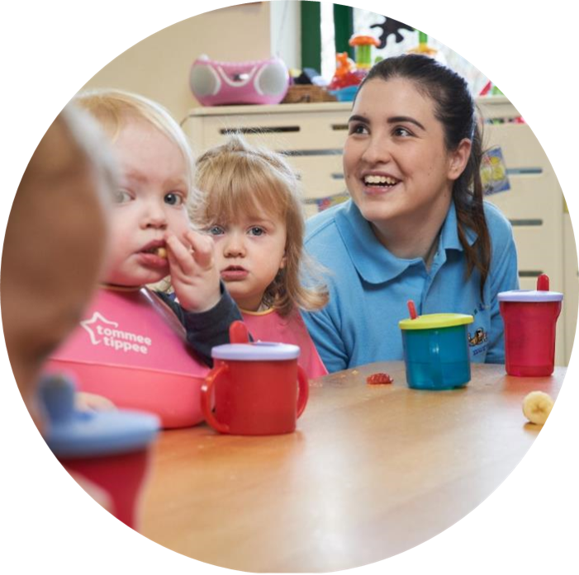
Ionawr 2024
Pecyn Cymorth

Slide 9
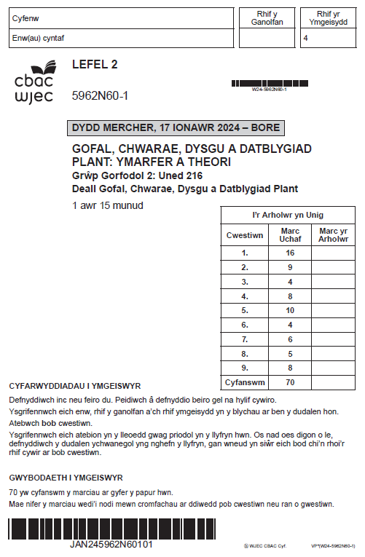
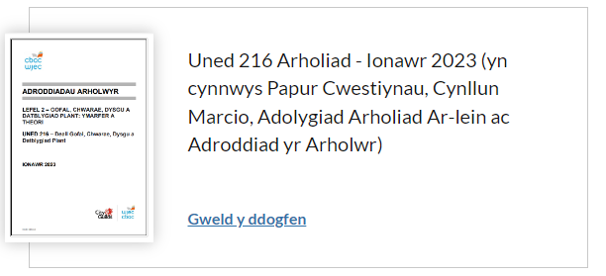
Lefel 2: Gofal, Chwarae, Dysgu, a Datblygiad Plant: Ymarfer a Theori (dysguiechydagofal.cymru)
Ionawr 2024

Slide 10
Adborth yr Uwch Arholwr
Ionawr 2024

Slide 11
Adborth Lefel Uchel
Roedd cynnwys y papur hwn yn cyflwyno amrywiaeth o fathau o gwestiynau yn ymdrin â chynnwys Uned 216 fel y nodir yn y fanyleb.
Rhoddwyd cynnig ar gymhwyso gwybodaeth a dealltwriaeth yn rhai o'r cwestiynau a gyflwynwyd. Fodd bynnag, roedd yn ymddangos bod hyn wedi bod yn anodd i rai dysgwyr mewn mannau..
Roedd ychwanegiadau neu newidiadau a wnaed i'r cynllun marcio yn ystod y gynhadledd wedi cyfrannu at farcio cadarnhaol, gan ganiatáu ar gyfer rhoi marciau ychwanegol gan ddefnyddio'r canllawiau i roi credyd am unrhyw ymateb arall.
Dim ond rhai dysgwyr wnaeth geisio ateb pob cwestiwn gan adael rhai cwestiynau yn wag. Roedd hyn yn ddangosydd o ddealltwriaeth cyfyngedig o rai meysydd o'r fanyleb.
Er bod dealltwriaeth gyffredinol o ferfau gorchymyn, collodd rhai dysgwyr farciau gwerthfawr lle na ddilynwyd berfau gorchymyn, gan arwain at ymatebion ar ffurf pwyntiau bwled.
Unwaith eto, roedd yr ymgeiswyr hynny oedd yn cwblhau papurau ar-lein yn gallu ymestyn eu hymatebion ac ennill marciau yn y bandiau uwch yn aml. Roedd sawl arholwr yn ei chael hi’n anodd darllen papurau wedi’u hysgrifennu â llaw. Mae’n bosibl bod hyn wedi cyfrannu at roi marciau is.

Slide 12
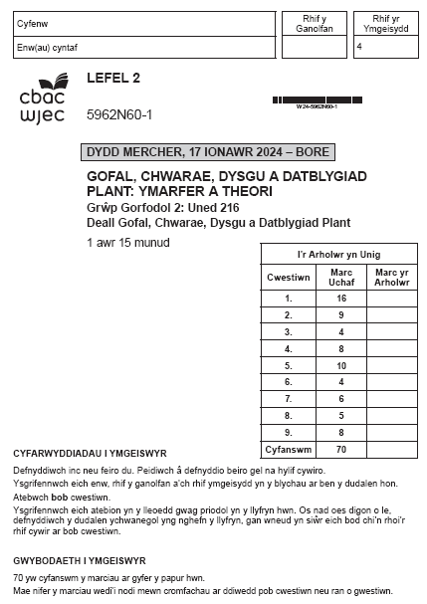
Uned 216 – Deall Gofal, Chwarae, Dysgu a Datblygiad Plant

Slide 13
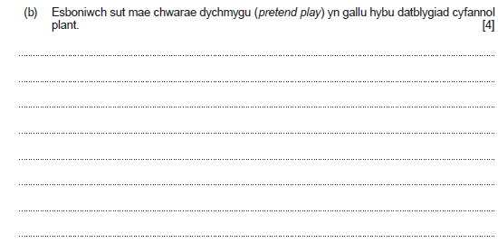
Berfau Gorchymyn: Esboniwch Rhowch fanylion a rhesymau dros sut a pham mae rhywbeth fel y mae
Cwestiwn 1(b) a'r cynllun marcio
Rhowch hyd at 4 marc
Rhowch 0 marc os nad yw'r ymateb yn haeddu ennill marciau.
Rhowch 1 marc am esboniad sylfaenol sy'n dangos gwybodaeth a dealltwriaeth gyfyngedig o sut mae chwarae dychmygu yn gallu hybu datblygiad cyfannol plant.
Rhowch 2-3 marc am esboniad da sy'n dangos rhywfaint o wybodaeth a dealltwriaeth o sut mae chwarae dychmygu yn gallu hybu datblygiad cyfannol plant.
Rhowch 4 marc am esboniad da iawn sy'n dangos gwybodaeth a dealltwriaeth gadarn o sut mae chwarae dychmygu yn gallu hybu datblygiad cyfannol plant.
Gall yr ateb gyfeirio at y canlynol:
mae'n cefnogi plant i ddatblygu a rhannu syniadau
mae'n galluogi plant i fynegi syniadau sy'n cefnogi cyfathrebu
mae'n cynnig cyfle i ddatrys problemau a datblygu sgiliau rhesymu
mae'n annog plant i weithio'n ymarferol a darganfod beth sy'n gweithio
mae'n datblygu geirfa newydd gan gefnogi trafodaeth a chyfle i feddwl
mae plant yn dysgu am eu hunain a'r byd o'u hamgylch
mae'n cefnogi plant i archwilio profiadau sy'n codi ofn neu'n peri gofid
mae plant yn dysgu sut i drafod ac ystyried safbwyntiau eraill
trosglwyddo gwybodaeth o un sefyllfa i un arall
mae'n galluogi plant i ddarllen ciwiau cymdeithasol
mae'n galluogi plant i adnabod a rheoli emosiynau
bydd plant yn gallu trafod a chymryd eu tro
mae'n caniatáu i blant ddatblygu dychymyg a chreadigrwydd
mae'n annog plant i weithio gyda'i gilydd a chydweithredu.
Nid yw’r rhestr yn gynhwysfawr. Rhowch farciau am unrhyw ateb perthnasol arall.

Slide 14
Cwestiwn 1(b) ateb yr ymgeisydd gyda sylwadau’r Uwch Arholwr
Pretend play can help improve physical development by using their gross motor skills to use their legs to walk around , and also their fine motor skills to pick different types of things up during the play. It can increase their level of imagination(improving their intellectual skills) as they will be playing creatively either by themselves or with other people. Their language skills will be growing as they will be talking , an example of this would be playing house as roleplay and talking to other people to create the storyline. The childs' emotional development will also be being used in pretend play as the child will have different types of emotions for each scene of the pretend play. As a child is playing pretend play , their social loevel will highly increase as they will be talking to other peers , teachers or family members as they play in an imaginative story.
Adborth yr Uwch Arholwr
The examiner has acknowledged the very good understanding shown by this learner in relation to the role of pretend play. Full marks are awarded for the explanation as the learner has developed the response in line with requirements. This can be seen where the explanation refers to each aspect of development in logical progression. The presentation of a response in this logical manner ensures consideration is given to the question as a whole and limits error or duplication.
Marc a ddyfarnwyd 4/4

Slide 15
Cwestiwn 1(b) ateb yr ymgeisydd gyda sylwadau’r Uwch Arholwr
Pretend play will help with the childs intellectual skills as they are using their imagination and learning from what they know.The language skill of the child will be developed as the child will be communicating with their friends or asking adults questions which they are able to use throughout their pretend play. The childs emotional skill will also be developing as they are using what they know and expressing their feelings through role play. In addition to this their physical skills will also be developing as they are moving around for exmaple they will be walking around, could be running or jumping.
Principal Examiner feedback
Once again by separating the
answer into relevant sections this learner has presented a response showing very good understanding of holistic development as the question requires. The explanation is supported at each stage with a brief example, such as using imagination to support intellectual development and expressing feelings to develop emotional skills.
A well-deserved full marks awarded.
Marks awarded 4/4

Slide 16
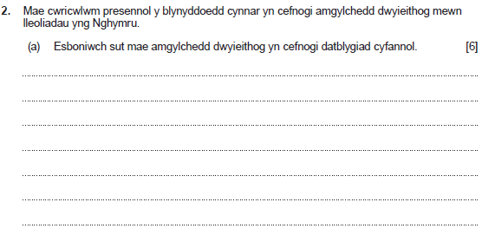
Cwestiwn 2(a) a'r cynllun marcio
Berfau Gorchymyn: Esboniwch Rhowch fanylion a rhesymau dros sut a pham mae rhywbeth fel y mae
Gall yr ateb gyfeirio at y canlynol:
mae plant dwyieithog yn aml yn ei chael hi'n haws datrys problemau geiriau
mae dwyieithrwydd yn gallu cefnogi sgiliau meddwl a chofio a dealltwriaeth o resymeg
mae bod yn ddwyieithog yn gallu annog plant i ddysgu iaith arall gan ei bod hi'n haws caffael trydedd iaith
mae'n cefnogi prosesau dysgu hyd at oedolaeth a thrwy gydol bywyd
mae newid o un iaith i un arall yn datblygu'r gallu i fod yn hyblyg wrth ddefnyddio sgiliau meddwl
mae'n cefnogi swyddogaeth ymennydd well ac yn gohirio cyflyrau dirywiol fel dementia
mae'n helpu i feithrin perthnasoedd teuluol a chymunedol.
mae'n helpu i ddatblygu dealltwriaeth o ieithoedd a diwylliannau eraill
mae'n galluogi plant i ddatblygu amrywiaeth o grwpiau o ffrindiau
mae'n creu dealltwriaeth o gydraddoldeb ac amrywiaeth
mae'n darparu profiadau i gyfathrebu'n well er mwyn meithrin perthnasoedd gwell
mae'n caniatáu mynediad i amrywiaeth estynedig o weithgareddau cymdeithasol
mae'n cynnig cyfleoedd yn yr awyr agored na fyddai'n hygyrch fel arall o bosibl
mae'n caniatáu i blant gymryd rhan mewn amrywiaeth o weithgareddau corfforol gyda gwahanol grwpiau cyfoedion
mae modd cynllunio gweithgareddau corfforol/awyr agored mewn cwricwlwm dwyieithog, fydd yn cefnogi ffordd iach o fyw
mae dewis o iaith yn gallu cefnogi cyfleoedd i fwynhau a chael hwyl wrth wella cyfleoedd i ddatblygu'n gorfforol.
Nid yw’r rhestr yn gynhwysfawr.
Rhowch farciau am unrhyw ateb perthnasol arall.
Rhowch hyd at 6 marc
Rhowch 0 marc os nad yw'r ymateb yn haeddu ennill marciau.
Rhowch 1-2 farc am esboniad sylfaenol sy'n dangos gwybodaeth a dealltwriaeth gyfyngedig o sut mae amgylchedd dwyieithog yn cefnogi datblygiad cyfannol.
Rhowch 3-4 marc am esboniad da sy'n dangos rhywfaint o wybodaeth a dealltwriaeth o sut mae amgylchedd dwyieithog yn cefnogi datblygiad cyfannol.
Rhowch 5-6 marc am esboniad da iawn sy'n dangos gwybodaeth a dealltwriaeth gadarn o sut mae amgylchedd dwyieithog yn cefnogi datblygiad cyfannol.

Slide 17
Cwestiwn 2(a) ateb yr ymgeisydd gyda sylwadau’r Uwch Arholwr
Bilingualy enviroment supports holistic development because bilingual children will be able to communicate with more people,givie them a wider range of frends, it will support the intellecrtual develpment as it will get the child thinking and improve there vocabulary,emotional development will be suppoerted because it will then become a inclusive enviroment this will help everyone express their feelings,the bilingual eviroment will als support holistic developments because the childs brain will develop quicker than someone who is not bilingual and they will feel feel supported while becoming bilingual this will grenurally support the hiolistic development as a whole.
Principal Examiner feedback
Falling at the top end of the middle band this learner has provided a good explanation. The command verb is met where the learner uses the word “because” or terms such as “this will help/support” to expand knowledge and understanding. To move to the top band the learner could have suggested more specific examples in relation to brain development as can be seen in the mark scheme.
Marks awarded 4/6

Slide 18
Cwestiwn 2(a) ateb yr ymgeisydd gyda sylwadau’r Uwch Arholwr
Bilingual enviroments are great for children in educational settings as they learn and develop their lingustic/language skills, they also will develop their social skills because theyll be able to interact with other children who may only be able to speak welsh and or english. They'll also be able to participate later on in their schooling wih certain fun-educational activities such as the eisteddfod which would develop a child in almost all areas. Intelectually, learning a new language supports development as their expanding their intake of knowledge and so are getting an even wider diverse education, and emotionally the children may learn about certain welsh history such as the welsh knott and the welsh settlements in Patagonia.
Principal Examiner feedback
This response has been awarded 4 marks again falling into the top end of the middle band. Although the learner has made reference to areas of development this is not clear in every aspect. Had the learner expanded and avoided the use of terms like” in almost all areas” additional marks may have been given particularly as links to historical events and emotional development are made which shows very good knowledge.
Marks awarded 4/6

Slide 19
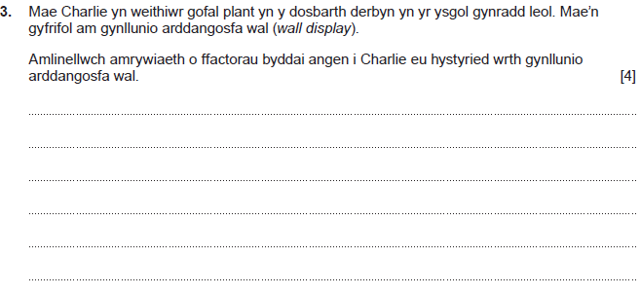
Cwestiwn 3 a'r cynllun marcio
Berfau Gorchymyn: Amlinellwch
Nodwch y prif bwyntiau/rhowch ddisgrifiad byr neu nodwch y prif nodweddion
Gall yr ateb gyfeirio at:
y thema sydd ar waith yn y dosbarth derbyn ar y pryd
y lle sydd ar gael ar gyfer yr arddangosfa
y math o arddangosfa sydd ei hangen e.e. arddangosfa wal/hongian/ffenestr/awyr agored/top bwrdd/rhyngweithiol.
y defnyddiau sydd eu hangen/sydd ar gael
cost unrhyw ddefnyddiau newydd i'w prynu
lleoliad yr arddangosfeydd
pa mor hygyrch ydyn nhw i blant
plant yn cymryd rhan ac yn rhannu syniadau
oed a chyfnod y plant i'w hystyried at bwrpas labelu
y math o iaith i'w defnyddio e.e. arddangosfa ddwyieithog
gwydnwch y defnyddiau
iechyd a diogelwch y defnyddiau sy'n cael eu defnyddio
confensiynau darllen wrth labelu
diogelu e.e. ffotograffau ac enwau
iechyd a diogelwch.
Nid yw’r rhestr yn gynhwysfawr.
Rhowch farciau am unrhyw ateb perthnasol arall.
Rhowch 0 marc os nad yw'r ymateb yn haeddu ennill marciau.
Rhowch 1 marc am amlinelliad sylfaenol sy'n dangos gwybodaeth a dealltwriaeth gyfyngedig o amrywiaeth o ffactorau byddai angen i Charlie eu hystyried wrth gynllunio arddangosfa wal.
Rhowch 2-3 marc am amlinelliad da sy'n dangos rhywfaint o wybodaeth a dealltwriaeth o amrywiaeth o ffactorau byddai angen i Charlie eu hystyried wrth gynllunio arddangosfa wal.
Rhowch 4 marc am amlinelliad da iawn sy'n dangos gwybodaeth a dealltwriaeth gadarn o amrywiaeth o ffactorau byddai angen i Charlie eu hystyried wrth gynllunio arddangosfa wal.

Slide 20
Cwestiwn 3 ateb yr ymgeisydd gyda sylwadau’r Uwch Arholwr
When planning a wall display , Charlie will need to make it interesting so that the children will be drawn to it. For example this could be using bright colours , using big but also simple words so that the children can read and understand it (depending on their abilities). Charlie will also have to remember to mkae sure that it is relevent to the class topic or something that they have been or going to learn. Like i said , the children will have to be drawn to the wall display so Charlie will need to make sure that it is seen. The wall display could include pictures , bubble writing , and other fun creatve things like that to get the childrens' attention.
Principal Examiner feedback The command verb requires learners to present and outline. This learner has met this requirement to a very good standard allowing full marks to be awarded. Several relevant points have been included with examples and/or reasons provided to support the ideas offered in the outline. This can be seen where the learner has suggested Charlie will need to consider the children's interest and how this might be achieved through using bright colours.
Marks awarded 4/4

Slide 21
Cwestiwn 3 ateb yr ymgeisydd gyda sylwadau’r Uwch Arholwr
Charlie would have to include children, for example if Charlie is putting up the year 1 class photo up on the wall for display he should also include all the other school years. Also Charlie would have to consider where to place the photos or work on the wall because if it is too high up on the wall some or most of the children wont be able to look at the display. He also has to consider what materials he would use to put it up on the wall, for example if he used glue that would be safe but if he used a stapler that could be a risk as it could fall onto the floor and a child stepping on it ending in injury.
Principal Examiner feedback
Once again, this learner has included suggestions to support the outline presented. A range of ideas are offered, and the understanding of inclusion indicates a high level of knowledge to support the awarding of full marks.
Marks awarded 4/4

Slide 22
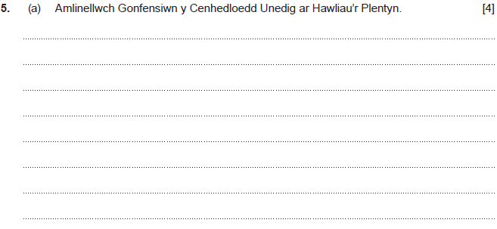
Cwestiwn 5(a) a'r cynllun marcio
Berfau Gorchymyn: Amlinellwch
Nodwch y prif bwyntiau/rhowch ddisgrifiad byr neu nodwch y prif nodweddion
Rhowch hyd at 4 marc
Rhowch 0 marc os nad yw'r ymateb yn haeddu ennill marciau.
Rhowch 1 marc am amlinelliad sylfaenol sy'n dangos gwybodaeth a dealltwriaeth gyfyngedig o Gonfensiwn y Cenhedloedd Unedig ar Hawliau’r Plentyn.
Rhowch 2-3 marc am amlinelliad da sy'n dangos rhywfaint o wybodaeth a dealltwriaeth o Gonfensiwn y Cenhedloedd Unedig ar Hawliau’r Plentyn.
Rhowch 4 marc am amlinelliad da iawn sy'n dangos gwybodaeth a dealltwriaeth gadarn o Gonfensiwn y Cenhedloedd Unedig ar Hawliau’r Plentyn.
Gall yr ateb/enghraifft gyfeirio at y canlynol:
mae Confensiwn y CU yn cefnogi dull plentyn-ganolog
mae Confensiwn y CU yn seiliedig ar egwyddor ymarfer sydd ddim yn gwahaniaethu
mae Confensiwn y CU yn cefnogi'r angen i blant fynegi eu hunain yn rhwydd
mae Confensiwn y CU yn cydnabod yr angen i blant ddatblygu mewn amgylchedd diogel
mae Confensiwn y CU yn nodi bod gan blant yr hawl i chwarae
mae Confensiwn y CU yn credu bod gan blant yr hawl i addysg rad ac am ddim
mae Confensiwn y CU yn ystyried bod safon byw ddigonol yn hawl i blant
mae Confensiwn y CU yn cefnogi hawliau plant ag anghenion ychwanegol
54 erthygl ar hawliau
Nid yw’r rhestr yn gynhwysfawr.
Rhowch farciau am unrhyw ateb perthnasol arall.

Slide 23
Cwestiwn 5(a) ateb yr ymgeisydd gyda sylwadau’r Uwch Arholwr
The United Nations Convention on the Rights of the Child law (The UNCRC) cover that each child has their own rights and that the childs' needs are always met. They cover that the child is always protected and safe , for an example living in a safe and stable home where they are fed , bathed and looked after for properly.
Principal Examiner feedback The examiner has acknowledged the good understanding shown by this learner in relation to United Nations Convention on the Rights of the Child. The learner has focussed the response on children’s needs and protection and given a relevant example. Had the learner expanded the outline to include further examples, such as the right to play or the right to education full marks may have been awarded.
Marks awarded 3/4

Slide 24
Cwestiwn 5(a) ateb yr ymgeisydd gyda sylwadau’r Uwch Arholwr
The UNCRC has 54 articles, 42 which are directly linked to young children. The UNCRC is to protect the rights of the child, to make sure they are listened to, to make sure that they are not discrimincated against and to make sure that the child has equal opportunity as the other children. The UNCRC is designed to make sure that all educational services are treating each child failry and that they have the correct procedures and policies which will protect the child and make sure they are treated fairly.
Principal Examiner feedback A clearly developed outline well deserving of the full marks awarded.
This is a mature response where examples are given to extend the outline indicating very good knowledge and understanding. Terminology used supports the response, in particular where the learner refers to the 54 articles of the UNCRC. The development of the final section where the learner make links to policies and procedures shows high level understanding.
Marks awarded 4/4

Slide 25
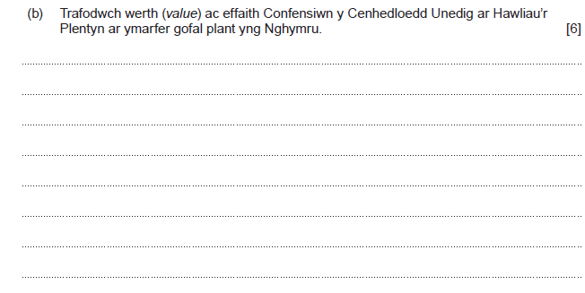
Cwestiwn 5(b) a'r cynllun marcio
Berfau Gorchymyn: Trafodwch
Archwiliwch fater yn fanwl/mewn ffordd strwythuredig, gan ystyried syniadau gwahanol
Gall yr ateb gyfeirio at y canlynol:
mae lles pennaf y plentyn yn cael ei ystyried, ac mae penderfyniadau'n cael eu gwneud yn seiliedig ar anghenion y plant
mae'n cefnogi gweithrediad y polisi Cyfleoedd Cyfartal, gan annog tegwch ac amrywiaeth yn ymarferol
mae'n cefnogi cwricwlwm lle mae dewis yn cael ei gynnig drwy amrywiaeth o weithgareddau
mae'n cydnabod yr angen am arferion diogel a pholisi Iechyd a Diogelwch. Os yw plant yn teimlo'n ddiogel, maen nhw'n fwy tebygol o setlo a theimlo'n gyfforddus yn y lleoliad
mae'r hawl i chwarae wedi'i gydnabod a'i annog dan do ac yn yr awyr agored
mae lleoliadau'n cynnig cyfleoedd i chwarae sy'n cefnogi datblygiad iach
mae rhwymedigaeth gyfreithiol ar staff i gyfyngu ar risg ac i gadw plant a nhw eu hunain mor ddiogel â phosibl gan annog annibyniaeth
mae cyflwyno mentrau megis Dechrau'n Deg yn cefnogi teuluoedd sy'n byw mewn tlodi neu deuluoedd incwm isel
mae lleoliadau'n cefnogi mentrau bwyta'n iach a gofal iechyd megis y fenter 'y bws brwsio' ('the brush bus')
mae'n cefnogi datblygiad amgylchedd galluogi sy'n annog staff i ddatblygu gweithgareddau heriol mewn amgylchedd diogel, gan annog archwilio a dysgu
mae'n cefnogi ymarfer amlasiantaethol sy'n sicrhau bod anghenion unigol yn cael eu bodloni
mae'n rhoi gwerth ar fewnbwn rhieni/gofalwyr fel addysgwyr cyntaf y plentyn
mae ymarfer amrywiol mewn lleoliadau'n sicrhau bod plant yn cadw eu hunaniaeth a'u hiaith o'u dewis
mae lleoliadau'n cynnig cyfleoedd i blant rannu teimladau a deall teimladau unigolion eraill
mae cyfleoedd i ddatblygu diddordebau a gweithgareddau grŵp yn cael eu datblygu gan y rhai hynny sy'n gyfrifol am blant, megis y cynghorau lleol
mae lleoliadau'n cydnabod pwysigrwydd cyfrinachedd er mwyn cadw plant yn ddiogel.
Nid yw’r rhestr yn gynhwysfawr.
Rhowch farciau am unrhyw ateb perthnasol arall.
Rhowch hyd at 6 marc
Rhowch 0 marc os nad yw'r ymateb yn haeddu ennill marciau.
Rhowch 1-2 farc am drafodaeth sylfaenol sy'n dangos gwybodaeth a dealltwriaeth gyfyngedig o werth ac effaith Confensiwn y Cenhedloedd Unedig ar Hawliau’r Plentyn ar ymarfer gofal plant yng Nghymru.
Rhowch 3-4 marc am drafodaeth dda sy'n dangos rhywfaint o wybodaeth a dealltwriaeth o werth ac effaith Confensiwn y Cenhedloedd Unedig ar Hawliau’r Plentyn ar ymarfer gofal plant yng Nghymru.
Rhowch 5-6 marc am drafodaeth dda iawn sy'n dangos gwybodaeth a dealltwriaeth gadarn o werth ac effaith Confensiwn y Cenhedloedd Unedig ar Hawliau’r Plentyn ar ymarfer gofal plant yng Nghymru.

Slide 26
Cwestiwn 5(b) ateb yr ymgeisydd gyda sylwadau’r Uwch Arholwr
It has ensured every child has a voice and that they are listened to. It ensures changes are made to the best interest of the children's health, well-being and education. It has ensured children are fed and safe within their own homes as well as within a childcare setting, it has changed the way staff will interact with the children, ensuring that they are treated with upmost respect and spoken to correctly. It has allowed them to feel secure within their settings and ensures children are comfortable enough to talk about any issues at home which may lead to safeguarding concerns. It has allowed children the freedom to build on their identify and creativitity and not be forced into unsafe conditions or forced to do anything they do not want to do.
Principal Examiner feedback This learner has correctly identified several valid points all developed to a good standard. It is particularly pleasing to see links to children’s best interests and settings ensuring safety and security linked to safeguarding issues.
The response, although good, takes the form of a series of sentences each beginning with the same phrase, this structure has limited the marks awarded as it does not meet the requirements of the higher band where a “ very good discussion” is required
Marks awarded 4/6

Slide 27
Cwestiwn 5(b) ateb yr ymgeisydd gyda sylwadau’r Uwch Arholwr
The UNCRC has been put in place to make sure that all children are treated fairly and that all children have their rights. It is important for childcare practices to have the correct procideures and policies in place which will help meed the requirements of the UNCRC. It is important that all staff within the setting are aware of these policies and have regular training. One thing that a setting could have are activities where the children are able to express themsevles and how they feel. During these activities such as circle time the child is able to discuss any worries they have. The childcare setting will for example have health and safety policies and non-discrimination policies in place to make sure that the child is protcted and that theyre needs are met.
Principal Examiner feedback
This learner has made clear links to the value and impact in practice as the question asks. This can be seen where the discussion develops and includes examples of activities that support the implementation of The UNCRC in settings. The over reliance of the need for policies may have guided the examiner to award 5 marks in place of the full 6 marks available.
Marks awarded 5/6

Slide 28
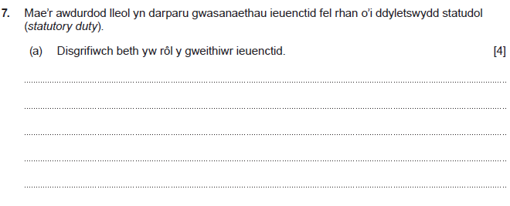
Cwestiwn 7(a) a'r cynllun marcio
Berfau Gorchymyn: Disgrifiwch Nodwch nodweddion/prif nodweddion neu rhowch ddisgrifiad byr
Gall yr ateb gyfeirio at:
mae gweithwyr ieuenctid yn gweithio gyda phlant a phobl ifanc sy'n agored i niwed
mae gweithwyr ieuenctid yn cefnogi datblygiad personol ac addysgol plant a phobl ifanc
bydd gweithwyr ieuenctid weithiau'n gweithredu fel eiriolwyr ac yn cysylltu ag aelodau eraill o'r tîm
bydd gweithwyr ieuenctid yn meithrin perthnasoedd â phlant a phobl ifanc
bydd gweithwyr ieuenctid weithiau'n helpu mewn sefyllfaoedd cyfreithiol
bydd gweithwyr ieuenctid yn cefnogi teuluoedd lle mae materion diogelu yn bosibl
gall gweithwyr ieuenctid gyfeirio plant a phobl ifanc at sefydliadau eraill i gael cefnogaeth e.e. cefnogaeth o ran camddefnyddio alcohol neu gyffuriau
gall gweithwyr ieuenctid ymwneud â'r tîm addysg os yw plentyn/person ifanc yn cael problemau yn yr ysgol
gall gweithwyr ieuenctid weithio mewn amrywiaeth o leoliadau megis clybiau ieuenctid neu ganolfannau cwnsela
gall gweithwyr ieuenctid roi cefnogaeth i bobl ifanc sy'n chwilio am waith
gall gweithwyr ieuenctid gefnogi pobl ifanc â materion perthynas
mae gweithwyr ieuenctid yn cynnwys plant a phobl ifanc yn eu gofal eu hunain ac yn cefnogi cynhwysiant cymdeithasol
trefnu gweithgareddau.
Nid yw’r rhestr yn gynhwysfawr. Rhowch farciau am unrhyw ateb perthnasol arall.
Rhowch hyd at 4 marc
Rhowch 0 marc os nad yw'r ymateb yn haeddu ennill marciau.
Rhowch 1 marc am ddisgrifiad sylfaenol sy'n dangos gwybodaeth a dealltwriaeth gyfyngedig o rôl y gweithiwr ieuenctid.
Rhowch 2-3 marc am ddisgrifiad da sy'n dangos rhywfaint o wybodaeth a dealltwriaeth o rôl y gweithiwr ieuenctid.
Rhowch 4 marc am ddisgrifiad da iawn sy'n dangos gwybodaeth a dealltwriaeth gadarn o rôl y gweithiwr ieuenctid.

Slide 29
Cwestiwn 7(a) ateb yr ymgeisydd gyda sylwadau’r Uwch Arholwr
The roll of a youth worker is the work with people ages 11-25 to help them improve their social and mental skills. It works with young people to give them a safe space whwere they can be themselves and meet new people. It's also a safe space where young people can go to be away from home if hey ar having issues at home, or they can speak to someone about their issues at home.
Principal Examiner feedback
Full marks are awarded here for a discussion showing very good knowledge of the role of the youth worker. The learner understands there is an age element to consider which indicates very good understanding, often learners focus on the early years which can cause loss of marks.
Marks awarded 4/4

Slide 30
Cwestiwn 7(a) ateb yr ymgeisydd gyda sylwadau’r Uwch Arholwr
A Youth worker is someone who works out of an educational setting with children, for example a support worker in a youth club. Their role is to help a child who may have some issues wirth behaviour or learning, by letting them vent, taking them on nice calming engaging trips, and talking about certain stressful experiences that the child ay have gone through. Youth workers also may run and hold youth day club events, where children can go after school to wind down, enjoy a snack provided for them, have a game of pool, xbox, football, netball etc. Another example of youth workers may be people who run things like CAGS, which is a place where children go to do fun activites if they are having trouble in shcool such as anger managment.
Principal Examiner feedback
Another well-developed response gaining full marks. This discussion includes clear examples, referring to what the youth worker might provide in order to fulfil the identified role. To indicate further knowledge and understanding the learner possibly makes reference to their own experience, where young people can attend clubs, organised by youth workers when they need support for anger management.
Marks awarded 4/4

Slide 31
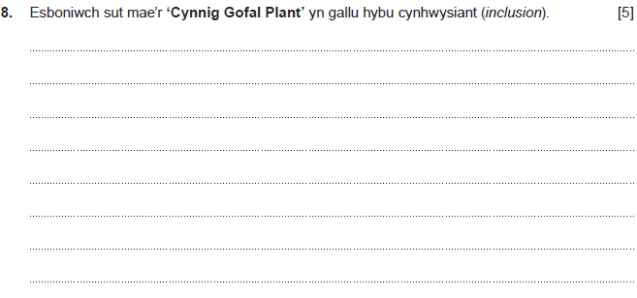
Cwestiwn 8 a'r cynllun marcio
Berfau Gorchymyn: Esboniwch Rhowch fanylion a rhesymau dros sut a pham mae rhywbeth fel y mae
Gall yr ateb gyfeirio at y canlynol:
mae'n cynnig 30 awr o addysg gynnar a gofal plant yr wythnos, am hyd at 48 wythnos o'r flwyddyn
ei nod yw gwneud bywyd yn haws i rieni drwy gynnig cymorth â chostau gofal plant
mae'n helpu rhieni/gofalwyr i ddychwelyd i'r gwaith sy'n gallu helpu teuluoedd yn ariannol
mae'n helpu rhieni/gofalwyr i gynyddu oriau gwaith sy'n gallu golygu mwy o gyflog i gael adnoddau ychwanegol
mae'n caniatáu i rieni/gofalwyr fod yn fwy hyblyg o ran oriau gwaith. Byddai hyn yn gallu golygu bod teuluoedd yn treulio mwy o amser gyda'i gilydd
mae ar gael am 48 wythnos o'r flwyddyn felly mae modd cael mynediad i ofal drwy wyliau'r ysgol
mae amrywiaeth o ddarparwyr yn rhan o'r cynnig sy'n golygu mwy o ddewis i deuluoedd
mae'r amrywiaeth o ddewis yn golygu bod modd ystyried anghenion teuluoedd
mae modd cael darpariaeth drwy ddewis o ieithoedd
mae modd hawlio credydau treth ar yr un pryd â'r cynnig gofal plant o hyd
mae mwy o arian ar gael er mwyn cael mynediad i wasanaethau na fyddent ar gael fel arall
mae'n cefnogi pob math o deuluoedd.
Nid yw’r rhestr yn gynhwysfawr. Rhowch farciau am unrhyw ateb perthnasol arall.
Rhowch hyd at 5 marc
Rhowch 0 marc os nad yw'r ymateb yn haeddu ennill marciau.
Rhowch 1-2 farc am esboniad sylfaenol sy'n dangos gwybodaeth a dealltwriaeth gyfyngedig o sut mae'r 'Cynnig Gofal Plant' yn gallu hybu cynhwysiant.
Rhowch 3-4 marc am esboniad da sy'n dangos rhywfaint o wybodaeth a dealltwriaeth o sut mae'r 'Cynnig Gofal Plant' yn gallu hybu cynhwysiant.
Rhowch 5 marc am esboniad da iawn sy'n dangos gwybodaeth a dealltwriaeth gadarn o sut mae'r 'Cynnig Gofal Plant' yn gallu hybu cynhwysiant.

Slide 32
Cwestiwn 8 ateb yr ymgeisydd gyda sylwadau’r Uwch Arholwr
The childacre offer for Wale can promot inclusion because it gives less fotunate familys a bit of finacial help this will make it easier to put there children in childcare so they can make more money to provid for the familys, it supports women to go back to works after pregancy adn gives the perants a oppitunity to work longer hours.No family is at a disavatage due to povity this will goive evryone a fair chance.
Principal Examiner feedback Although this question proved difficult for some learners this learner has shown some knowledge and understanding of the childcare offer. The learner explains how families are offered financial support for childcare which, in turn, allows access to work opportunities and extra money for the family. Despite the grammar and spelling issues, the examiner would have seen the meaning of the explanation and awarded accordingly.
Marks awarded 4/5

Slide 33
Cwestiwn 8 ateb yr ymgeisydd gyda sylwadau’r Uwch Arholwr
The childcare offer ensures that all children have accessibility to an education and are able to access childcare. The government will often provide help to parents/ carers with certain requiremnts which enables them to gain discounts or access free childcare. This is highly beneficial for parents especially if they are struggling finanicaly or need the extra support. The Childcare offer ensures that all children have equal opportunity and are able to access all services. The childcare offer ensures that fiancial barriers are not an issue and are not stopping the child from accessing required services.
Principal Examiner feedback A good explanation for which middle band marks have been awarded. The learner indicates good knowledge and understanding of the childcare offer from the outset. This is developed when the learner identifies the Government as the provider and explains how financial barriers are tackled allowing equal opportunity for all. The final section ensures the question is answered appropriately in relation to inclusion. Had the learner expanded and made reference to specifics such as “30 hours” or “ access during school holidays” full marks may have been awarded.
Marks awarded 4/5

Slide 34
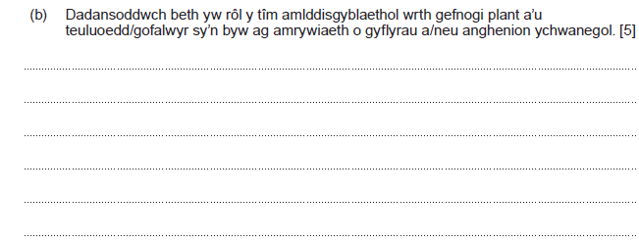
Cwestiwn 9(b) a'r cynllun marcio
Berfau Gorchymyn: Dadansoddwch Archwiliwch fater yn fanwl/sut mae'r rhannau'n berthnasol i'r cyfan, esboniwch a dehonglwch
sicrhau bod gwybodaeth yn cael ei rhannu mewn ffordd sy'n golygu bod pawb dan sylw yn ymwybodol o'r ffeithiau pwysig er mwyn parhau â'r ddarpariaeth briodol
dirprwyo tasgau i'r rhai mwyaf addas sy'n sicrhau bod defnyddwyr gwasanaeth yn cael y gofal cywir gan yr aelodau perthnasol o'r tîm
lleihau'r risg o fethu darparu gwasanaethau angenrheidiol gan osgoi dyblygu ar yr un pryd
annog dull cyfannol sy'n osgoi gwasanaethau digyswllt
bod â dealltwriaeth o ddarpariaeth leol fel bod yr unigolion hynny sydd mewn angen yn gallu cael mynediad yn rhwydd i'r gwasanaethau sydd ar gael, gan gyfyngu ar rwystrau ar yr un pryd
gweithio gyda'i gilydd mewn un lle gan osgoi'r angen i ddefnyddiwr gwasanaeth deithio'n eang. Mae hyn weithiau'n cael ei alw'n "siop un stop"
cynnig rhwydwaith ehangach o wasanaethau gan wella'r cyfleoedd i blant a theuluoedd sy'n hygyrch
ymgynghori â defnyddwyr gwasanaeth sy'n creu gwell dealltwriaeth o angen
creu awyrgylch llawn parch sy'n annog perthnasoedd gwaith da er mwyn cefnogi gwasanaethau o safon dda
gweithio tuag at yr un nod er mwyn arwain at ganlyniadau da a gwell cefnogaeth i ddefnyddwyr gwasanaeth
codi ymwybyddiaeth a dealltwriaeth o bolisïau a gweithdrefnau sy'n berthnasol i'r sefyllfa, fydd yn helpu i wneud penderfyniadau
rhannu gwybodaeth mewn ffordd gyfrinachol sy'n cadw at y gyfraith ac yn cefnogi perthnasoedd cadarnhaol ac ymddiriedaeth rhwng y tîm a defnyddwyr y gwasanaeth
sicrhau bod agweddau ar ddiogelwch yn cael eu bodloni lle mae angen arbenigedd benodol i gefnogi defnyddwyr gwasanaeth
rhannu cyfrifoldebau a lleihau lefelau straen i bawb dan sylw
annog dull teulu cyfan i rymuso wrth wneud penderfyniadau
dileu'r angen am ailadrodd y wybodaeth sy'n cael ei rhannu, sydd weithiau'n creu rhwystr i ddefnyddwyr gwasanaeth.
Nid yw’r rhestr yn gynhwysfawr. Rhowch farciau am unrhyw ateb perthnasol arall.
Award 0 marks where response is not creditworthy.
Rhowch 0 marc os nad yw'r ymateb yn haeddu ennill marciau.
Rhowch 1-2 farc am ddadansoddiad sylfaenol sy'n dangos gwybodaeth a dealltwriaeth gyfyngedig o rôl y tîm amlddisgyblaethol wrth gefnogi plant a’u teuluoedd/gofalwyr sy’n byw ag amrywiaeth o gyflyrau a/neu anghenion ychwanegol.
Rhowch 3-4 marc am ddadansoddiad da sy'n dangos rhywfaint o wybodaeth a dealltwriaeth o rôl y tîm amlddisgyblaethol wrth gefnogi plant a’u teuluoedd/gofalwyr sy’n byw ag amrywiaeth o gyflyrau a/neu anghenion ychwanegol.
Rhowch 5 marc am ddadansoddiad da iawn sy'n dangos gwybodaeth a dealltwriaeth gadarn o rôl y tîm amlddisgyblaethol wrth gefnogi plant a’u teuluoedd/gofalwyr sy’n byw ag amrywiaeth o gyflyrau a/neu anghenion ychwanegol.
Gall yr ateb gyfeirio at y canlynol:
datblygu dealltwriaeth o rolau a chyfrifoldebau ei gilydd i ddarparu gwasanaeth gwell i deuluoedd
cefnogi ei gilydd drwy gyfathrebu'n agored er mwyn rhannu gwybodaeth, fydd yn sicrhau darpariaeth briodol
defnyddio amrywiaeth o ddulliau cyfathrebu sy'n cefnogi'r tîm a'r teulu mewn ffordd mae pawb yn ei deall
gwella llesiant yr unigolion y mae angen cefnogaeth y tîm arnyn nhw, sy'n gwella ac yn cefnogi canlyniadau cadarnhaol

Slide 35
Cwestiwn 9(b) ateb yr ymgeisydd gyda sylwadau’r Uwch Arholwr
A role of an multi displinary team when supporting children and families/careers living with range of conditions/ or additional needs include all diffent services working with one another to benefit the children making sure they have best interest at heart, for an example with learing additional needs individuial the multi agency would need to have referals to one another, and to have contact with the learning langauge therapist to helpthe child developm the langauge development, supporting the child to be able to speak improve there thinking ability with intellectucal development,even though they may strugle speaking they may say small words to express what ther efeeling.AN multi-dispinary team always needs to refer to one another when meeting the needs of the children, as well as the parents they would work one another as well as communicating with the parents/careers to better undersdand who the child is and what sought of living conditions to they live in.Hyperthetically now the child is living in a poor environment, like there in poverty the multi displinary team can refer to one another and get contact with the service that is needed to provide the resourses to the family, they could contact health socail services where they could support the child and the family, most inportiantely though they could get in contact with flying start for them to help them financially, to make the sure the child is safe in every way possible.
Principal Examiner feedback
There is good evidence of analysis where the learner attempts development using examples of multi-disciplinary team members. Some of this analysis is lost where the evidence becomes slightly confusing and repetitive hence the loss of 1 mark. The 4 marks achieved are well deserved as the learner shows good understanding of the purpose of working together to meet the needs and interests of the child.
Marks awarded 4/5

Slide 36
Cwestiwn 9(b) ateb yr ymgeisydd gyda sylwadau’r Uwch Arholwr
A multi disaplinary team will work together to find the best intrest for the child and there family. The child may be working with a few diffrent allied health proffesionals, but the allied health proffesuonals willl need to work together to find the best intrest of the childs individuals needs, as a exaple the child has gone to the health visitor for there check nd the health visitor thinks he need some suppot with his speech, the health visitor will now refure the child to a speech and language therapist and they wil disscus his development this is how they work as a multi disaplinary team.They will attend regular meetings to disscus what stage the child is at and how they can support them futer as a group.
Principal Examiner feedback
This response shows sound knowledge and understanding of the role of the multi-disciplinary team. The learner has utilised the knowledge to develop a very good response.
Full marks are awarded for the development of the content as the learner gives a clear example of how particular members of the team work together in a specific scenario. The examiner would have considered this example in relation to the command verb.
Marks awarded 5/5

Slide 37
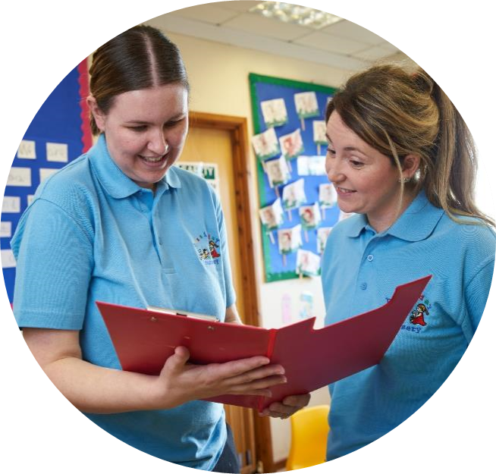
Cyflwyno Lefel 2 – Gweithgor

Slide 38
Pryderon
Atebion

Slide 39
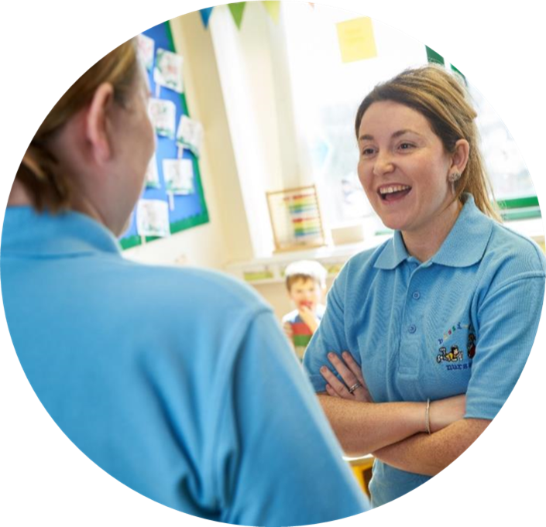
Uned 216 - Arholiad
4 Mehefin 2024 PM

Slide 40
Gwerthuso'r Digwyddiad
https://www.surveymonkey.co.uk/r/WJEConline2023-24

Slide 41
Diolch
Thank you

Slide 42
Manylion cyswllt:
Cysylltwch â’n Swyddogion Pwnc arbenigol, Cynghorydd Technegol a’r tîm cefnogaeth weinyddol ar gyfer eich pwnc gydag unrhyw ymholiadau.
CBAC
Amy Allen-Thomas – Swyddog Pwnc
Tania Lucas – Swyddogaeth Cefnogaeth Pwnc e-bost: gchddp@cbac.co.uk

